Slide 1
Open The Gateway For China-Russia Energy Companies Cooperation
OilLinkTM- a bridge between Chinese and Russian companies

Slide 2
Content
Who we are
What we can do for Russia and China Companies

Slide 3
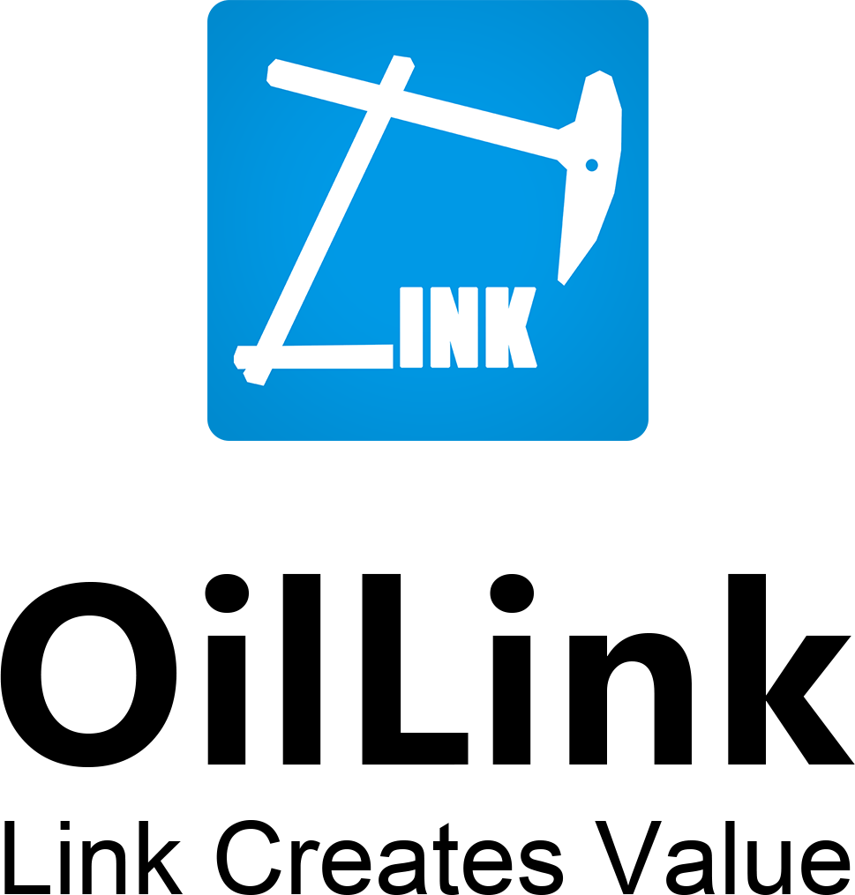
OilLink Introduction
Enterprise Services Platform

Slide 4
OilLink Introduction
O & G data service
Industry media
Enterprise service
Global Oil Field Market Information database and consulting service. Help companies to break through global market in E&P, oil field service, financial service, international market data
Help international companies explore and expand in China market or find Cooperation partners in Chinese market. We link them together
OilLink is now the fastest growing online and social media star in China with 400,000 registers and 20,000 companies

Slide 5
OilLink Introduction

Slide 6
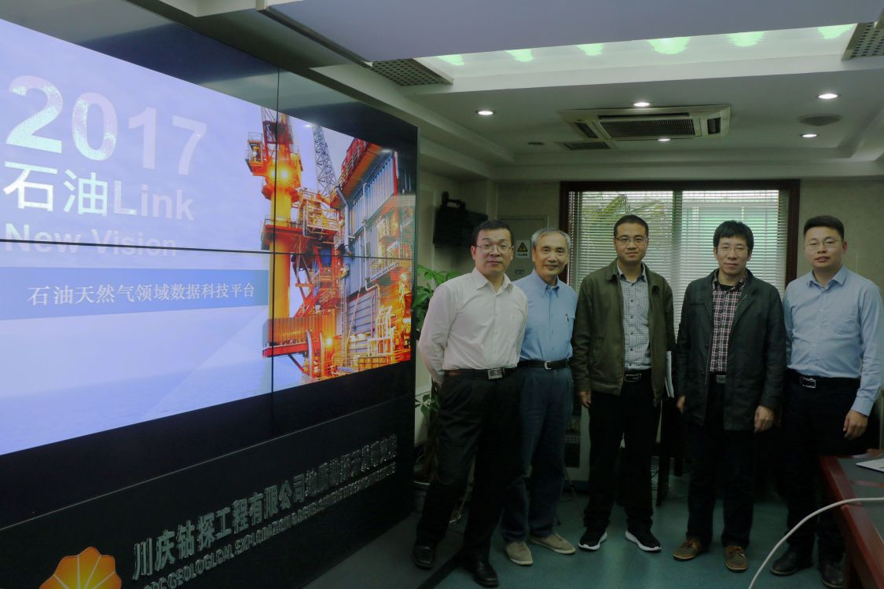
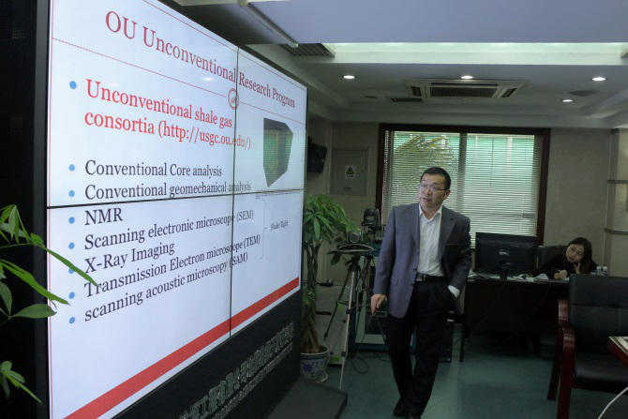
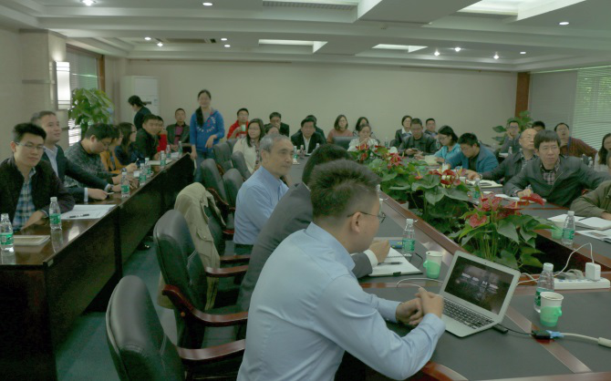
OilLink & CNPC Chuanqing Drilling Department
石油Link技术论坛邀请海外专家走进川庆钻探工程公司
左起分别为邬星儒（美国俄克拉荷马大学教授），金亮（美国德州大学奥斯丁分校
博士，前壳牌全球储层伤害专家），川庆钻探地研院副院长，川庆钻探地质专家，
马一峰（石油Link CEO）
夯实渠道——优质线下活动

Slide 7
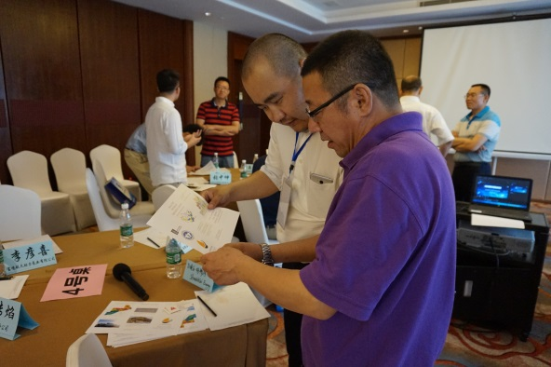
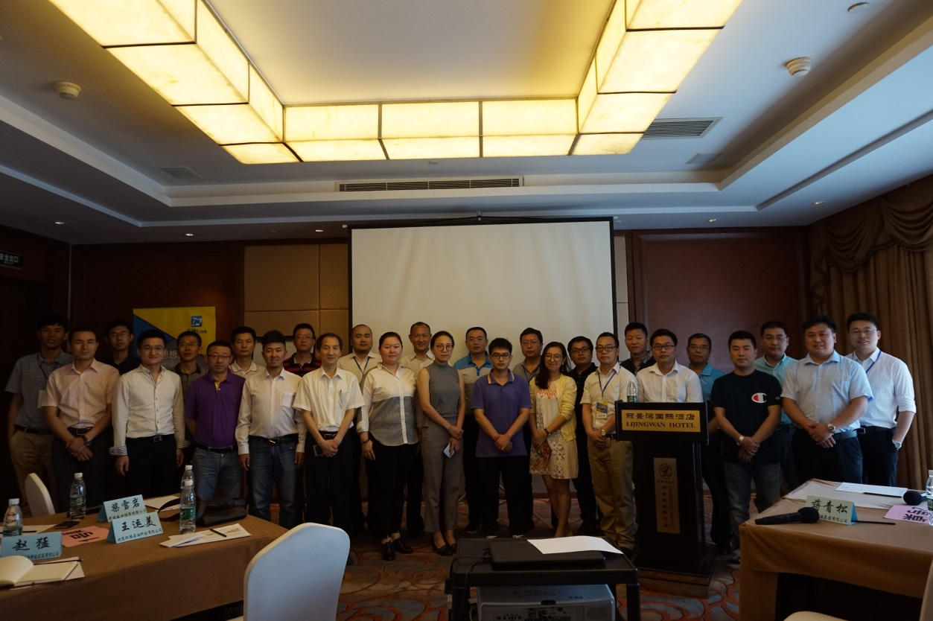
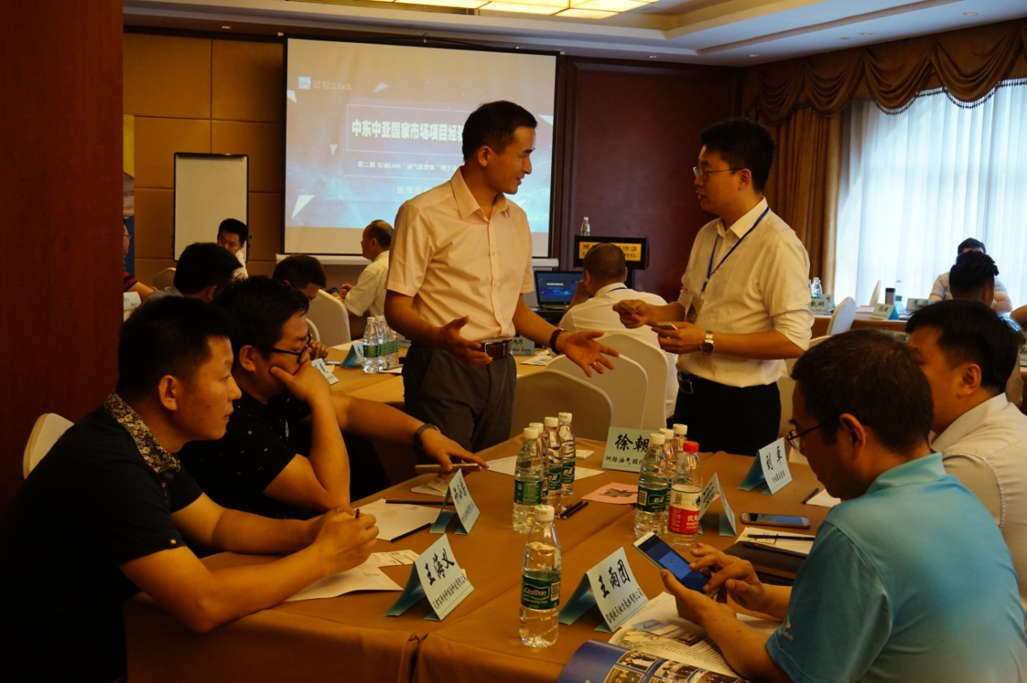
OilLink One Belt One Road Projects Salon
石油Link一带一路沿线国家市场项目经验交流会——北京站
Participants in salon
China Export ＆ Credit Insurance Corporation
CNPC Offshore Engineering Company Limited
China National Offshore Oil Corporation
China Petroleum Engineering Co.,Ltd
Beijing Company
China Petroleum Engineering & Construction Corp
BGP Inc.,China National Petroleum Corporation
Tianjin Oriental Xianke Petroleum Machinery Co., Ltd.
SPT Energy Group Inc.
Jiangsu Shuangqin New Energy Technology Co.,Ltd
Beijing Zhenwei Exhibitions Co., Ltd.
Create Solar Energy (Qingdao) Co., Ltd.
Beijing Okaili Technology Development Co., Ltd.
Geo-jade Petroleum Corporation
Jiangsu Xinyang New Materials Co., Ltd.
Shandong Tongli Chemical Co., Ltd.
Daqing High-tech Zone Hualongxiang Chemical Co., Ltd.
Seg China Beijing Ai Si Yi Ji Geotechnical Consulting Co., Ltd.
Henan Sheng Yuan Group
China University Of Petroleum Education Development Group
Hilong Group Of Companies
Hangzhou Zaopin St Co.,Ltd
Beijing Sainuo Phenix Energy Technology Co., Ltd.
Beijing Qianyong Technology ＆ Service Co.,Ltd
夯实渠道——优质线下活动

Slide 8
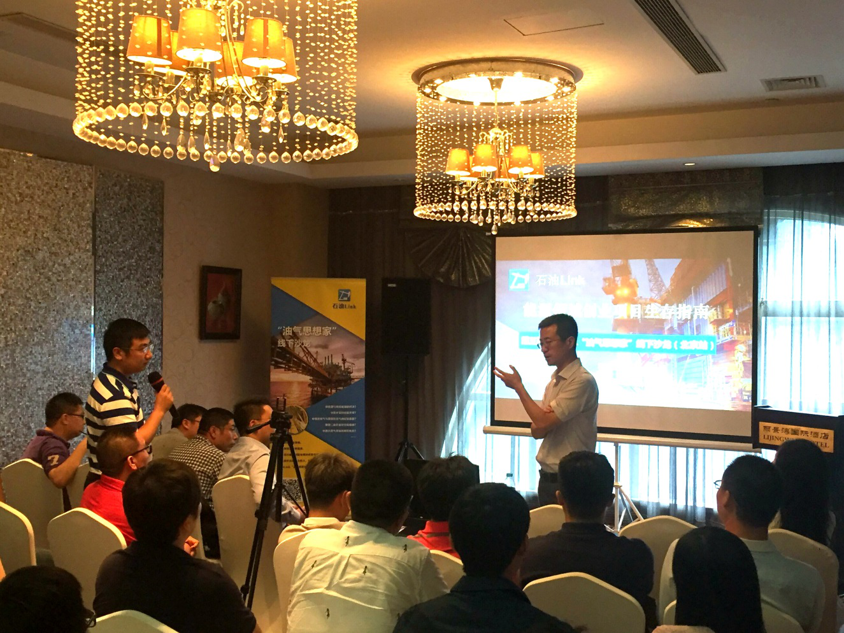
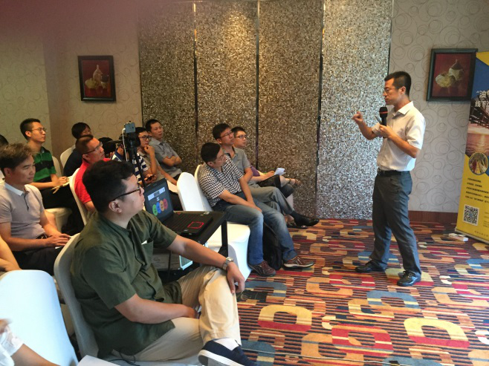
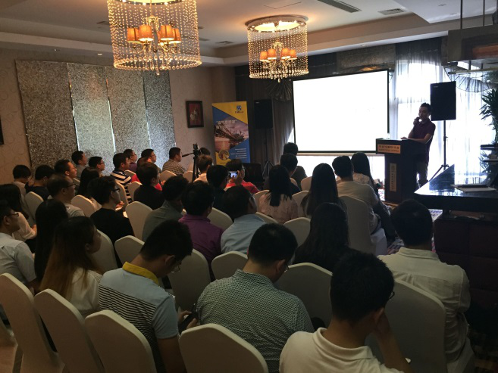
OilLink Capital and Projects Matchmaking
石油Link能源项目股权融资线下交流会——北京站
Participants in salon
Sinopec Shanghai Offshore Petroleum
China Fuel Group Co., Ltd.
BP Us Branch Upstream Exploration Department
ICBC Leasing Offshore And Natural Gas Energy Finance
Geo-jade Petroleum Corporation
China International Economic Hui Zhou Energy Investment(beijing)co.,Ltd
Zhonghai Youbang (CNOOC)
CNOOC Finance Leasing Sector
Snopec Petroleum Exploration And Production Research Institute
Sinopec Petroleum Service
Shijiazhuang Chikun Petrochemical Sales Company
National Golbal Energy
MI Energy
Beijing Fengrui New Energy
Frac-china
Hangzhou Fenghe Petroleum Technology Co., Ltd.(Shenkai)
Beijing Blue Whale Industrial International Energy Consulting Co., Ltd.
Stimlab
Optimization Petroleum Technologies, Inc.
Panjin Ruimei Petroleum Technology Service Co., Ltd.
Geo-jade Petroleum Corporation
Kelinruier Pipeline Engineering Co., Ltd.
Huadian Zibo Thermal Power Co., Ltd.
Beijing Zhongneng Huayuan Energy Co., Ltd., Oil And Gas Block Trading
Henan Dongsheng Energy Saving And Environmental Protection Co., Ltd
Beijing Yike Xinneng Technology
夯实渠道——优质线下活动

Slide 9
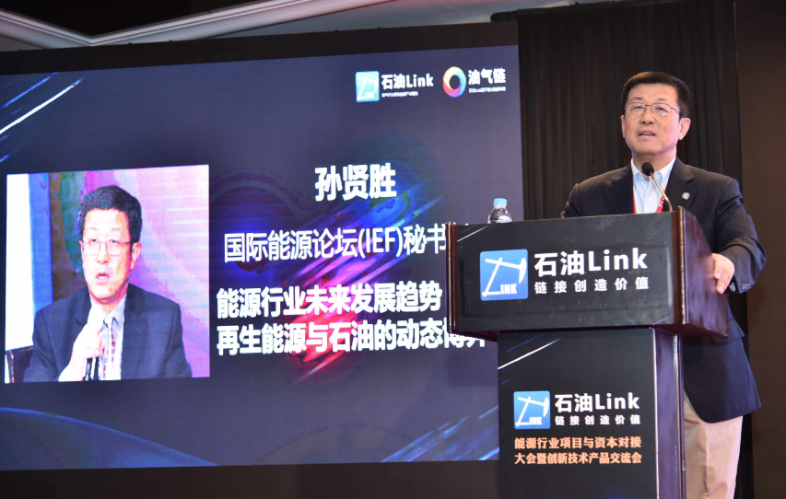
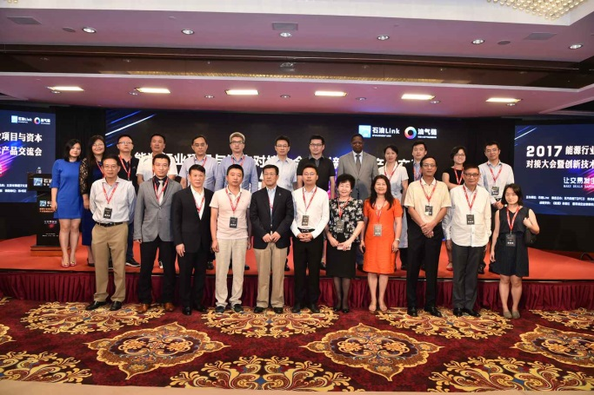
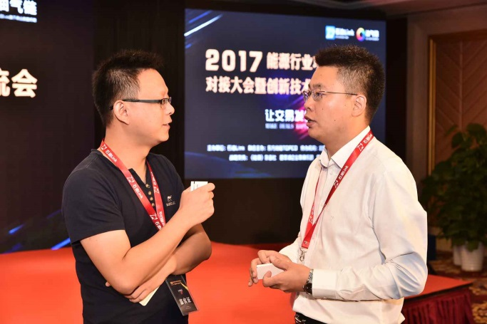
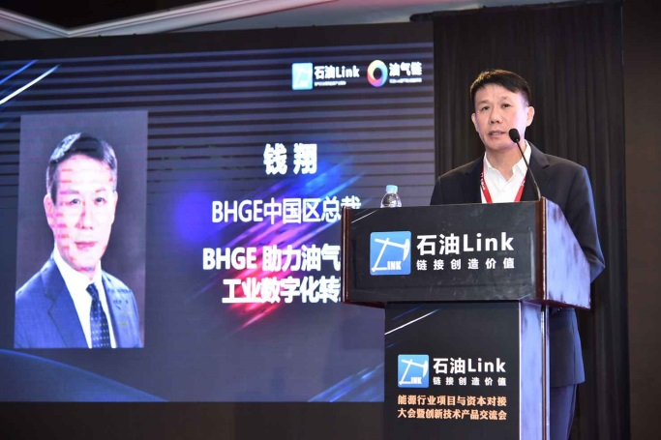
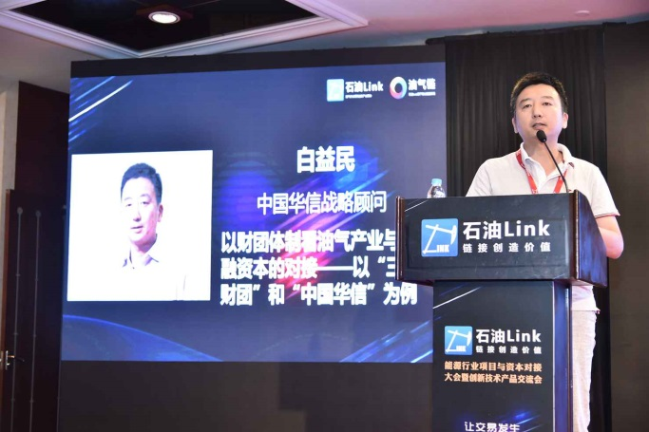
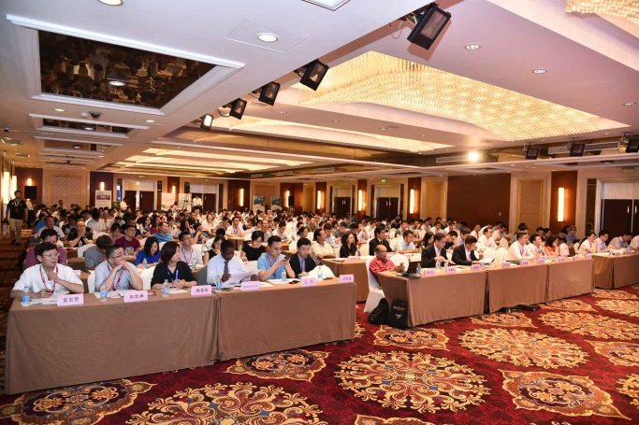
2017 OilLink Energy Summit in Beijing(400 participants attended)
石油Link能源领域项目与资本对接大会暨创新技术产品交流大会7月28日在京圆满完成
夯实渠道——优质线下活动

Slide 10
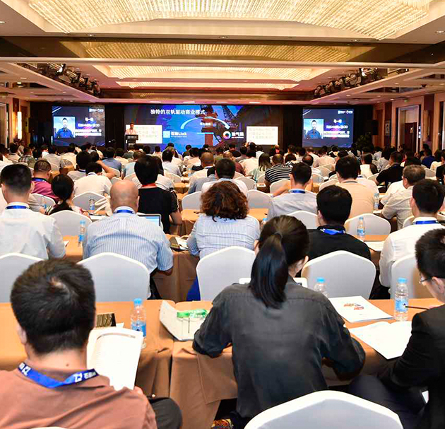
2017 OilLink Energy Summit in Beijing(400 participants attended)
Most of the mainstream oil and gas industry companies participated in the conference - BP, Shell, Total, BHGE (Merged GE Oil & Gas Group and Baker Hughes), CNPC, Sinopec, CNOOC, Sinochem Group, CEFC,CHD, POWER CHINA, KERUI, JEREH, SunPower (the world's three major photovoltaic companies), ROC OIL, Honeywell, GNT, etc.;
A number of investment institutions in the energy sector attended the conference, Cinda Securities, Saudi Aramco Energy Innovation Investment, China Securities Co., Ltd., CITIC Guoan Innovation Fund Management Co., Ltd., Tongde Panshi Holdings (Beijing) Co., Ltd., China New Era Co., Ltd., CNOOC International Finance Leasing Co., Ltd., etc. Nearly 30 investment institutions attended the conference.
Nearly 400 people attended the conference, and nearly 40 high-quality financing projects participated in the meeting and docking with the investor, involving overseas EPC projects, environmental technology companies, overseas oil and gas blocks, North American microbial oil recovery, artificial intelligence and big data drilling projects, etc.
2017 OilLink Energy Summit in Beijing
photo of the scene
夯实渠道——优质线下活动

Slide 11
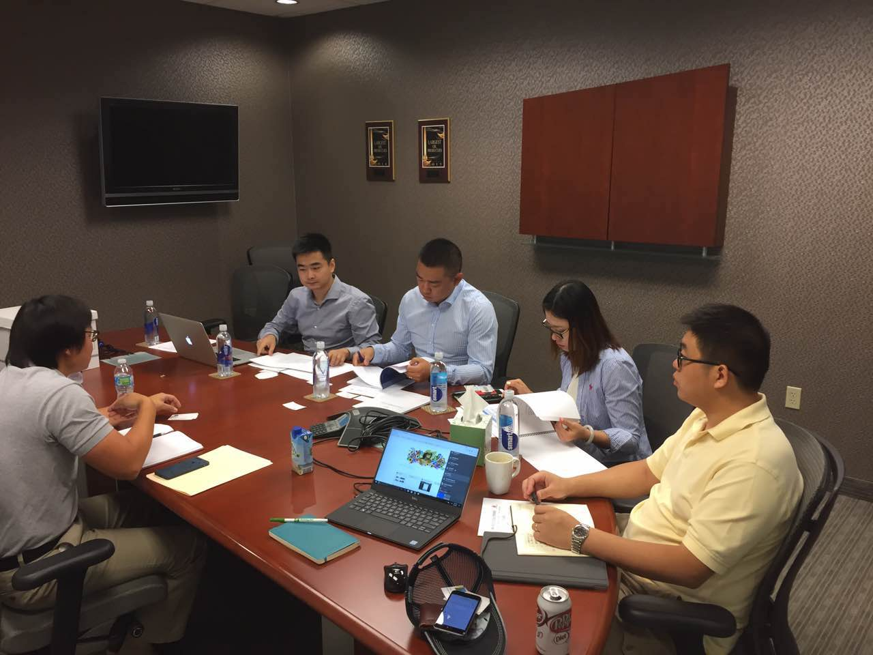
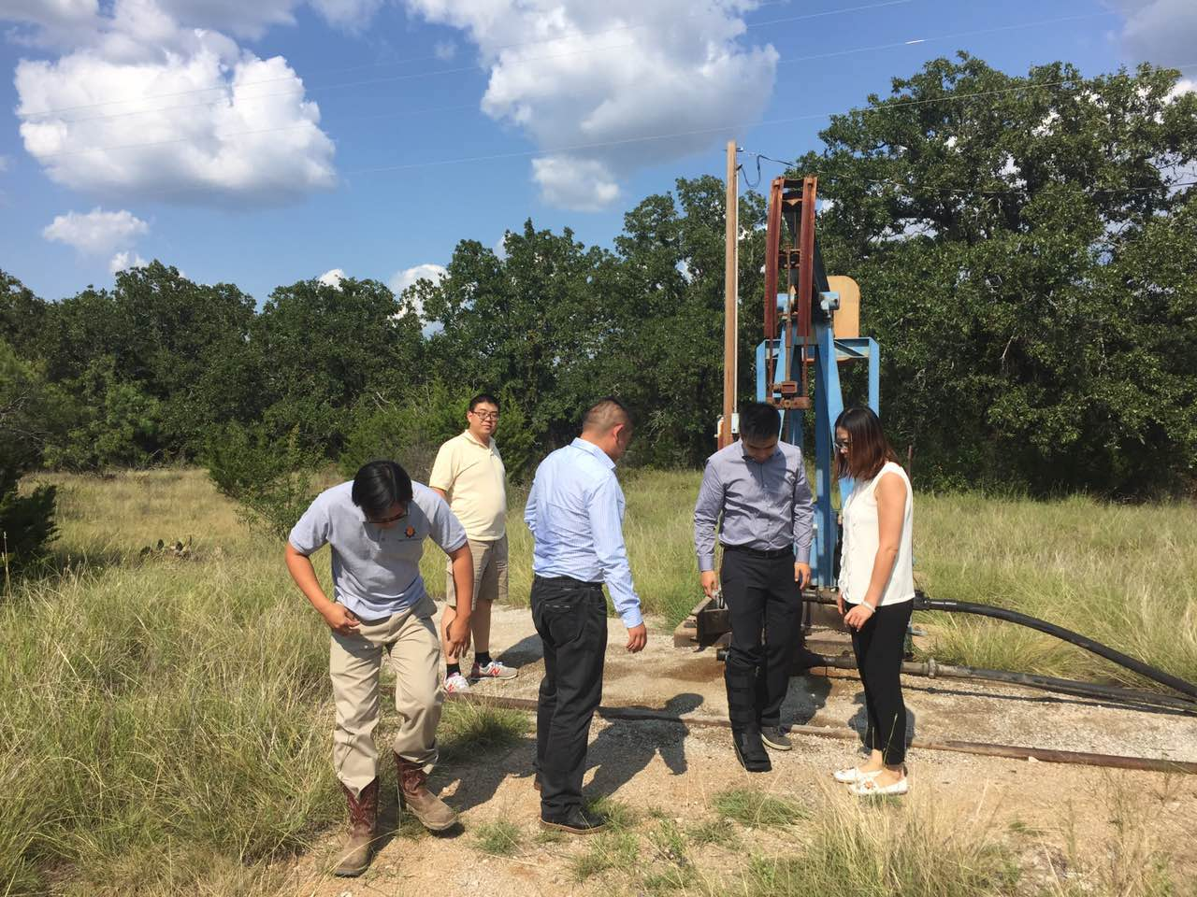
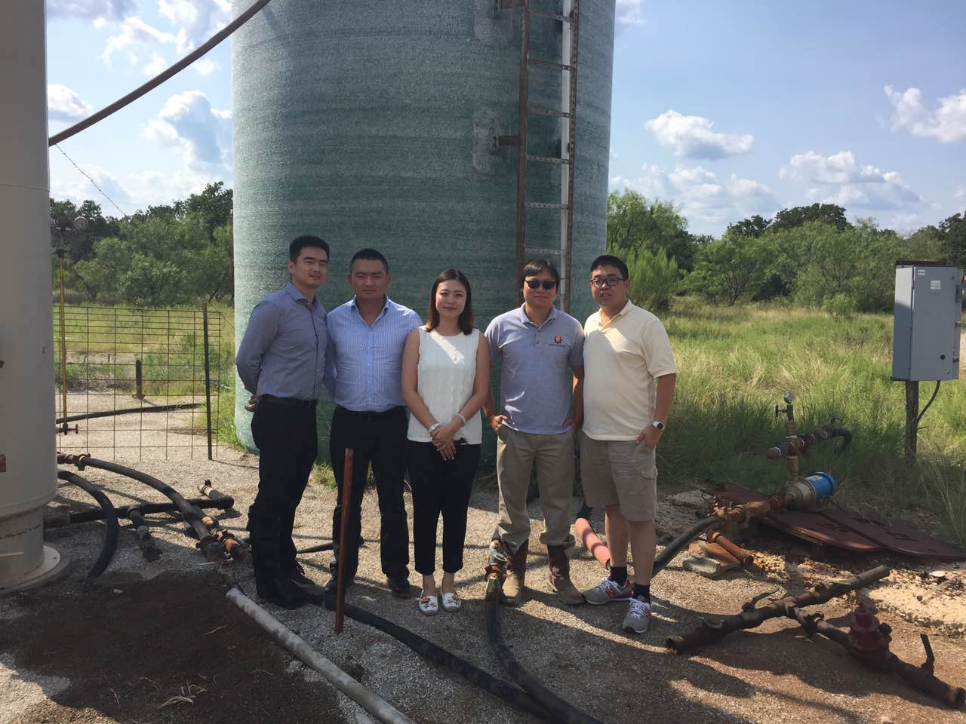
OilLink Recommend Chinese Investors To North America Oil Field Asset
8月3日石油Link北美合伙人靳路超带领投资人进行油田并购考察，油田业主方为B&D Petroleum
America B&D company & investors & OilLink in B&D company office
Oil field trip
America B&D company & investors & OilLink on object oil field

Slide 12
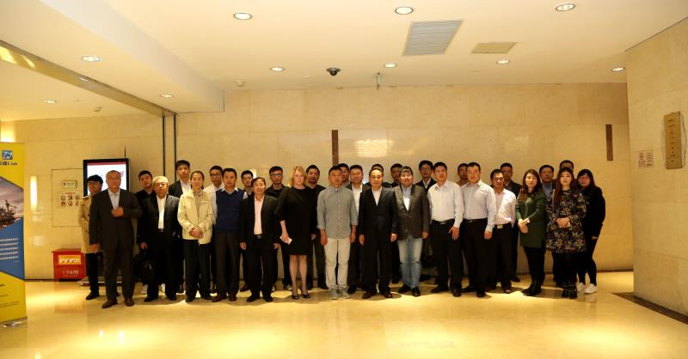
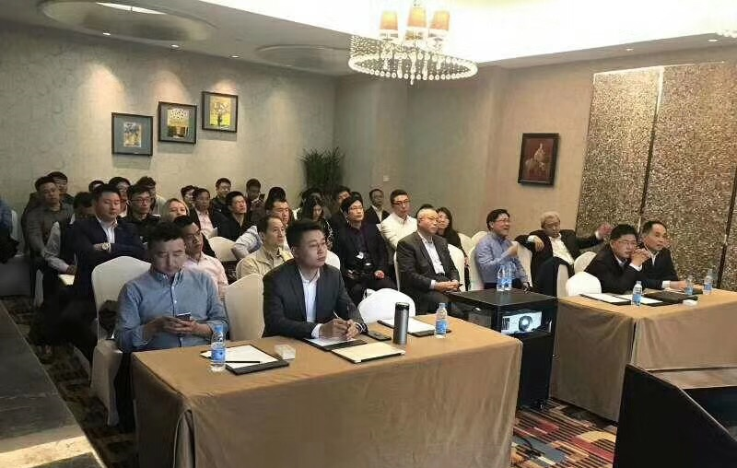
OilLink Chinese Capital and Energy Fund Resources
CDB China Development Bank
Export-import Bank
China Export & Credit Insurance Corporation
Agricultural Bank
SCB Standard Chartered Bank
China CITIC Bank
ICBC Industrial and Commercial Bank of China
Bank of China
CEB China Everbright Bank
KUNLUN FINANCIAL LEASING CO.,LTD

Slide 13

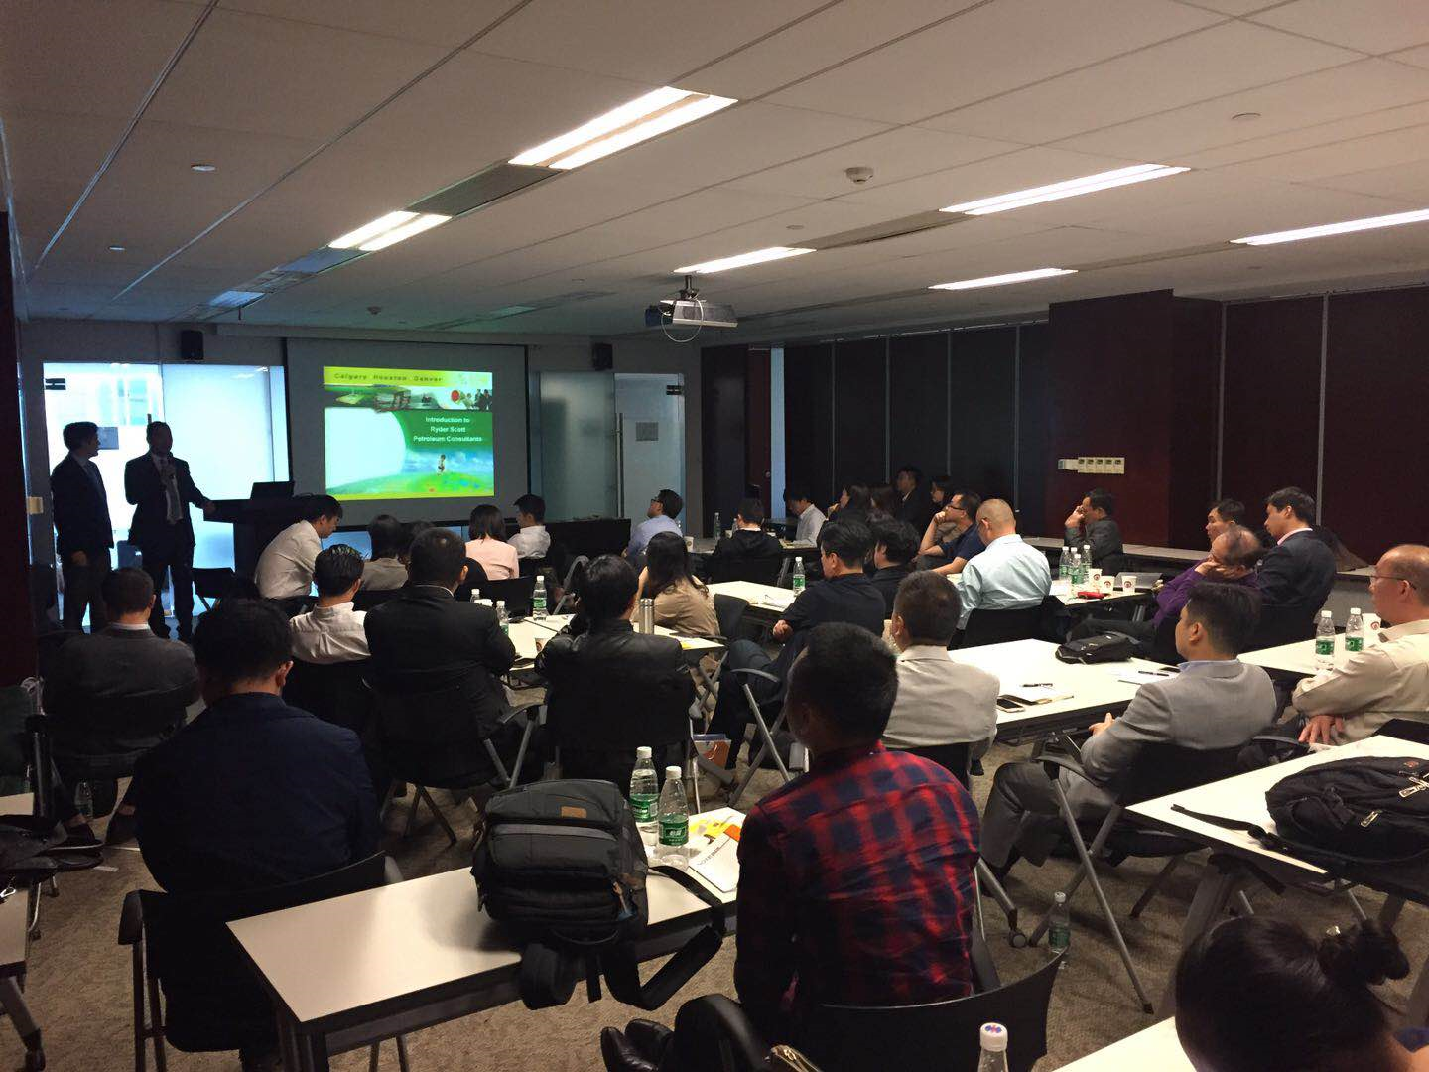
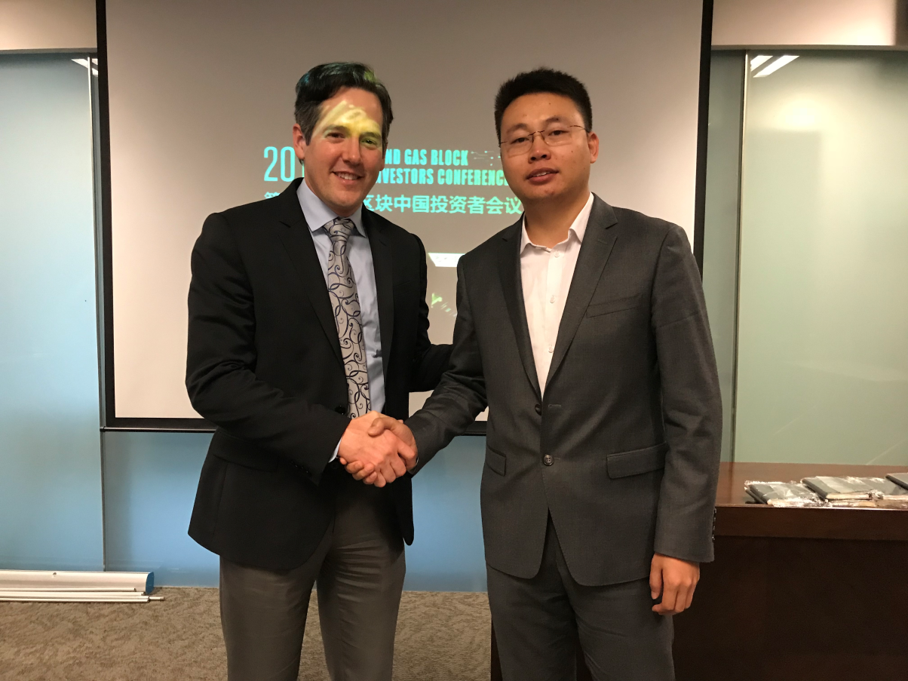
OilLink & Ryder Scott Petroleum Consultants
Ryder Scott Petroleum Consultants evaluates oil and gas properties and independently certifies petroleum reserves quantities in the U.S. and internationally. Founded in 1937, Ryder Scott is one of the largest, oldest and most respected reservoir-evaluation consulting firms in the industry.
OilLink CEO Ma Yifeng with Ryder Scott China VP
OilLink CEO Ma Yifeng with Ryder Scott China VP

Slide 14
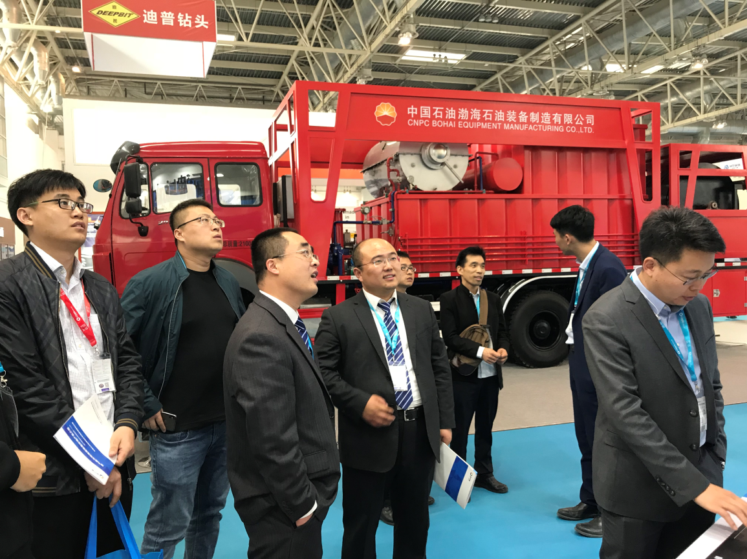
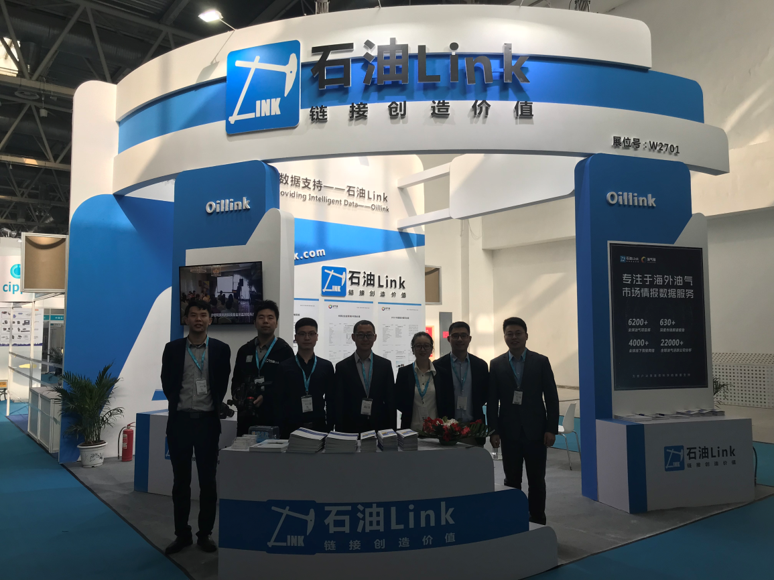
OilLink Attend CIPPE Petroleum Equipment Exhibition Every Year
Oillink参加CIPPE国际石油装备展

Slide 15

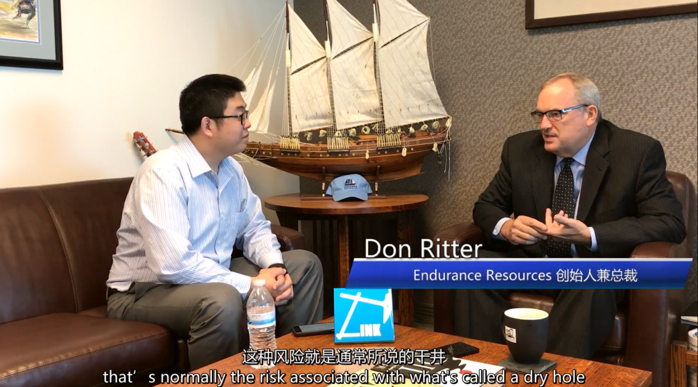
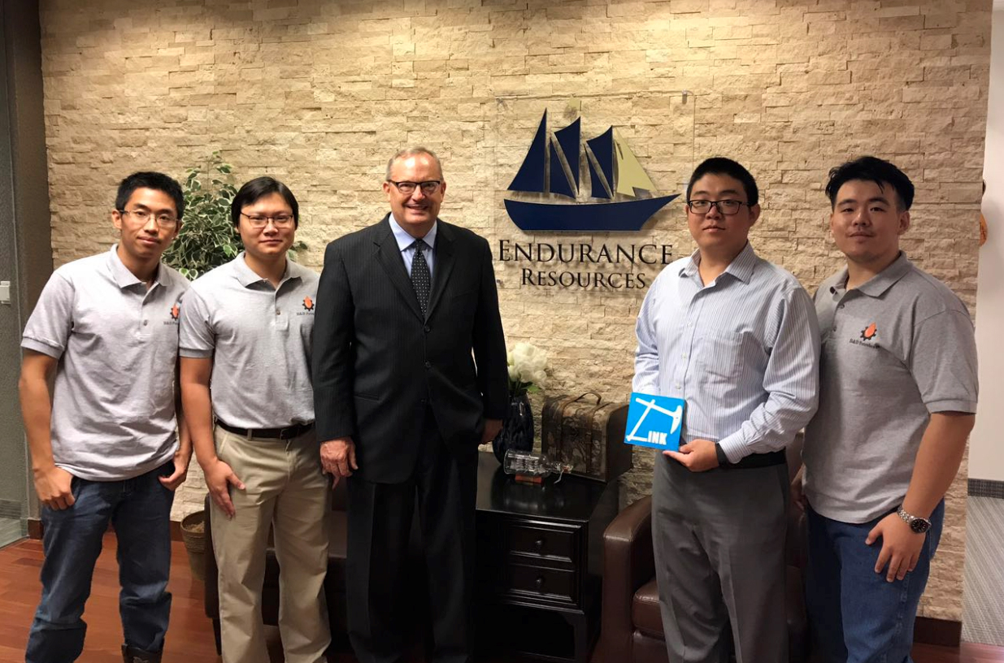
OilLink & IOC Endurance Resources III, LLC
Endurance Resources III, LLC is an oil and gas exploration and production enterprise focused on the Delaware Basin and Central Basin platform.
OilLink connects with Chinese capital partners, establishes China & North America investment consultation and connecting platform and has in-depth cooperation with Endurance Resources and B&D companies
石油Link北美合伙人靳路超专访Endurance Resource公司创始人 Don Ritter
石油Link北美合伙人靳路超与ER公司及B&D公司管理层

Slide 16
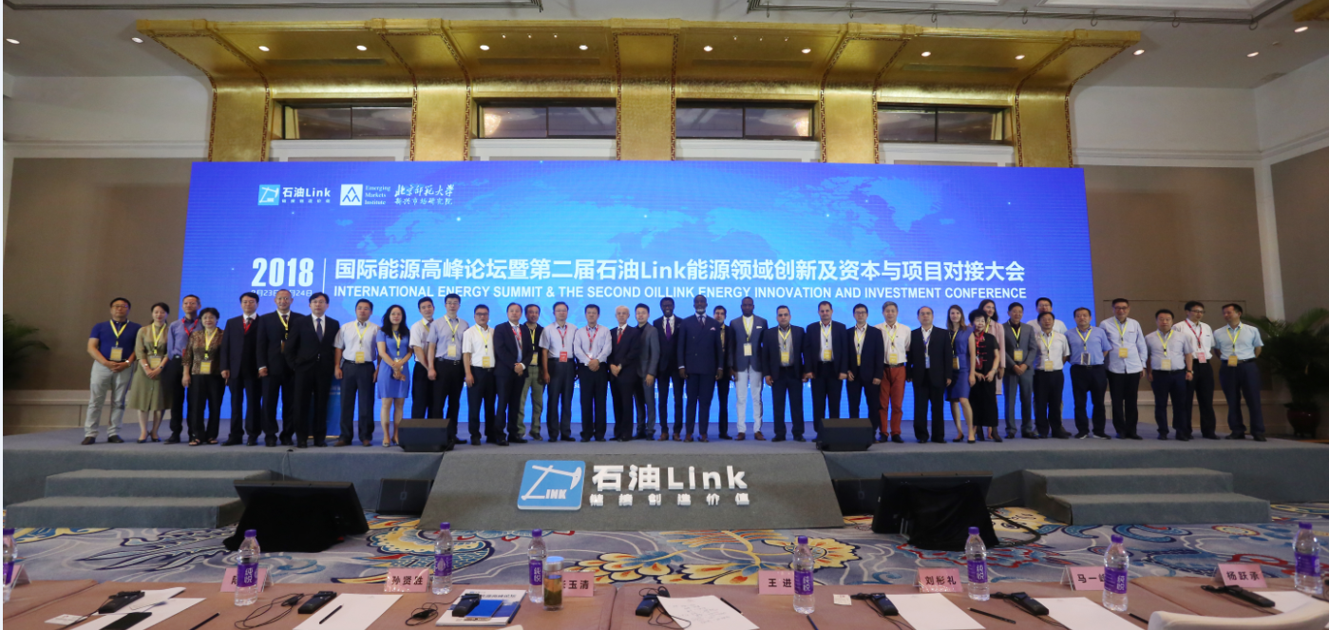
2018 OilLink Energy Summit in Beijing(1000 participants attended)

Slide 17
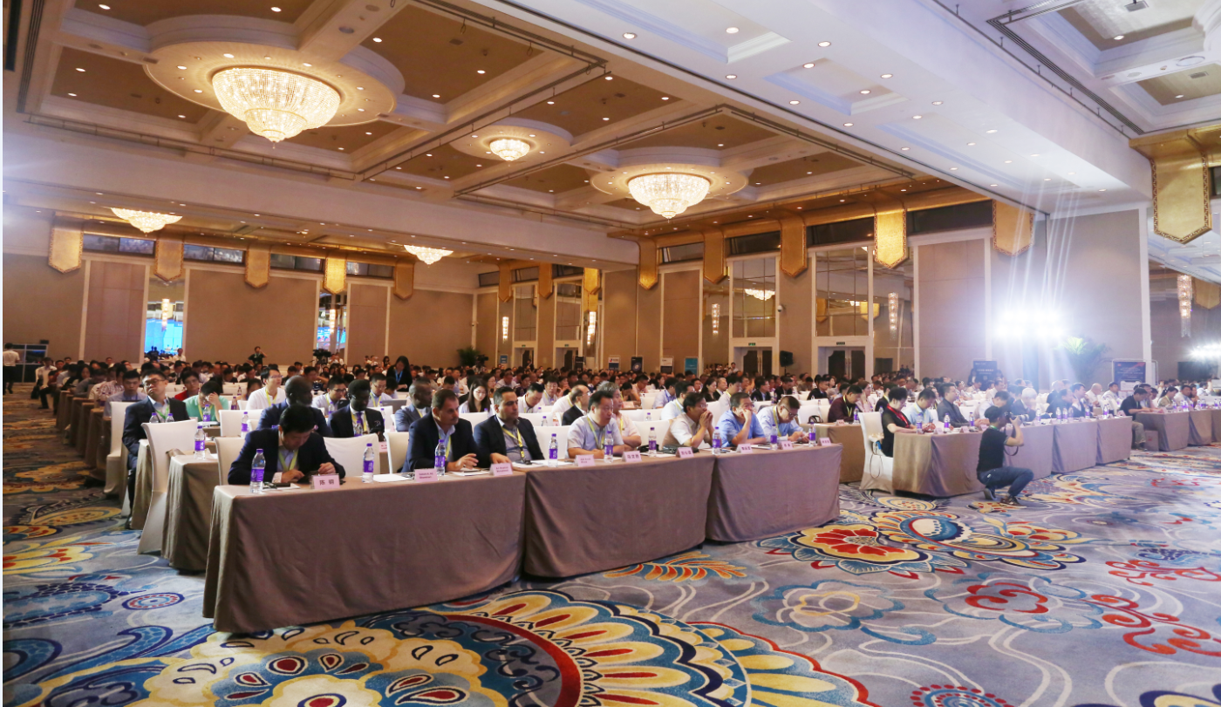
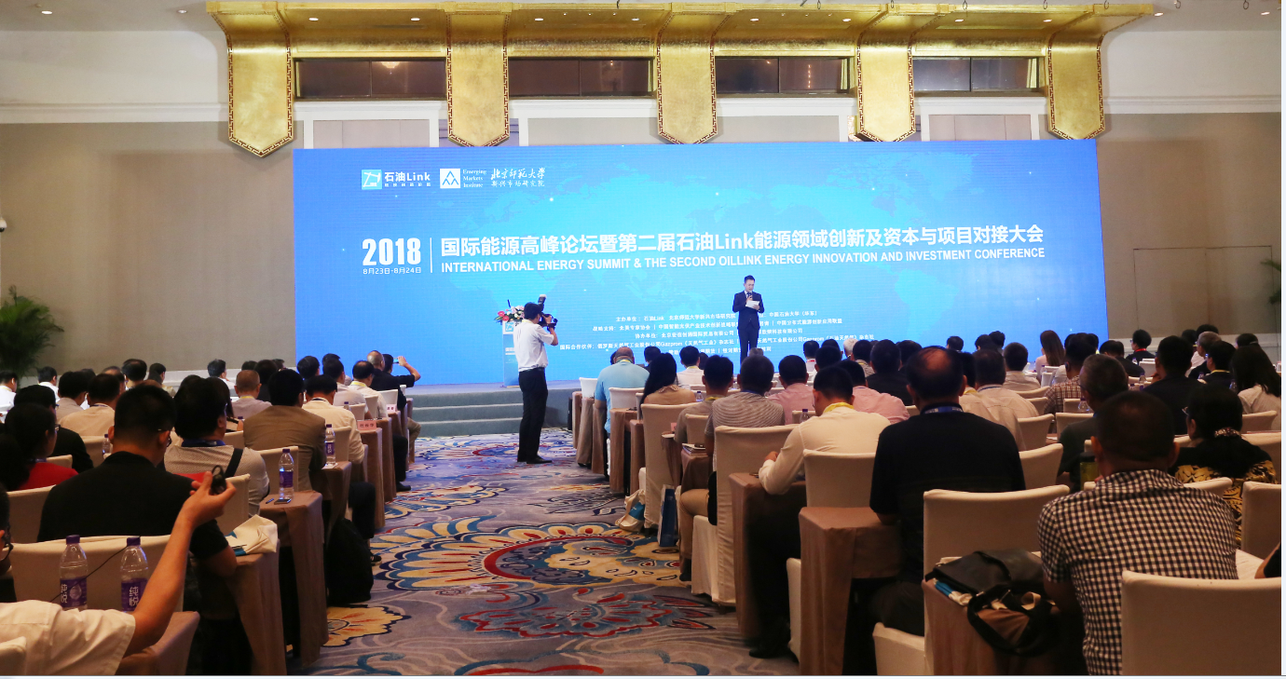
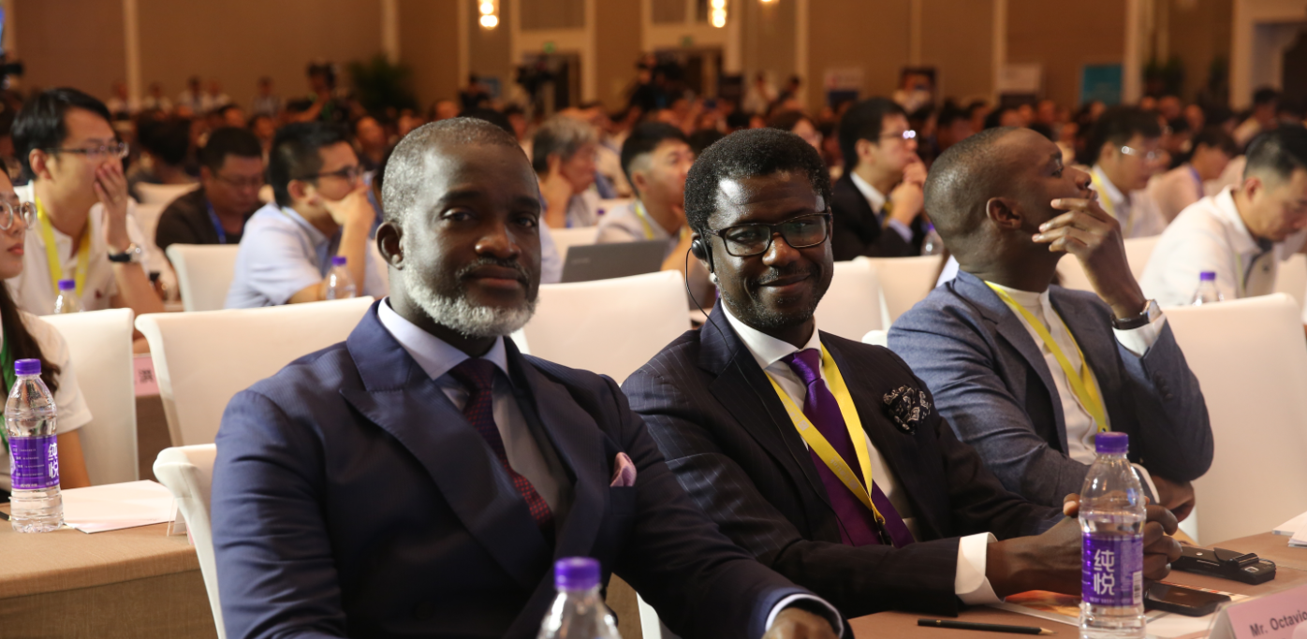
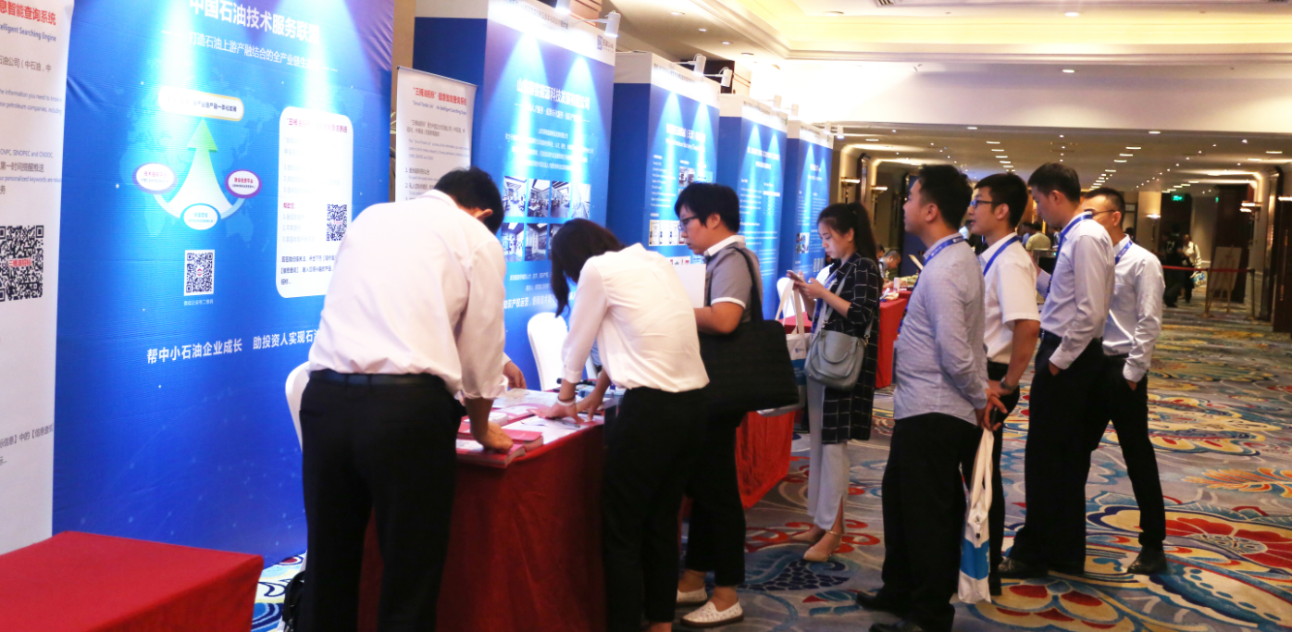
2018 OilLink Energy Summit in Beijing(1000 participants attended)

Slide 18
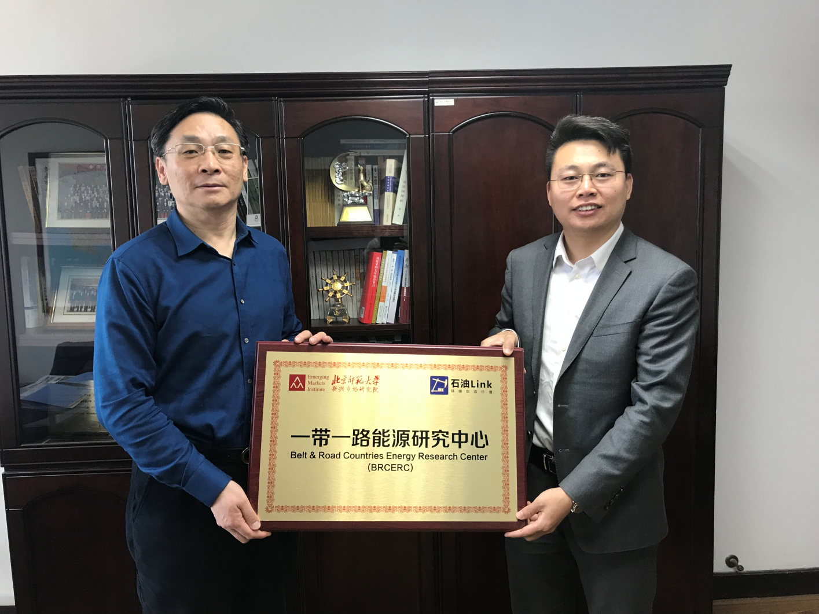
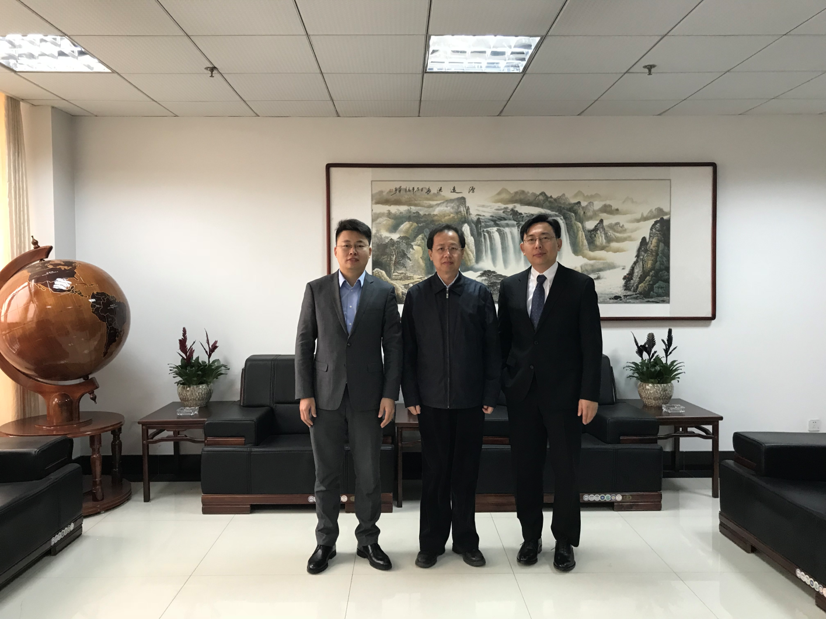
Local Governments Endorse Oillink
Qing Dao city, Shan Dong Province National Development and Reform Commission & OilLink
Shengli oil field of Sinopec located Dongying City, the picture shows OilLink with Dongying city the first secretary of the high-tech district Mr Liu

Slide 19
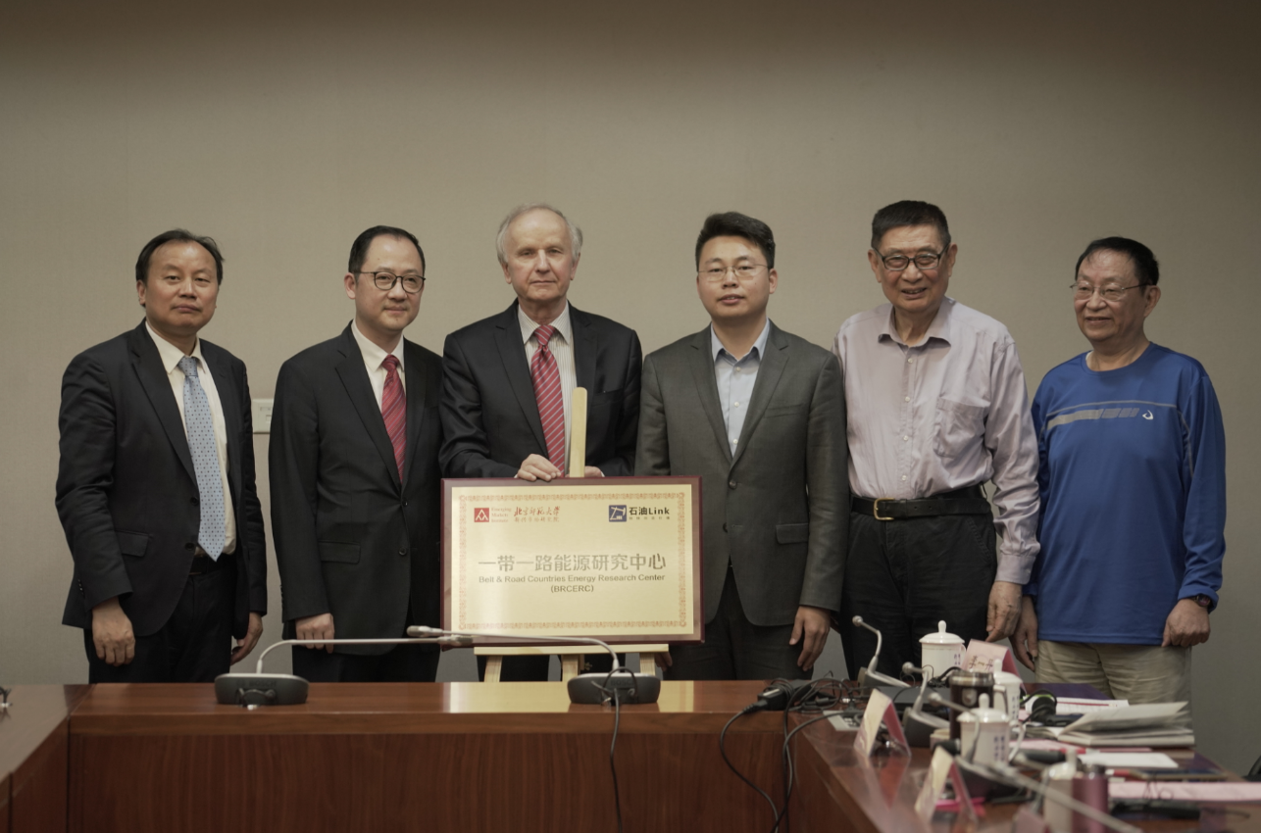
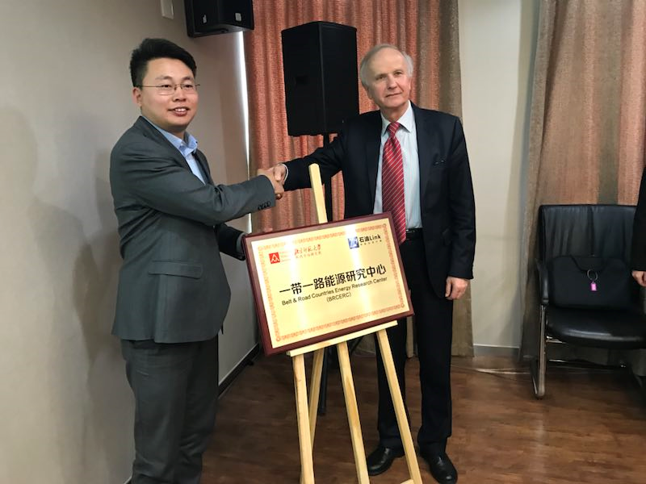
Energy University Endorse OilLink
The Belt and Road Energy Research Institute——OilLink & Beijing Normal University
The CEO of OilLink with Grzegorz the Former first deputy prime minister of Poland

Slide 20
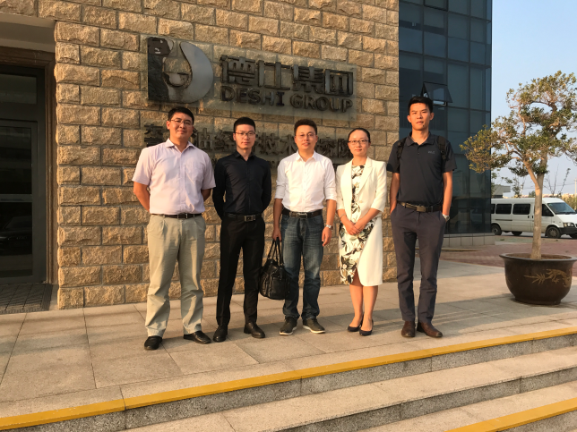
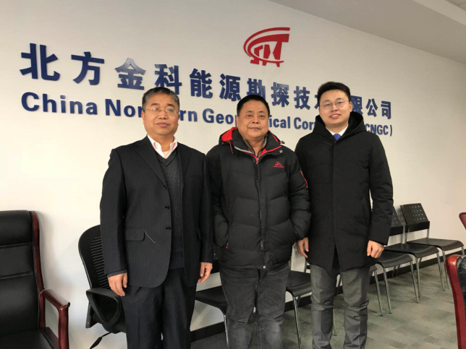
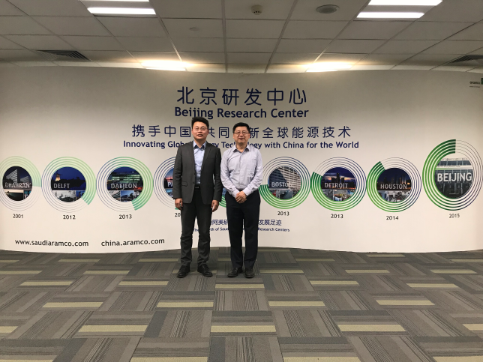
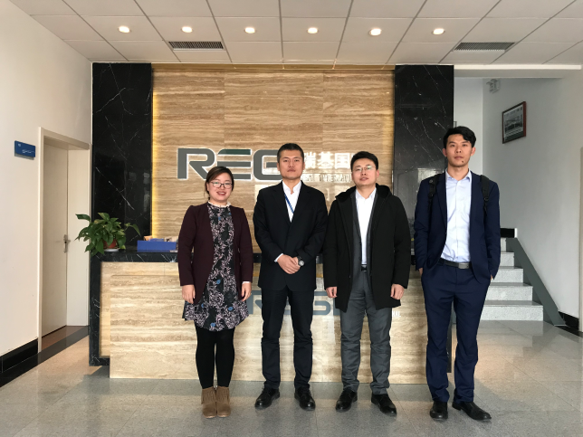
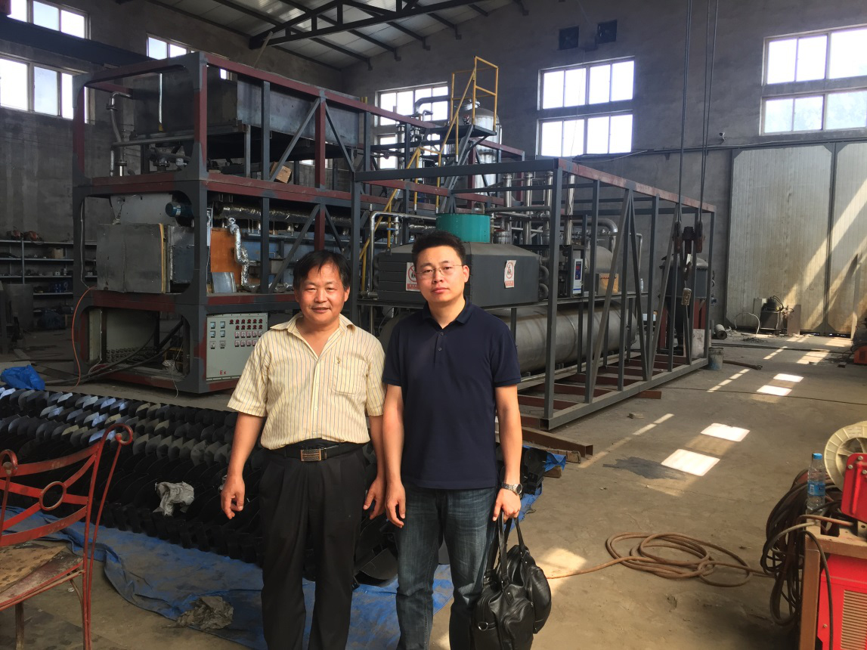
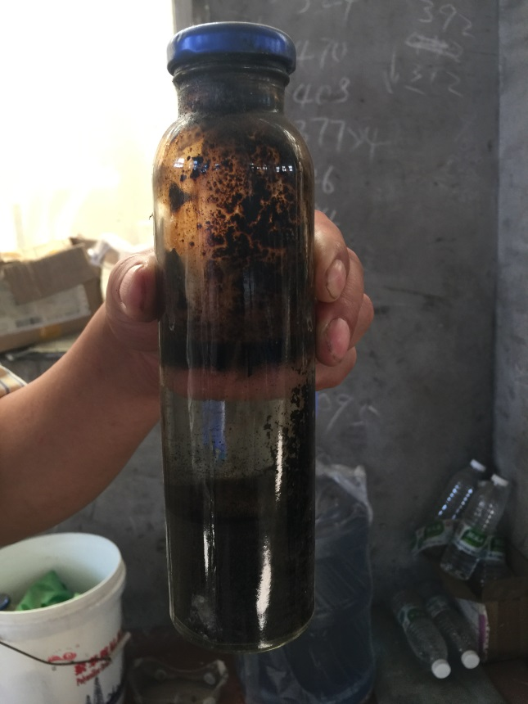
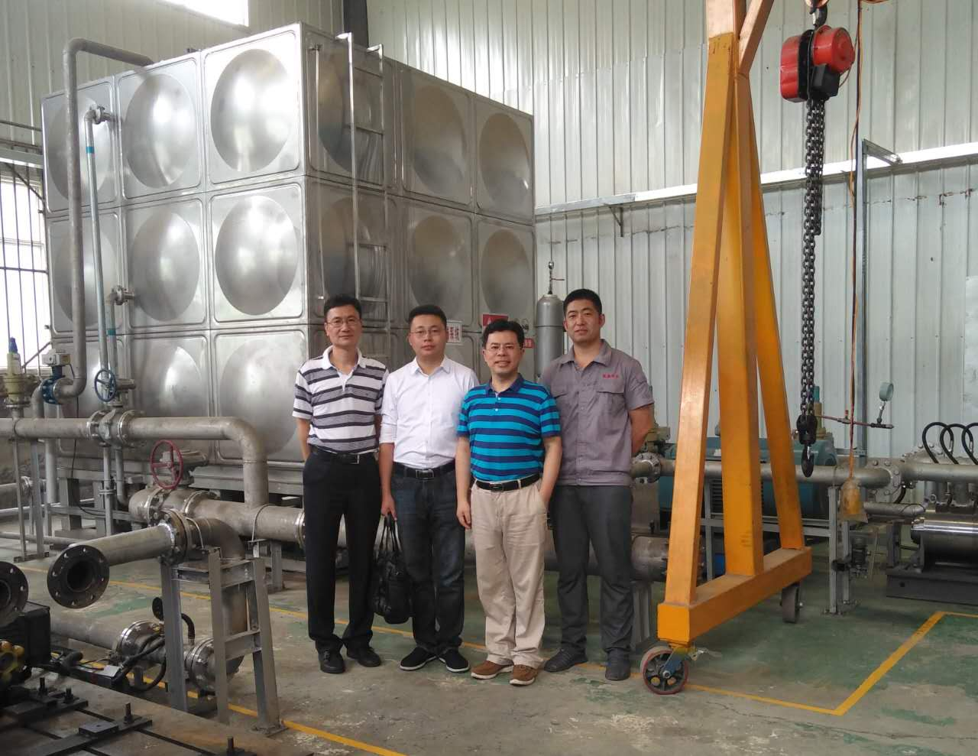
OilLink links different fields companies
Shan Dong DESHI the EOR company
China North Geo company
Saudi Aramco China
KERUI company

Slide 21
What we can do for Russia and China Companies
Enterprise Services Platform
  Over 20,000 companies resource help Russia companies find partners in China
  Shipbuilding, Oil field service, Equipment & Manufacturing, capital fund etc.
Oil and gas market data service(BI)
  Monitoring more than 6400 oil and gas projects globally and 5500 listed companies
  Global oil and gas tendering info database
Oil and gas industry media service
  More than 400,000 users and can cover the China oil and gas industry in one day, which help international companies find proper partners
Notes:
China Shipbuilding Industry Coproration(CSIC)
Qingdao Beihai Shipbuilding Heavy Industry Co., Ltd. (BSIC)
Wuchang Shipbuilding Industry Group Co.,Ltd (“WS”)……
ZPEC,COSL,ANTONG,HBP,SPT,HILONG……

Slide 22
www.oillink.com

