Slide 1
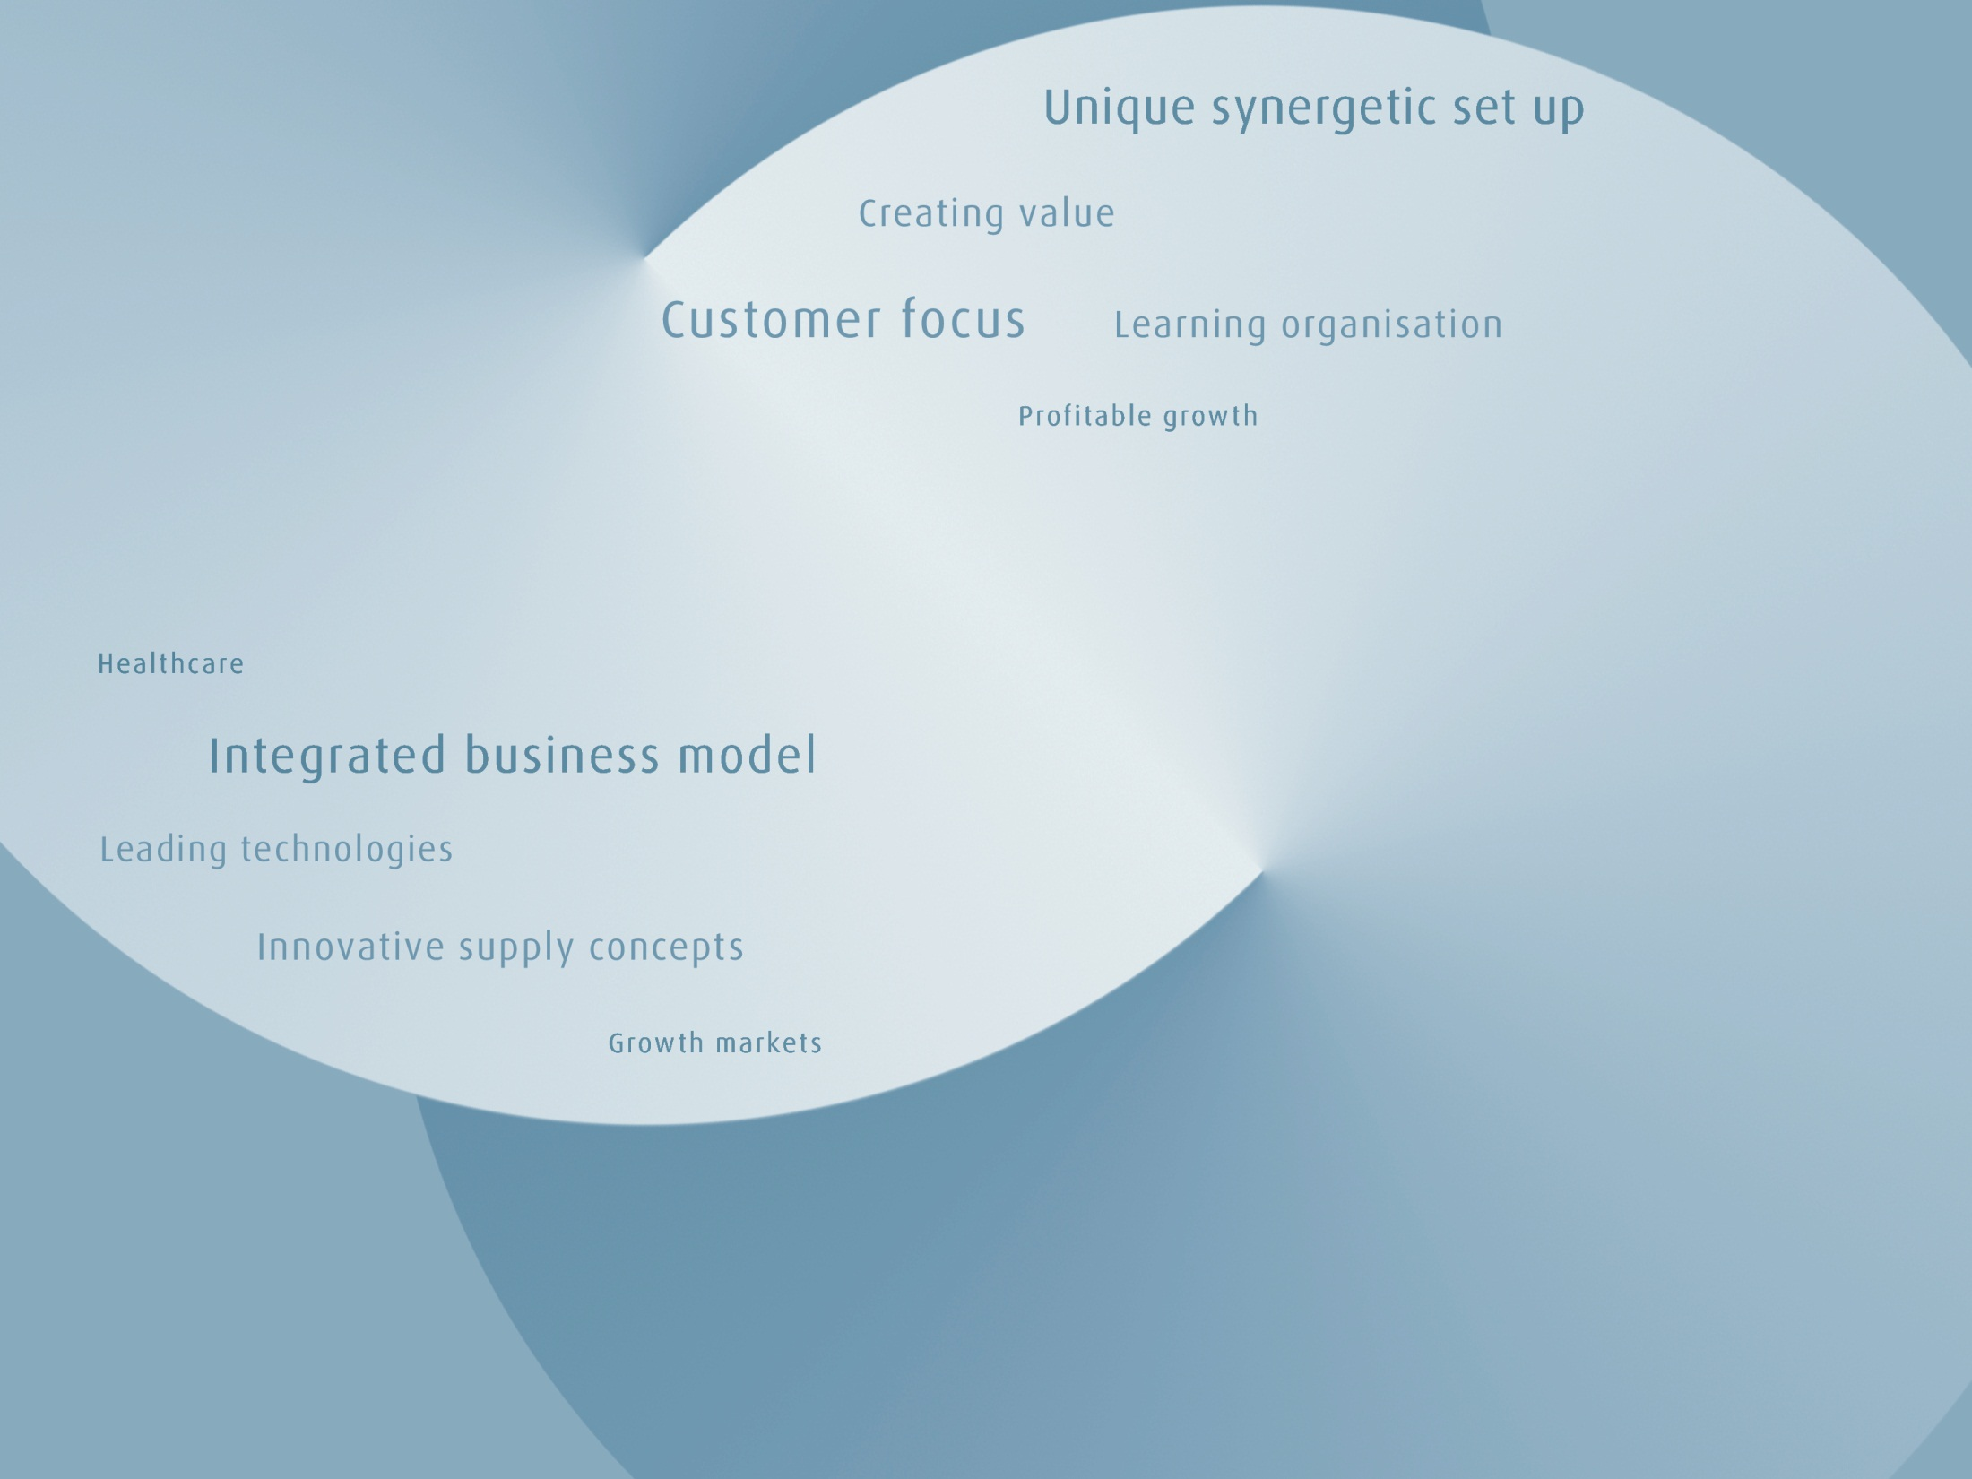

Experience, prospects and strategy of Linde in Russia
St Petersburg
October 4th, 2017

Slide 2
The Linde Group worldwide
Global presence in more than 100 countries, including Russia
Linde financial highlights 2016 |  |  |  |  | Group | Gases | Engineering
Revenue |  | in EUR m |  |  | 16,948 | 14,597 | 2,351
Capital Expenditure (Gas divisions excl. financial assets) |  | in EUR m |  |  |  | 1,660
Order Intake (Engineering division) |  | in EUR m |  |  |  |  | 2,257
Order Backlog (Engineering division) |  | in EUR m |  |  |  |  | 4,386
Number of employees (as at December 31st 2016) |  |  |  |  | 59,715 | 53,283 | 6,432
Linde in Russian Federation, previous ~ 10 years
Order Intake from Process Plants/EPC |  | in EUR m |  |  |  |  | App. 3,500
Capital Expenditure (incl. JV’s) |  | in EUR m |  |  |  | App. 500
Notes:
To enable comparability the figures of 2015 and 2016 are adjusted for discontinued operations (Gist)
¹ EBIT (before non-recurring items) adjusted for amortisation of intangible assets and depreciation of tangible assets
² Basis points

Slide 3
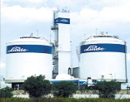
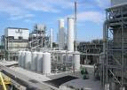






Linde Gas and Engineering
Engineering and operation synergies
Linde Gas Supply business
6,400 engineers
Linde Engineering
Operational Excellence
Design, Technology, Execution
Air Separation
Air Separation
Hydrogen/Syngas
HyCO On-Site Plants
ASU Tonnage Plants
Hydrogen/Syn Gas
ASU On-Site Plants
5,600 operators
>70 plants
>100 plants
>70 plants
>300 plants
Global #1
Global #2
>300 plants
Leveraging
Synergies
ECOVAR Std Plants
CO2 Plants
ECOVAR Std Plants
Olefins
Olefins
Natural Gas
Natural Gas
>1,000 plants
1
>100 plants
>950 plants
Global #2
Global #3
Notes:
3
3

Slide 4
Linde Gas
Reference Plants in Russia
ASU
Planned ASU
Acetylene plant
Filling Station
Ecovar
SPG Plant
Planned HyCO Plant
Planned FS
Linde Gas entered Russia in 2001, headquarter in Balashikha, Moscow
Estonia
Latvia
Lithuania
Belarus
Brest
Moscow
Ukraine
Bryansk
Niszhnyi
Perm
Togliatti
Yekaterinburg
Samara
Turkey
Atyrau
Russia
Kazakhstan
Uzbekistan
Iran
Mongolia
China
Afghanistan
China
4
Notes:
4
4
4
4

Slide 5
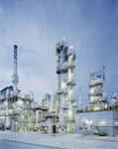
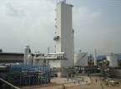
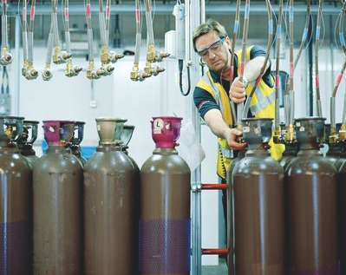
Linde Gas
Latest Projects in Russia
New H2/NH3 plant for Kuibyshevazot (Togliatti)
Capacity 1340 t/d NH3 and 8 000 m3/h H2
On stream in 2017, Linde Engineering acts as EPC contractor
Investments about 260 mln euro
2 ASUs for SIBUR-NEFTECHIM (Dzerzhinsk)
Capacity – 540 tpd each ASU
On stream in 2016, Linde Engineering acts as EPC contractor
Investments about 70 mln euro
Helium Transfil (Balashikha)
Entry to LHe market in Russia with market share about 5%
Medical equipment service
Investments about 2 mln euro
5

Slide 6
Linde Engineering
Reference Plants in Russia
Adsorption plants
Air separation units
Hydrogen and synthesis gas plants
Gas processing plants
Natural gas plants
Petrochemical plants
Estonia
Latvia
Lithuania
Belarus
Kohtla Yarve
Mosyr
Kalush
Shlobin
Weliki Nowgorod
Enakiewo
Klin
Ukraine
Schocino
Moscow
Novomoskovsk
Norilsk
Severodonezk
Lipezk
Mariupol
Beresniki
Nowy Urengoy
Togliatti
Kazan
Budennowsk
Perm
Ufa
Berezovsky
Russia
Turkey
Samara
Revda
Tobolsk
Atyrau
Karabash
Novosibirsk
Kazakhstan
Uzbekistan
Iran
Schurtan
Mongolia
China
Afghanistan
China
6
Notes:
6
6
6
6

Slide 7
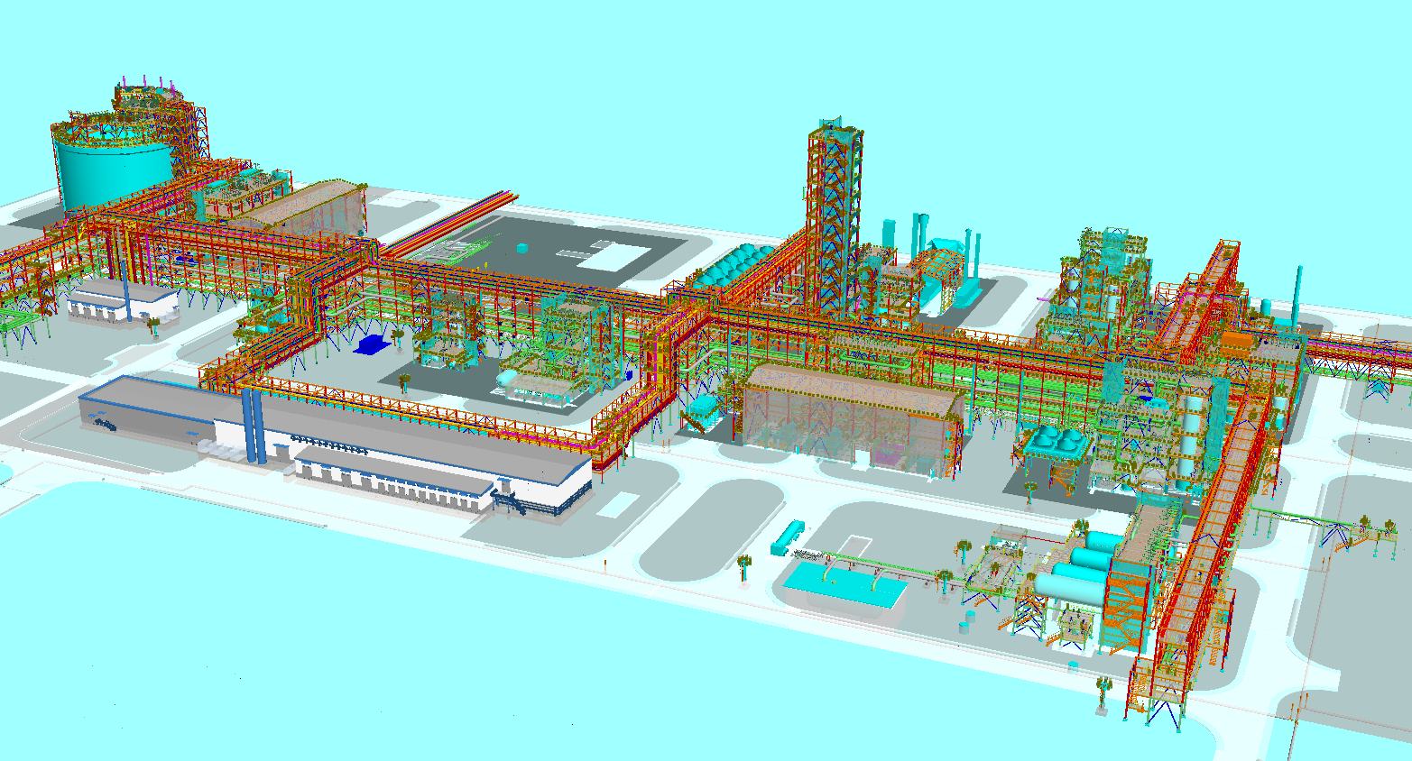
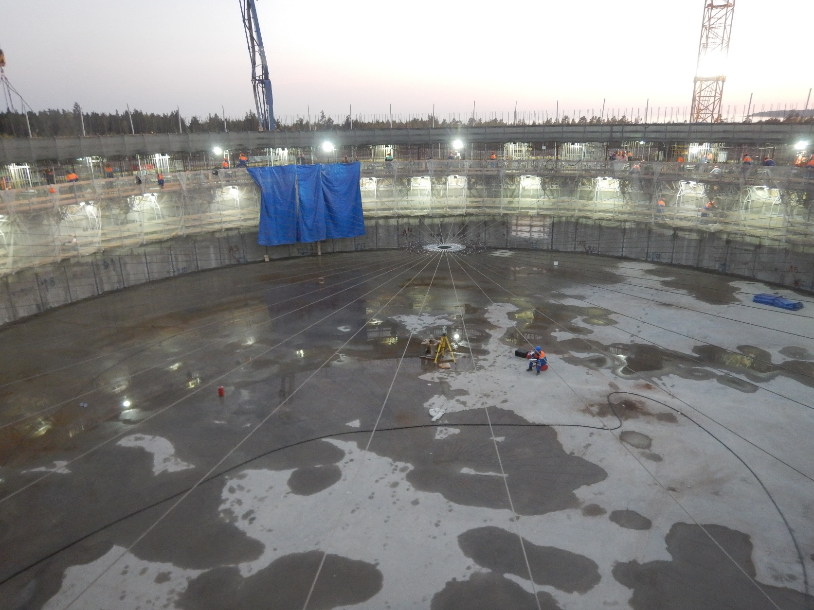
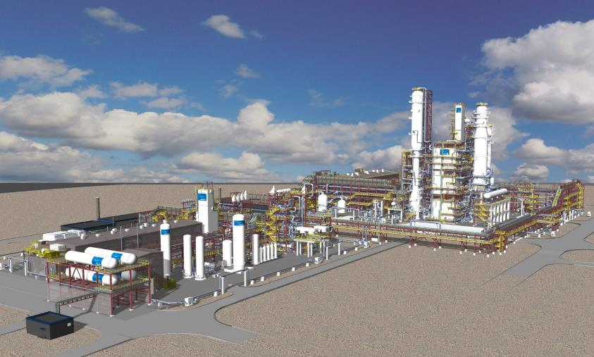
Linde Engineering
Latest Projects in Russia (Under Execution)
Portovaya LNG
Client Peton / Gazprom
Location Portovaya
Process LIMUM3 with CWHE
Capacity 1.5 million tpa
LE Scope EPSS
Amur GPP
Client Nipigaz / Gazprom
Location Svobodny
Process Combined NGL/NRU & HeRU
Capacity 6 x 875.000 Nm3/h
LE Scope EPSS
7

Slide 8
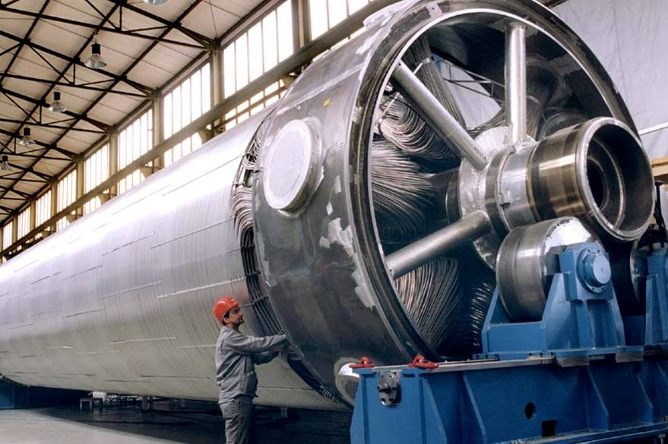
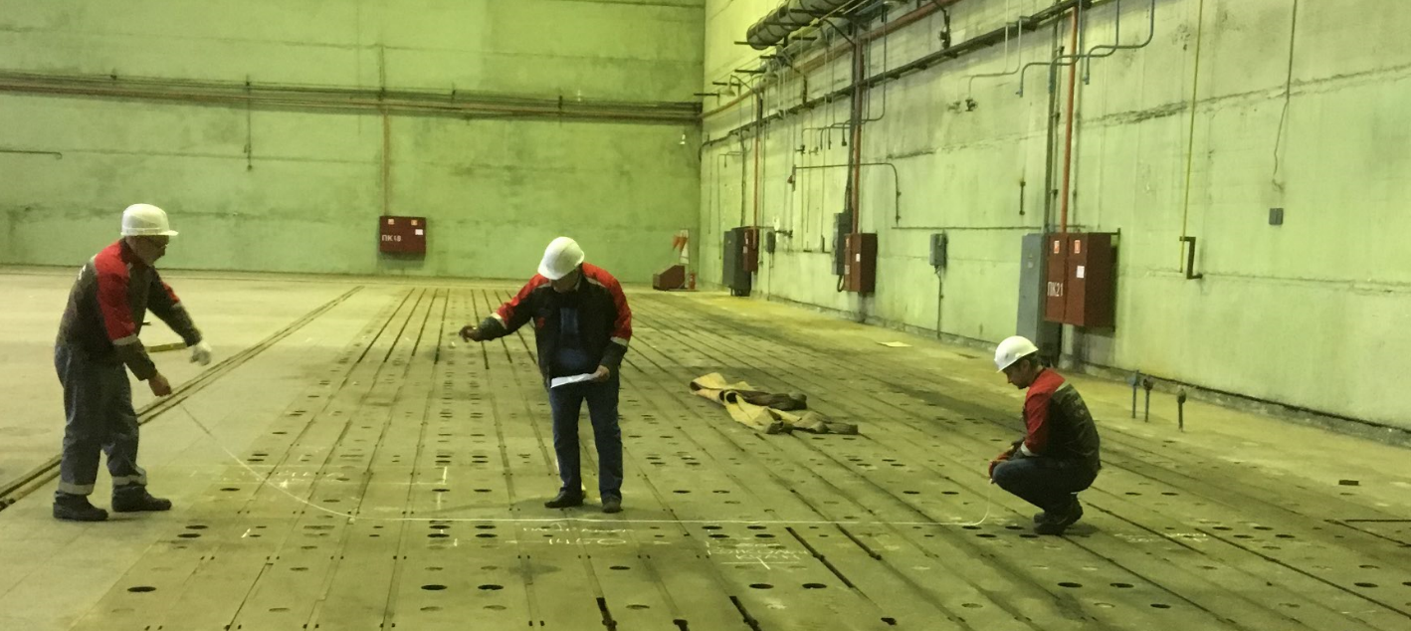
Linde Engineering
Localization Initiatives
Strategic Cooperation Agreement with Gazprom
End 2015 Gazprom and Linde signed a strategic cooperation agreement to cooperate in the following areas:
  Natural gas processing and liquefaction.
  Localisation of equipment for natural gas processing and liquefaction.
  Advanced personnel training.
  Formation of Joint Venture for manufacturing of CWHE with Power Machines
End 2016 Power Machines and Linde established a Joint Venture for manufacturing of Coil Wound Heat Exchangers in St. Petersburg
8

Slide 9
The Linde Group in Russia
Perspective and Strategy
Perspective
    Russia is a leading hydrocarbon supplier of the world and #1 in resources
    Linde recognizes Russia’s desire to enhance its local value chain and supports this strategy by expanding its Russian operations e.g. through investments in industrial plants and facilitating the development/localization of technologies/products in the area of gas processing
Strategy
    Extend support for localisation of fabrication, e.g. fabrication of Coil Wound Heat Exchangers or LNG filling stations
    Fostering understanding/modernization of Russian Codes and Standards
    Proactively adapting designs to enhance participation of Russian equipment fabricators
    Enhance engineering capabilities in Russia
    Identify/implement value adding technologies in the natural gas value chain
9

Slide 10
Thank you for your attention.

