Slide 1
Control System
for
Natural Gas Pipeline Compressor
Michael Wang
VP|Sales and Marketing
October 5th, 2018
Saint Petersburg

Slide 2
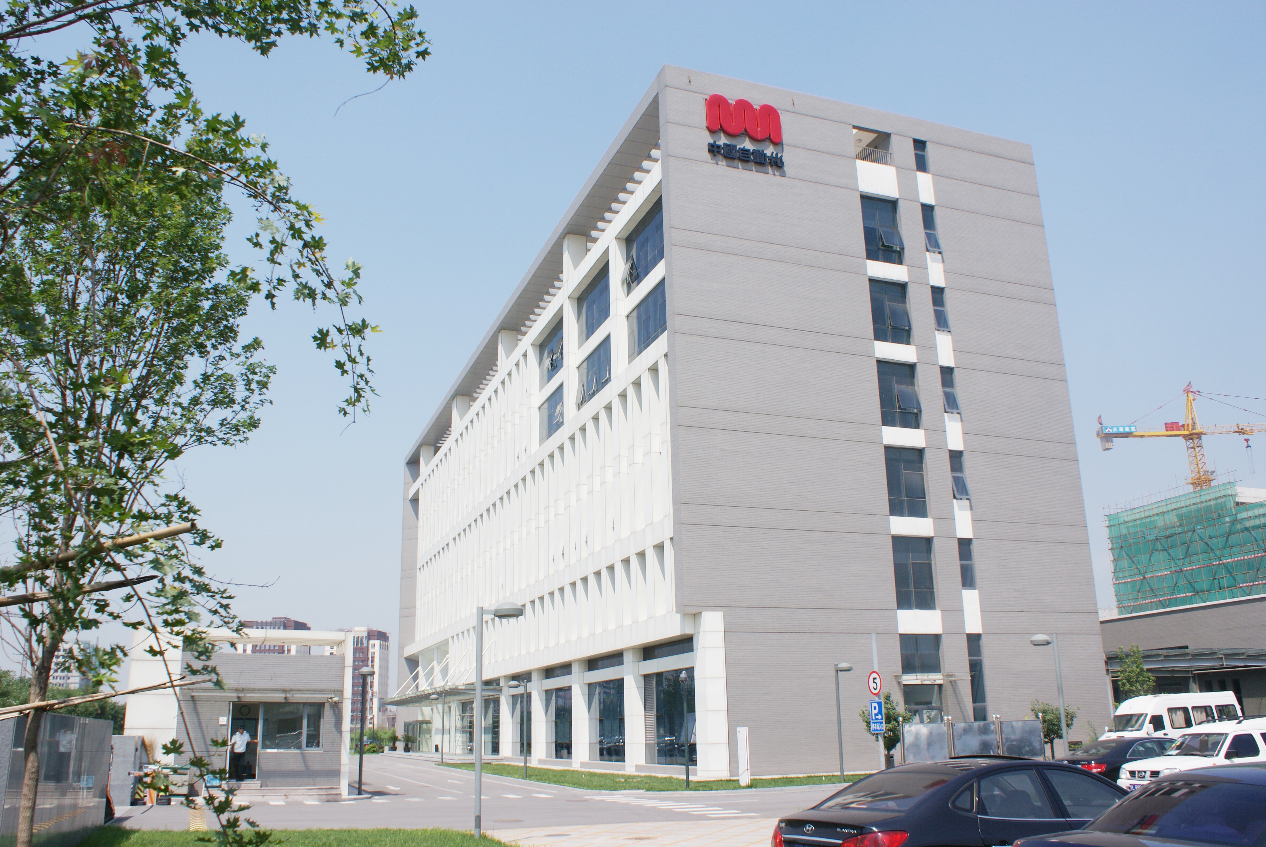
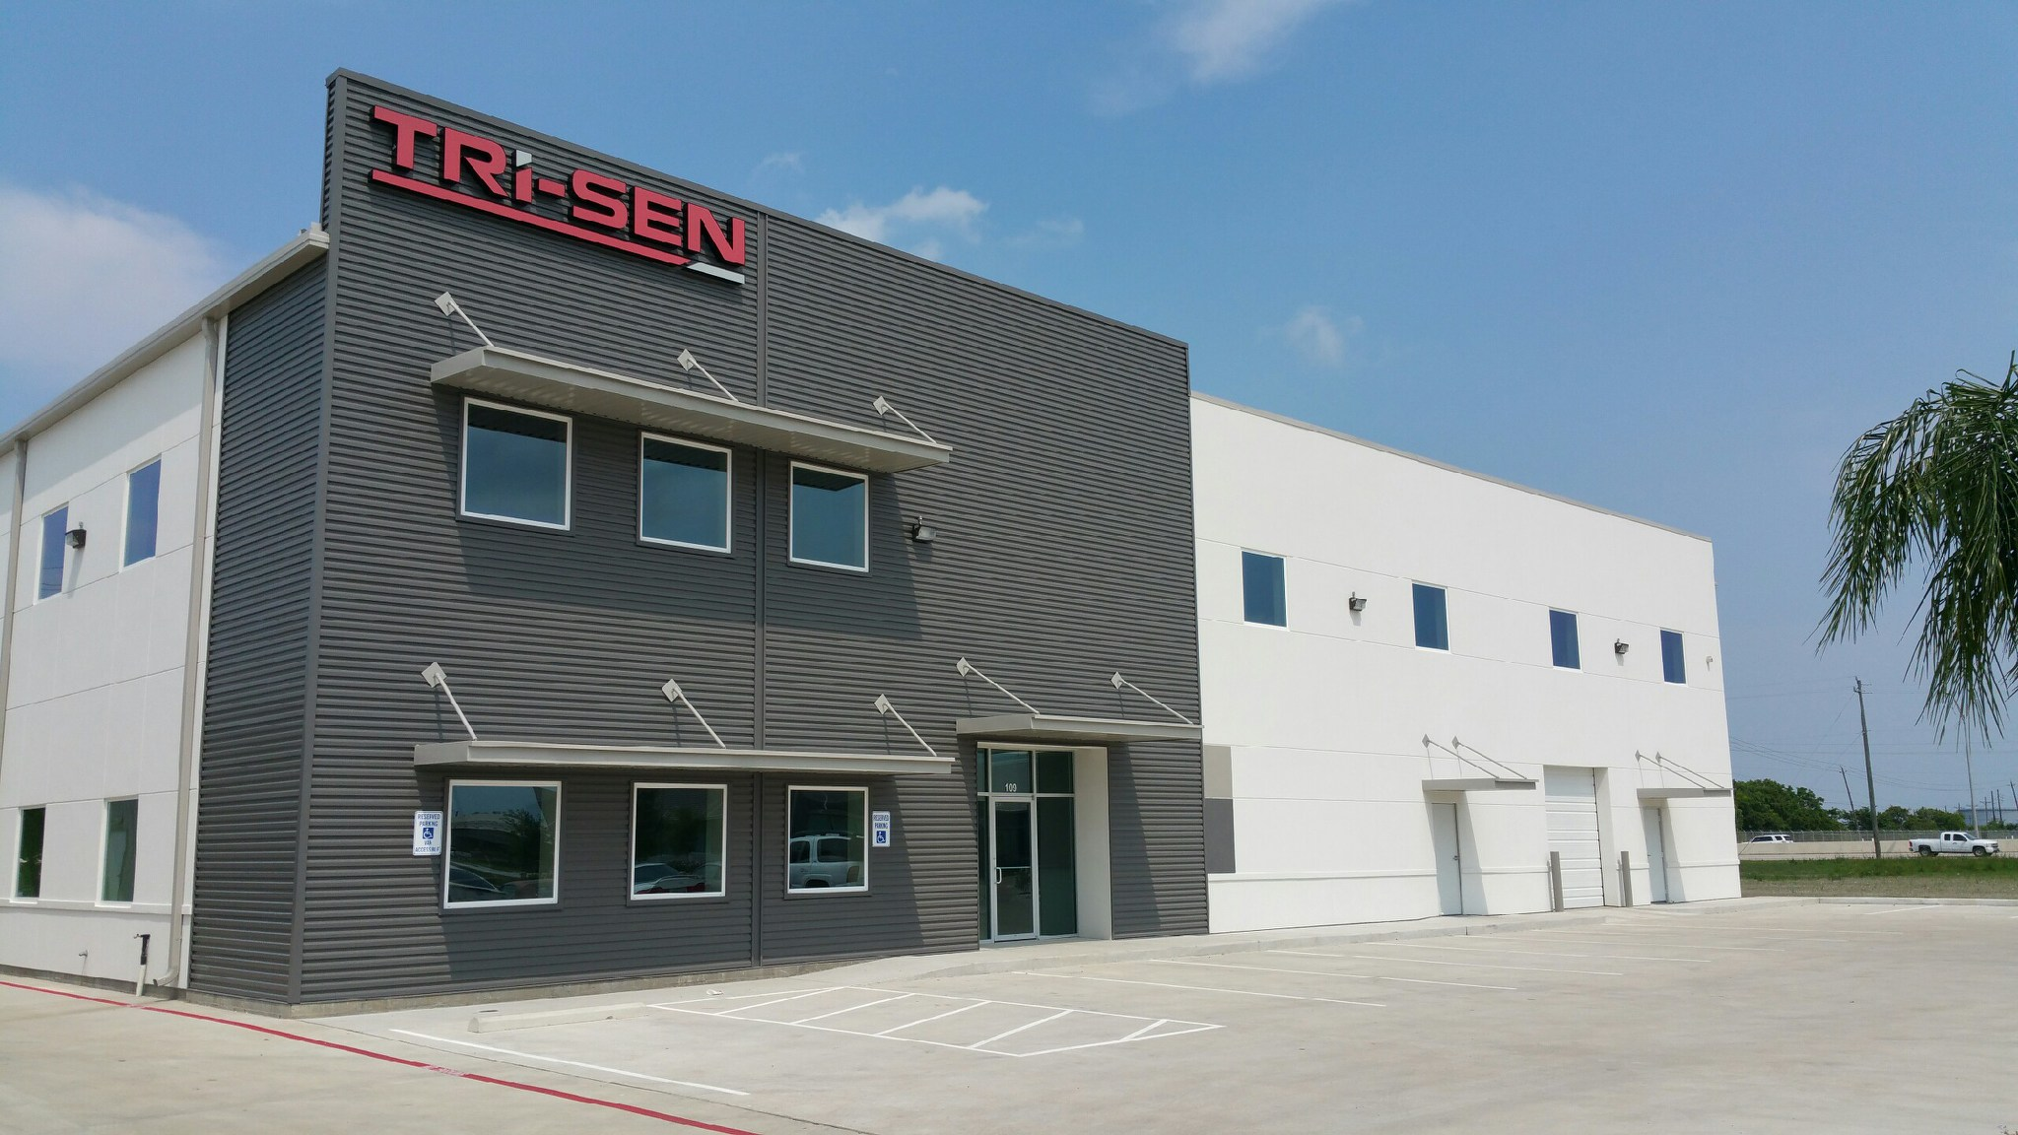
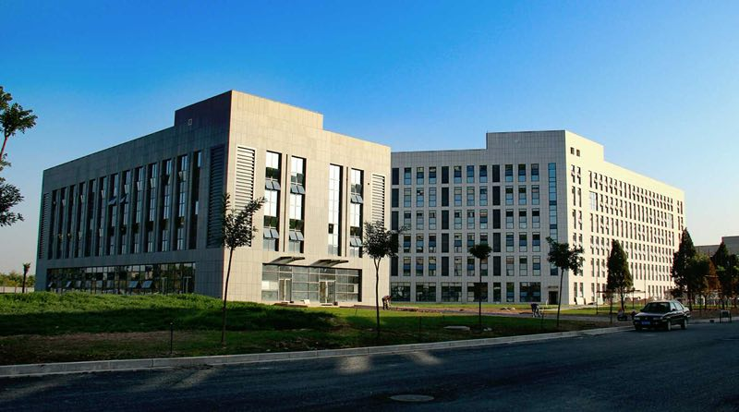
About us
1994
China Automation Group
Founding in
Beijing Consen Automation Co.Ltd.
No.1
Safety and critical control supplier in China.
Beijing Consen Technology Co.Ltd.
Wuzhong Instrument Company
No.1
Domestic control valve supplier in China.
Tri-sen Systems Corporation
Zhongjing Corporation
~2000
Employees
CAG Headquarter
Tri-sen Headquarter
Wuzhong

Slide 3
History Review
Founders started entering
into the field
of safety
and critical control systems
in China
Established business relationships with Mitsubishi Corporation of Japan and MAN-TURBO Corporation of Germany
Started to make partnership with Invensys Singapore
CAG*
listed on the Main Board of the Stock Exchange of Hong Kong
Established CONSEN Automation Tech Co.
Established the branch in Singapore:
Singapore CONSEN
1996
1999
2002
2003
2004
2006
2007
Won the ESD/FGS/ITCC project of the whole factory of Fujian Petrochemical Co., amounting to USD 20million, the largest joint-ventured petrochemical project
in China
Started cooperation with Shenyang Blower Works Automation Control System Company, and completed an ITCC system development project
Set up CONSEN Transportation Tech Co.,
start entering into the field of railway RIS
*: CAG (China Automation Group) is
the holding company of all CONSEN companies

Slide 4
History Review
CAG completed acquisition of 100% equity interest in Wuzhong Instrument Co.
CAG acquired 70% of the equity interest of Zhongjing Corporation
(for EPC business)
CAG completed acquisition of 51% equity interest in Nanjing Huashi Co.
Wuzhong Instrument Co. received the National Award for Technology Progress
CAG set up Tri-sen Systems Corporation in Houston, USA
2008
2009
2010
2011
2012
2014
2015
CAG established the wholly-owned subsidiary—Innovex
Japan Co.
CAG awarded “Deloitte Technology Fast 500 Asia Pacific 2011” by Deloitte and “200 Best under A Billion” for three consecutive years by Forbes Magazine
CAG started R&D on TSxPlus

Slide 5
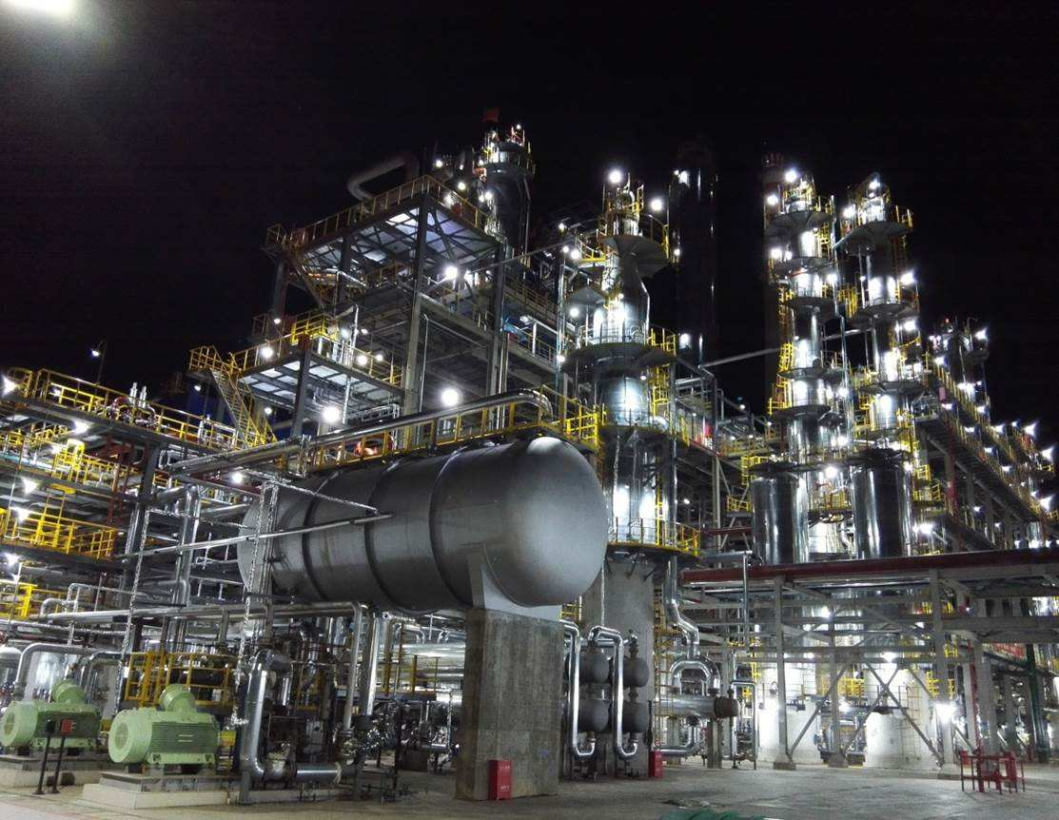
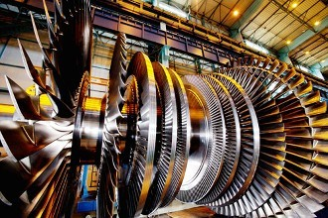
Core Business
Safety Instrument System
TMC Control
ESD
Burner Management System
Fire & Gas System
Emergency Trip System
Turbo Compressor Control
Generators
Steam Turbine Control
Gas Turbine Control

Slide 6
Experiences in TMC
More than 20 years Experiences in TMC using General Purpose type Hardware Platform （TMR and PLC）
All Types of Compressors and drivers
  Centrifugal android Axial Compressor
Expander
Steam Turbine
    Gas Turbine (Retrofit)-GE, SIEMENS, RR, UEC, etc.
Applications Include:
Oil and Gas Pipeline Refinery Petrochemical
Chemical Coal to Chemical / Oil
Metalogical Air Separation

Slide 7
Hardware Development
Development of Hardware Platform based on CONSEN’s accumulated knowledge of Safety and TMC Business, Functional design, Hardware design, System Software design, and Application software development all done by Consen Technology.
High Reliability and Availability (SIL3 Certificaiton by TÜV Rheinland)
Flexible and Expandable System size
Open Architecture Software allows System Integrators and Control Experts to develop and run their own Control Functions and Special Features.
SL-1 Information and Cyber Security certification.

Slide 8
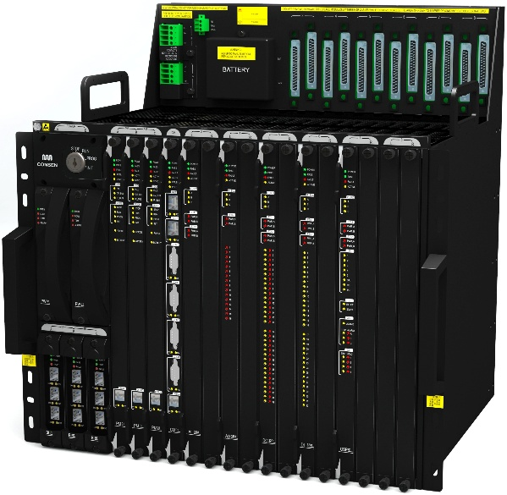
Features
Independent On board Overspeed Protection
Real-time
Multi-Tasks
Faster CPU
TMR
Opened-Software Platform
Power Supply
Quality Monitoring
Information
Security
HART
incorporated

Slide 9
Case Study of TSxPlus
Pipeline Station Control
Controls compressors from different Manufacturers
Guazhou Station
4 x GE PCL 800 Variable Frequency Motor driving
4 x Shenyang Blowers Works PCL804 Variable Frequency Motor driving
Zhangye Station
3 x GE PCL 800 (PGT25 gas turbine driving)
3 x Dresser-Rand Compressors (25MW Variable Frequency Motor driving)

Slide 10
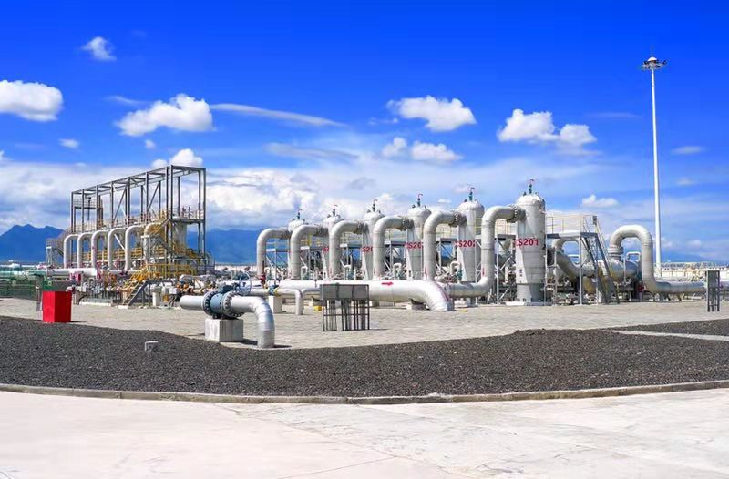
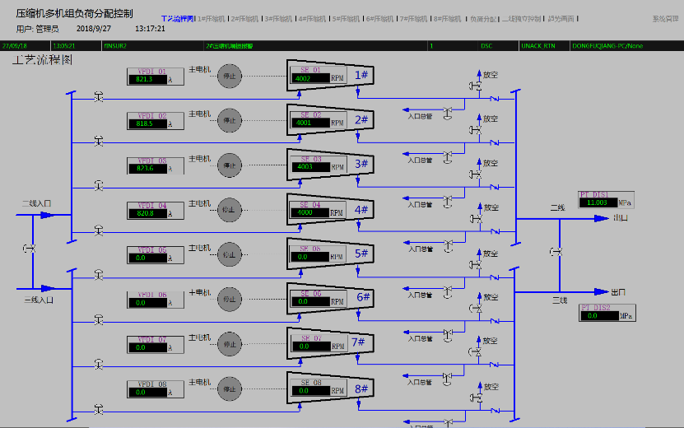
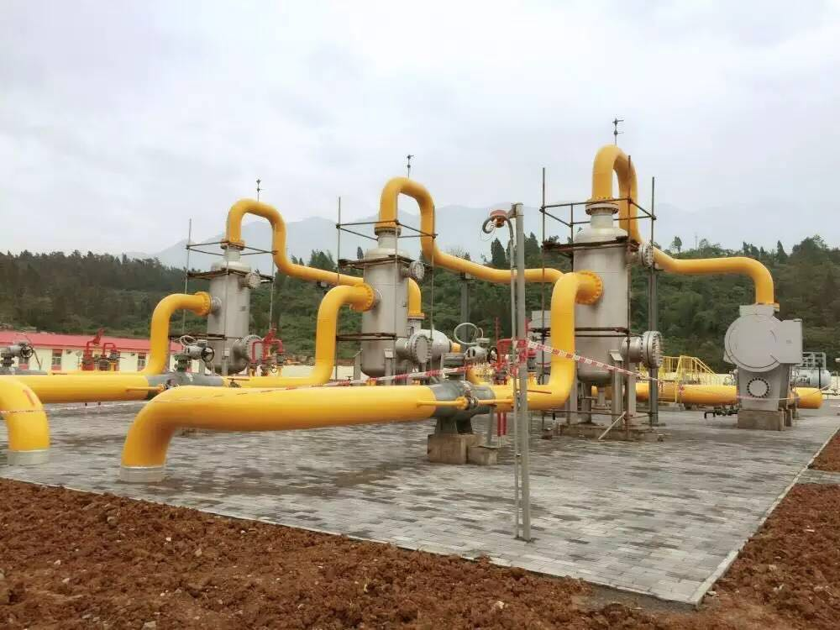
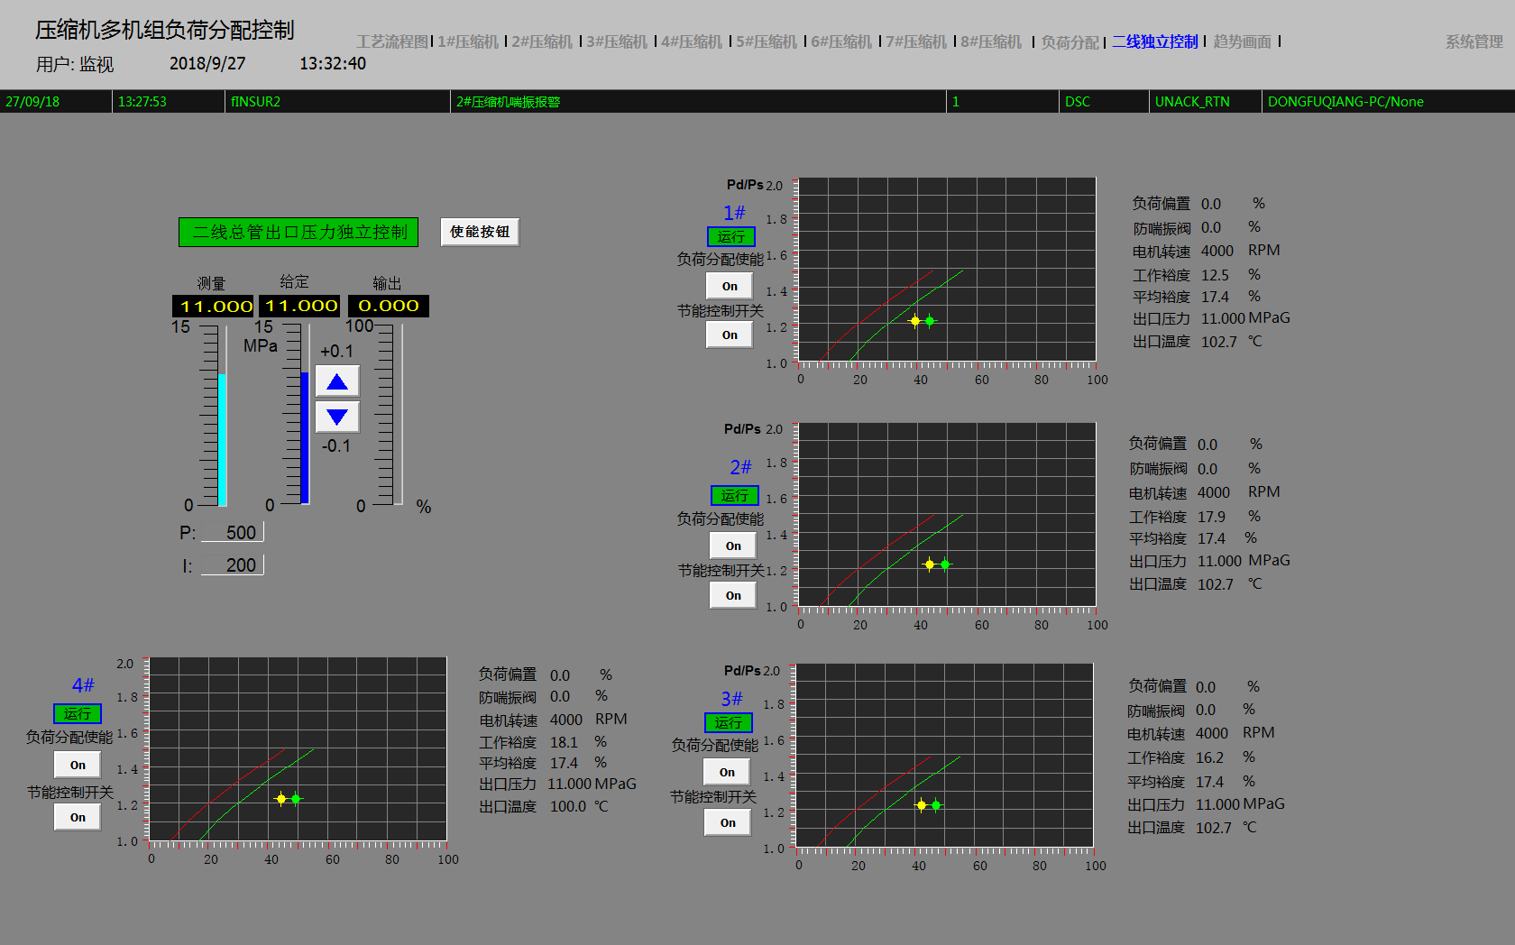
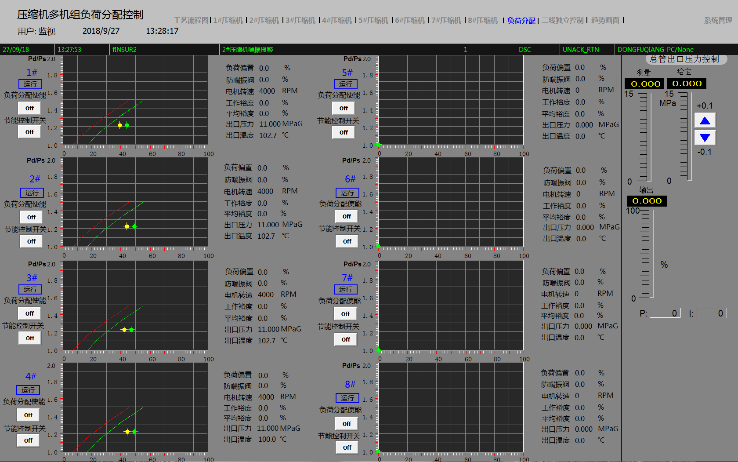
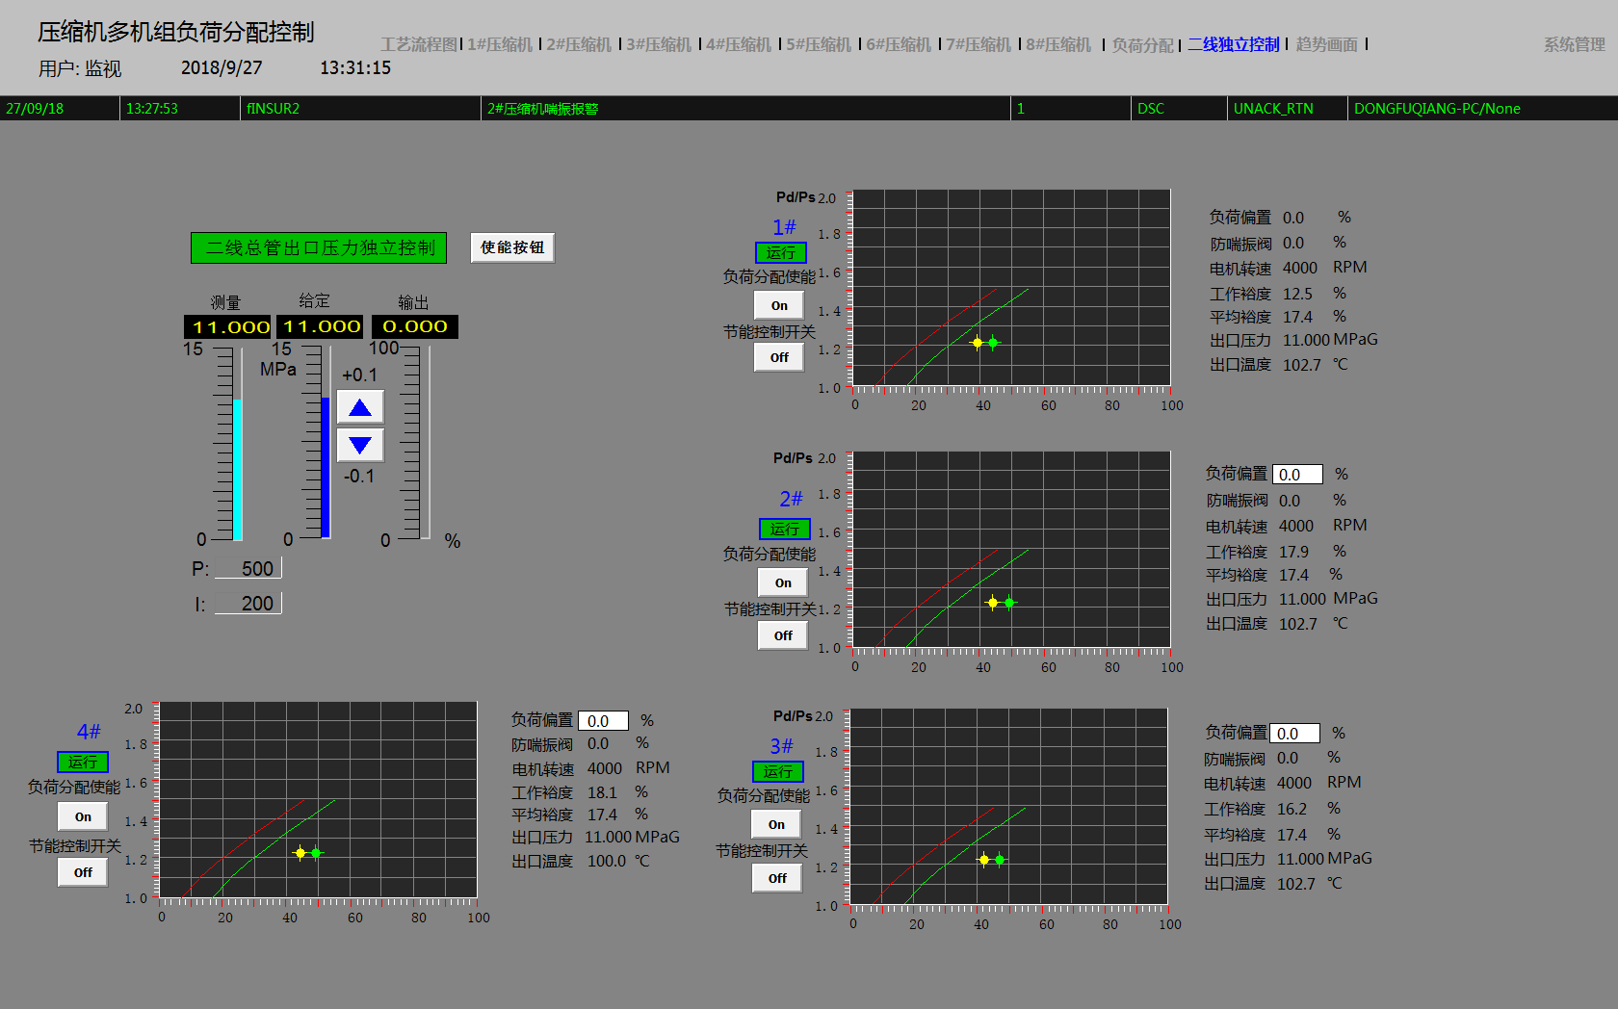
Case Study of TSxPlus
PetroChina West to East Pipepline II and III Station Loadsharing and Optimization Control

Slide 11
Case Study of TSxPlus
Pipeline Station Control
Better Load balance: Maximizing the load control
More efficient by automatic loading better efficient compressor with more load to optimizing the over all efficiency.
Results
2-3 % energy saving on the initial tests

Slide 12
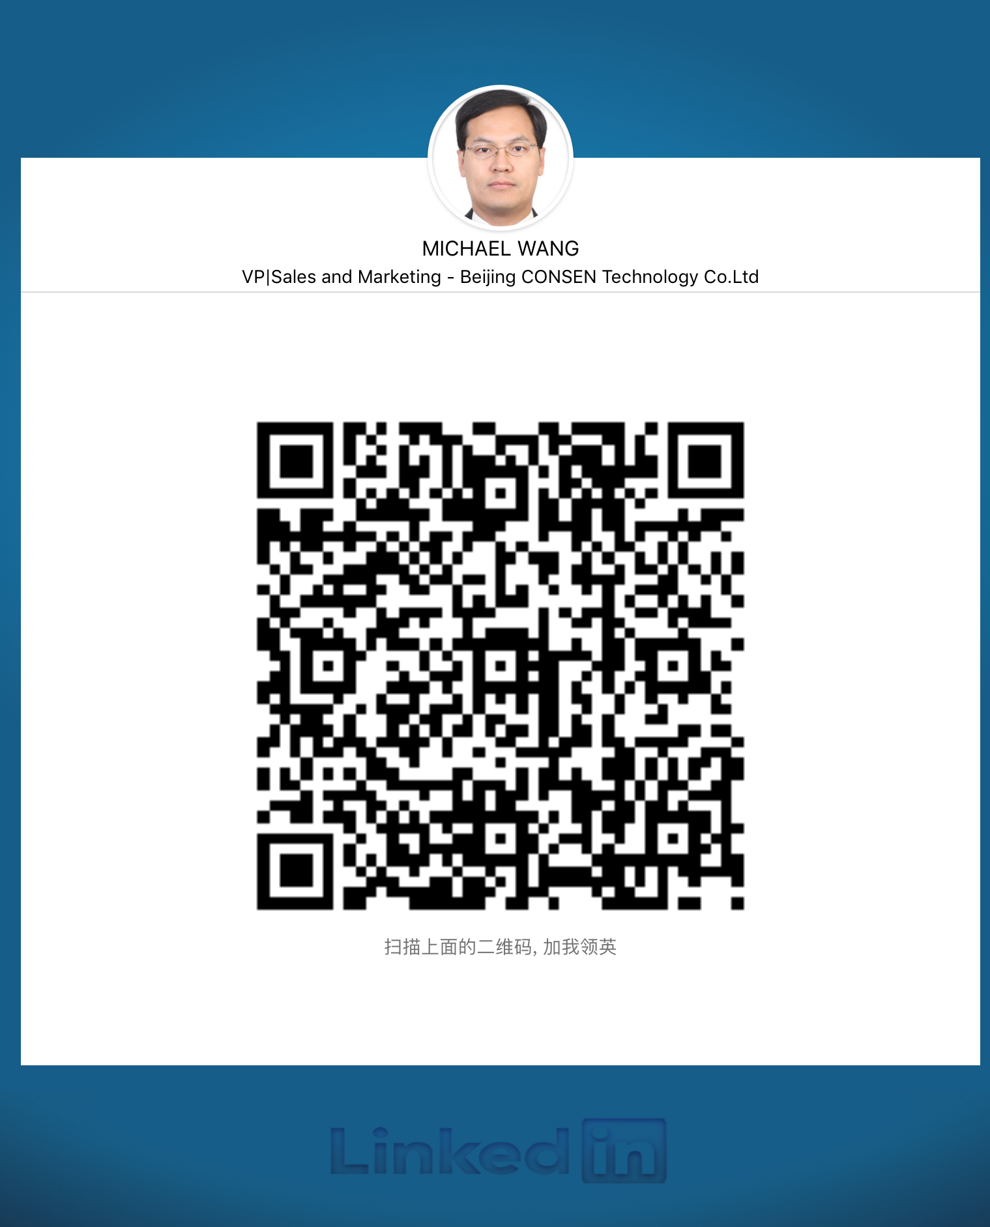


Contacts
Michael Wang
VP|Sales and Marketing
Add:No.7, Anxiang street, Chaoyang district, Beijing, China
Tel:+86 10-80469988 Fax:+86 10-80469966
MP:+86 13301292338
Email: wangpeng@cag.com.hk
Website: www.consentech.cn
We are looking forward to cooperate with enduser, compressor manufacturers and system integrators worldwide.

