Slide 1


Energy Systems Institute SB RAS
A shift in the paradigm of energy cooperation between Russia and NEA countries in the face of new global and regional challenges
Energy cooperation in Northeast Asia: Russian prospects, role of the renewable energy sources
B. Saneev
Energy Systems Institute SB RAS, Russia, Irkutsk
B. Saneev
Energy Systems Institute SB RAS, Russia, Irkutsk
Speech at the SB RAS-MOST Join Symposia,2016
08.11.2016, Taipei, Taiwan
The 15th International Conference on NAGPF-St. Petersburg, Russia, 05.10.2018

Slide 2
OUTLINE
Eastern vector of Russian energy strategy ( basic conceptual position )
2. The material basis of the eastern vector of Russia’s energy policy: current state of energy cooperation between Russia and NEA countries
3. Priority directions of innovation and technology cooperation between Russia and Northeast countries in the field of energy
4. Conclusion - Necessary conditions and initiatives for successful mutually beneficial innovation and technology cooperation between Russia and NEA countries in the field of energy
The 15th International Conference on NAGPF-St. Petersburg, Russia, 05.10.2018
Notes:
2

Slide 3
1. EASTERN VECTOR - A STRATEGIC DIRECTION IN RUSSIA’S ENERGY DEVELOPMENT IN THE FIRST HALF OF THE 21ST CENTURY (basic concept)
The 15th International Conference on NAGPF-St. Petersburg, Russia, 05.10.2018

Slide 4
EASTERN VECTOR OF RUSSIA’S ENERGY POLICY
• National interests of Russia require intensification of its mutually beneficial cooperation with Mongolia, China, Korea, Japan and other countries in North and Northeast Asia
Creation of new energy centers in East Siberia and the Far East will increase energy security of Russia, restore and strengthen the fuel and energy ties between the regions and solve many important federal, interregional and regional problems
Rapid and large-scale energy development in these regions and penetration into the energy markets of NEA countries should be considered as a primary means to timely ensure the appropriate positions of Russia in this strategically important region of the world
Creation of a developed energy infrastructure in the form of interstate gas-, oil pipelines and transmission lines in the East of Russia and in Northeast Asia will decrease the cost of energy carriers, enhance reliability of energy and fuel supply to consumers in different countries, and make it easier to solve the environmental problems
The 15th International Conference on NAGPF-St. Petersburg, Russia, 05.10.2018

Slide 5
EASTERN ENERGY POLICY AS AN INSTRUMENT FOR SOLVING URGENT PROBLEMS IN RUSSIA
Eastern energy policy of Russia, as part of Eastern economic policy,
is not an end in itself, but an instrument for solving many crucial
federal, interregional and regional problems
Social, economic and geopolitical problems
Social – improvement in comfort, style, quality of people’s life in the eastern regions of Russia
Political – consolidation and integration of the RF entities, strengthening of the unity of the economic and energy space of Russia
3. Geopolitical – reinforcement of Russia’s positions in the world economic system, in the community of APR, Central and Northeast Asian countries
Economic – enhancement of economic efficiency and competitiveness in the East of Russia, increase in supply of resources and accessibility to the remote areas of the country, expansion of active economic space of Russia, creation of conditions for attraction of foreign investment and advanced technologies, etc.
Energy problems
Improvement in adaptability and reliability
of energy and fuel supply to consumers
2. Increase in energy and environmental security of the country and regions
3. Improvement in territorial and production structure of Russia’s energy sector and particularly in the eastern regions
4. Formation of transport and energy infrastructure in Russia’s East – oil and gas pipeline systems, transmission lines– and creation of common transport and energy space in Russia, etc.
The 15th International Conference on NAGPF-St. Petersburg, Russia, 05.10.2018

Slide 6
Russia has developed a large number of policy documents determining the strategic development of the economy and energy in the East of the country until 2030 in the context of energy cooperation between Russia and Northeast Asian countries.
These documents are "Energy Strategy of Russia until 2030", "Program for Creation of Unified Gas Production, Transportation and Supply System in East Siberia and the Far East with Potential Gas Export to the Markets of China and other APR Countries” (Eastern Gas Program),“ Strategy of Socioeconomic Development of the Far East and the Baikal region until 2025", ”Strategy of Socioeconomic Development of Siberia until 2020", ”Energy Development Strategy of East Siberia and the Far East until 2030", "Program for Development of Oil Refining Capacities in East Siberia and the Far East”, etc.
The 15th International Conference on NAGPF-St. Petersburg, Russia, 05.10.2018

Slide 7
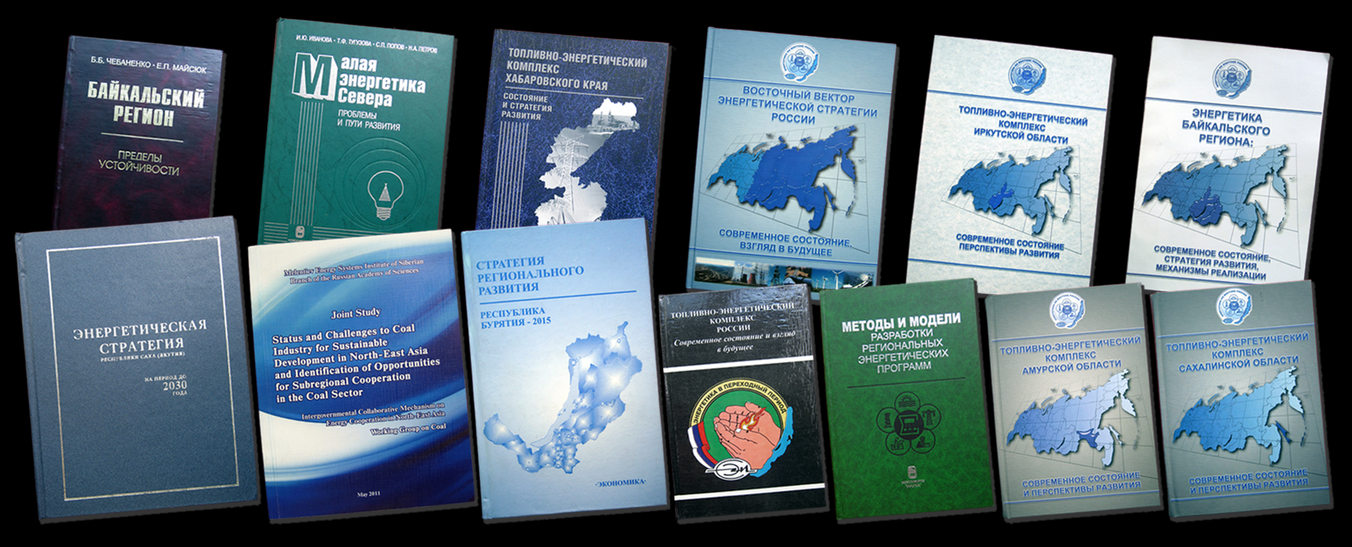
PARTICIPATION OF ENERGY SYSTEMS INSTITUTE SB OF RAS IN THE PROJECTS ORDERED BY FEDERAL AND REGIONAL AUTHORITIES IN 2007-2014
In the framework of the Energy Strategy of Russia 2030 (ordered by the Ministry of Energy of RF)
• The strategy for energy development in East Siberia and the Far East until 2030
The study on prospects for electric power industry development in Russia until 2030
Ordered by the regional authorities (Governments of the RF entities)
• The concept of reliable operation of energy facilities and energy security of Sakhalin region until 2020 – ordered by Administration of Sakhalin region
• The strategy for energy development in Amur region until 2010 and for the time horizon until 2030 – ordered by Administration of Amur region
The strategy for electric power industry development in Chukot Autonomous Area until 2020 – ordered by Administration of Chukot AA and JSC “Chukotenergo”
The strategy for energy development in Irkutsk region until 2015-2020 and for the time horizon until 2030 – ordered by the Government of Irkutsk region
The energy strategy of Sakha Republic (Yakutia) until 2020 and for the time horizon until 2030 – ordered by the Government of Sakha Republic (Yakutia)

Slide 8
Official program documents suggest a considerable increase in mutually beneficial supply of Russian energy resources to the markets of China, Japan, Korea, and other East and Northeast Asian countries
The 15th International Conference on NAGPF-St. Petersburg, Russia, 05.10.2018

Slide 9
An analysis of energy markets in China, Korea, Japan and other countries in Northeast and East Asia demonstrates that these countries have a niche for Russian energy resources.
Russia’s energy potential makes it possible to supply energy resources to these countries on mutually beneficial terms:
oil – from 69 million t in 2016 to 75-80 million t in 2030;
natural gas – from 15 billion m³ in 2016 to 50- 60 billion m³ in 2030;
coal – from 70 million t in 2016 to 75-85 million t in 2030;
electricity – from 3.6 billion kWh in 2016 to 45-50 billion kWh in 2030.
Source : Available forecasts of energy companies, supporting materials of Energy Strategy of Russia 2035, estimates of ESI SB RAS
The 15th International Conference on NAGPF-St. Petersburg, Russia, 05.10.2018

Slide 10
2. The material basis of the eastern vector of Russia’s energy policy: current state of energy cooperation between Russia and NEA countries

Slide 11

At present the material basis of the eastern vector of Russia’s energy policy is based on several large fuel and energy projects aimed at markets of NEA countries:
First, Construction of the oil pipeline “East Siberia – Pacific Ocean” with a capacity of 80 million t per year with a pipeline branch to Skovorodino towards China with a capacity of up to 15-20 million t of oil per year
Scheme of the main oil pipelines in the East of RF, including infrastructure for oil refining (next Slide)
The 15th International Conference on NAGPF-St. Petersburg, Russia, 05.10.2018

Slide 12
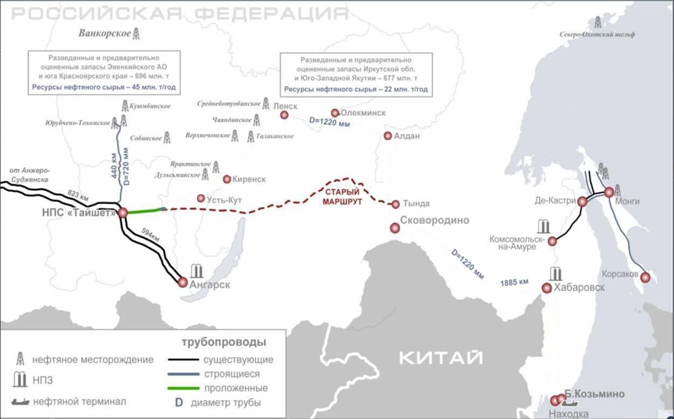

SCHEME OF THE MAIN OIL PIPELINES IN THE EAST OF RF, INCLUDING INFRASTRUCTURE FOR OIL REFINING
The explored and indicated reserves of Evenki AO and the south of Krasnoyarsk krai – 696 million t. Crude oil resources – 45 million t/year
The explored and indicated reserves of Irkutsk oblast and the Southwestern Yakutia – 677 million t
Crude oil resources – 22 million t/year
Oil field
Oil refinery Existing
Under construction Laid Pipe diameter
Previous Route
Pipelines
Existing
Under construction Laid
Pipe diameter
Oil field
Oil refinery Oil shipment terminal
The 15th International Conference on NAGPF-St. Petersburg, Russia, 05.10.2018

Slide 13
At present the material basis of the eastern vector of Russia’s energy policy is based on several large fuel and energy projects aimed at markets of NEA countries:
Second, “Gazprom” has elaborated a program on development of natural gas resources in the East of Russia, conversion to gas in Russian regions and natural gas delivery to the markets of China and other NEA countries
The 15th International Conference on NAGPF-St. Petersburg, Russia, 05.10.2018

Slide 14
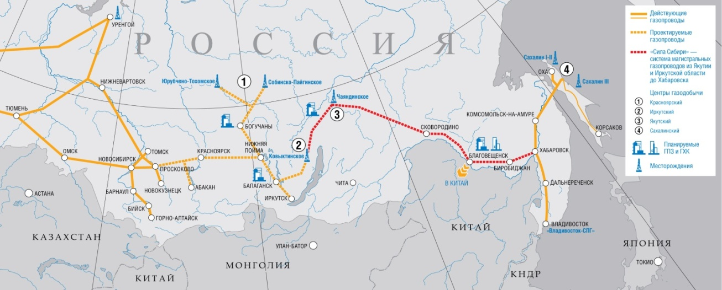
GTS «POWER OF SIBERIA»
Source: GAZPROM
The 15th International Conference on NAGPF-St. Petersburg, Russia, 05.10.2018

Slide 15
At present the material basis of the eastern vector of Russia’s energy policy is based on several large fuel and energy projects aimed at markets of NEA countries:
Third, Russia is going to be an important and active player in the Asian and Chinese coal markets
The 15th International Conference on NAGPF-St. Petersburg, Russia, 05.10.2018

Slide 16
RETROSPECTIVE DYNAMICS OF RUSSIAN COAL PRODUCTION AND EXPORT, MLN T (IN ROUND FIGURES)
Index | Year
 | 2008 | 2009 | 2010 | 2011 | 2013
Production | 329 | 300 | 323 | 355 | 352
Export, total, including: | 102 | 97 | 116 | 132 | 143
Eastern direction, total | 16.6 | 27.7 | 28.0 | 48.9 | 58.8
including:
Japan | 9.0 | 9.0 | 8.9 | 12.7 | 12.8
Republic of Korea | 6.6 | 4.0 | 3.9 | 12.7 | 15.3
China | 0.1 | 13.1 | 14.1 | 19.2 | 26.1
Others | 0.9 | 1.4 | 1.1 | 4.3 | 4.6
For information: The supplies of Russian coal to China from January to October 2012 made up 15 million t, including: by sea – 12 million t, by railway – 3 million t.
Source: Saneev B.G., Sokolov D.A. Energy Profile and Policy and Energy Statistics of the Russian Federation // Energy Policy and Statistics in Northeast Asia. Country Report for Mongolia, Korea, Russia, China. / Working Group on Energy Planning and Policy, the Intergovernmental Collaborative Mechanism on Energy Cooperation in Northeast Asia. – Korea Energy Economics Institute, 2011
The 15th International Conference on NAGPF-St. Petersburg, Russia, 05.10.2018

Slide 17
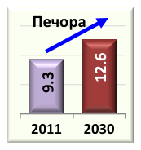

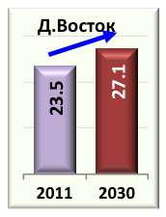
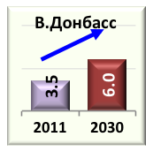

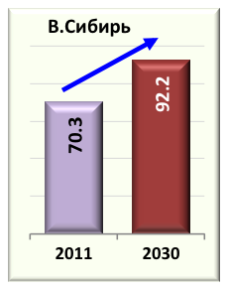
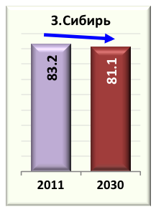
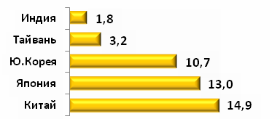
MAIN FLOWS OF RUSSIAN COAL
LONG-TERM PROGRAMME FOR DEVELOPMENT OF COAL INDUSTRY, MINISTRY OF ENERGY OF THE RUSSIAN FEDERATION
17
Atlantic market
COAL EXPORT, million t
(71 %)
(29 %)
APR market
2011
(50 %)
2030
(50 %)
2011 – 197.6 million t
2030 – 219.0 million t
Domestic market
– Production areas
– Delivery to domestic market
– Ports
Notes:
17
17

Slide 18
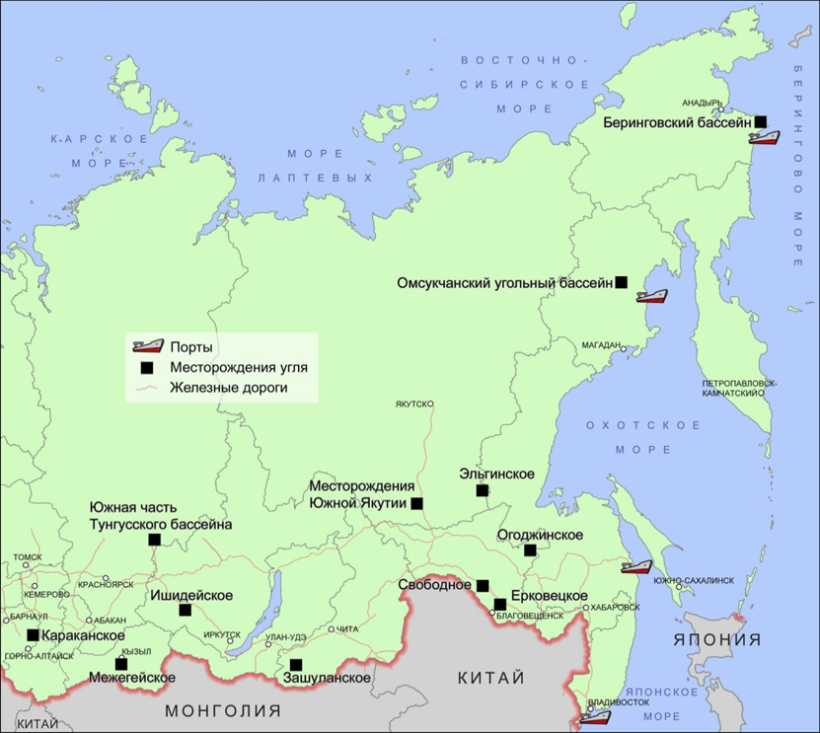
PROSPECTIVE COAL DEPOSITS AND BASINS IN THE EAST OF RUSSIA FOR THEIR DEVELOPMENT WITHIN THE FRAMEWORK OF MUTUALLY BENEFICIAL INTERNATIONAL COOPERATION
The 15th International Conference on NAGPF-St. Petersburg, Russia, 05.10.2018

Slide 19
In the face of global and regional challenges it is extremely important for Russia to cooperate with NEA countries not only by trading energy resources but also by carrying out active innovation and technology policy
The 15th International Conference on NAGPF-St. Petersburg, Russia, 05.10.2018

Slide 20
3.Priority directions of innovation and technology cooperation between Russia and NEA countries in the field of energy
3.1. Participation in the construction of new Russian oil and gas-chemical clusters and their joint control
The 15th International Conference on NAGPF-St. Petersburg, Russia, 05.10.2018
Notes:
20

Slide 21
Large-scale involvement of oil and natural gas in the turnover of the eastern regions of Russia and mutually beneficial supply of Russian oil and natural gas to the energy markets of NEA countries is a top priority of the socioeconomic development of Russia and its eastern regions.
As to oil and gas cooperation between Russia and NEA countries in the future, we should take into account the following 2 factors:
The 15th International Conference on NAGPF-St. Petersburg, Russia, 05.10.2018

Slide 22
Factor 1
At present the necessity to deliver not only hydrocarbon resources, but high-value-added products of their advanced processing to the international markets is clearly recognized at all levels in Russia. Therefore, it is planned to increase the output of oil products in the eastern regions of Russia and create there a oil-gas-chemical industry whose products are in rather high demand in the world, in Russia and in NEA countries
The 15th International Conference on NAGPF-St. Petersburg, Russia, 05.10.2018

Slide 23
DYNAMICS OF DEMAND FOR INDIVIDUAL KINDS OF CHEMICAL PRODUCTS, MLN T
Polyethylene
WORLD
RUSSIA
by 2.4 times
by 3.6 times
Polypropylene
by 2.7 times
by 4.2 times
PVC
by 2.5 times
by 1.8 times
22
Notes:
23
23

Slide 24
Factor 2
Natural gas and oil of the Siberian platform are
unique in the content of helium and ethane, which
essentially increases their consumer value
Natural gas of the Siberian platform contains
0.3-0.5% of helium and 4.6-7.2% of ethane
Helium reserves in the gas fields of the Siberian
platform are estimated at 9.0 billion m³, or about 30%
of the world helium reserves
In the future Russia can be the world largest helium
exporter
The 15th International Conference on NAGPF-St. Petersburg, Russia, 05.10.2018

Slide 25
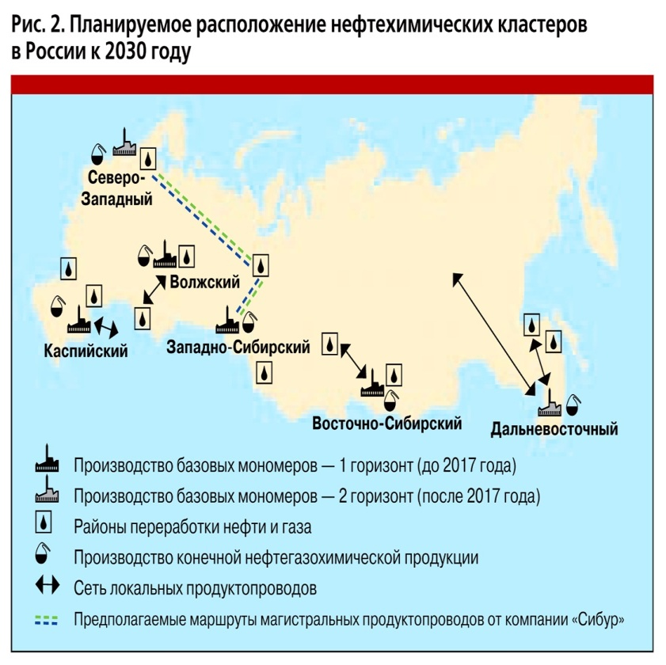
PLAN OF GAS- AND PETROCHEMICALS IN RUSSIA UNTIL 2030
This plan identifies six petrochemical clusters in Russia by 2030:
Northwest
Caspian
Volga
West Siberian
East-Siberian
Far Eastern
Construction of two plants in Irkutsk Region
The 15th International Conference on NAGPF-St. Petersburg, Russia, 05.10.2018

Slide 26
3. Priority directions of innovation and technology cooperation between Russia and NEA countries in the field of energy
3.2. Participation in the formation of cross-border transmission lines in NEA
The 15th International Conference on NAGPF-St. Petersburg, Russia, 05.10.2018
Notes:
26

Slide 27
Cross-border transmission lines in NEA are a top priority for innovation and technology cooperation between Russia and NEA countries in the field of energy
The Eastern energy strategy of Russia suggests the development of interstate electric ties between the Russian eastern regions and “neighboring” NEA countries
The 15th International Conference on NAGPF-St. Petersburg, Russia, 05.10.2018
Notes:
27

Slide 28
This concerns possible interconnection of electric power systems for parallel operation in Russia’s East (East Siberia and the Far East), Mongolia, People’s Republic of China, North and South Koreas and Japan
The operation area of such an interstate power super-interconnection may embrace different types of power plants (thermal, hydraulic, nuclear, wind, etc.) with a total installed capacity of above 450-500 million kW
The 15th International Conference on NAGPF-St. Petersburg, Russia, 05.10.2018

Slide 29
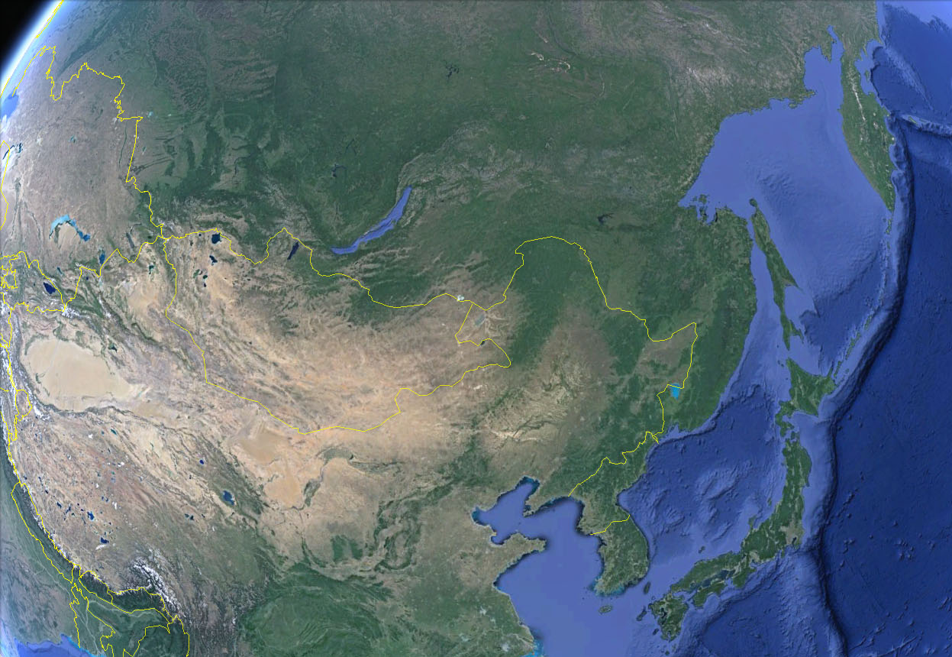
NATIONAL AND REGIONAL POWER GRIDS IN NORTHEAST ASIA (2010)
East Siberia
37GW
Far East
14GW
Mongolia
1GW
West China
217GW
Northeast China
78GW
North China
253GW
DPRK
17GW
Japan
284GW
ROK
80GW
GoogleEarth
Notes:
29

Slide 30
POSSIBLE SCENARIOS OF INTERSTATE INTERCONNECTION OF POWER SYSTEMS IN NEA COUNTRIES
Large Loop
Continental Loop
Sea of Japan Loop
Map Source: Google Earth
Source: (KERI, ESI) N. Voropai, S. Podkovalnikov. APERC Annual Conference, Tokyo, February 26-27, 2013

Slide 31
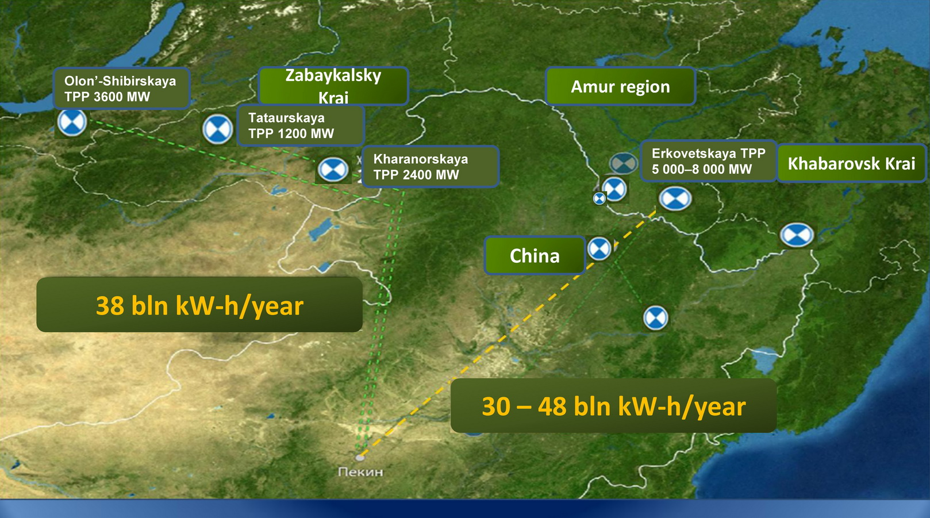
LARGE-SCALE ELECTRICITY EXPORT FROM RUSSIA TO CHINA
Source: Mikhail Shashmurin, Eastern Energy Company (INTER RAO UES Group) APEF, Vladivostok, May, 2013
Notes:
31

Slide 32
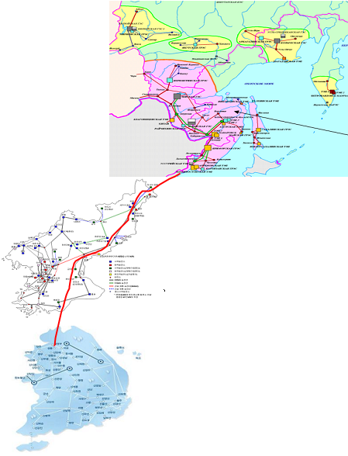
BREAKTHROUGH OF INTER-STATE E. TRANSPORTATION IN NEA
Korea-Russia Electricity Network Interconnection
1,200km HVDC interconnection passing
through DPRK
    Kraskino-Cheungjin: 150km
    Kraskino-Seoul: 1,200km
S. Korea-Russia Summit (September 2008)
  Construction of 800kV HVDC transmission line
  passing through DPR Korea
  Maximum 4,000MW per year
Ministry Level Action Plan (August 2009)
  Feasibility study by KEPCO and
  Inter RAO (2009-2010)
  Contact and discussion with DPR Korea
Negotiation with DPRK is ongoing
Source: Kyung Sool Kim Trans-Boundary Energy Transportation in North-East Asia, KEEI-ESI Workshop – 2011
Notes:
32

Slide 33
PROPOSED SCOPE OF RUSSIA-JAPAN POWER BRIDGE PROJECT
Delivery
Cost
Funding
Stage 1. Project implementation within the framework of existing plans on development of power system in the Sakhalin region
~ 0.5 – 0.6 GW
US$ 610 m*
US$ 300 m– FTP FE and BR until 2018
US$ 310 m - investor funds/project funding
Stage 2. Construction of large-scale export-oriented generation on Sakhalin island
~ 1.3 – 1.4 GW
US$ 4.7 m
Investor funds/project funding
Stage 3. Connection of the electric power system of Sakhalin region to the interconnected power system of the East
~ 2 – 4 GW
US$ 370 m
Investor funds/project funding
Electricity export can make up 2 - 4 GW
Preliminary investment is estimated at US$ 5.7 billion
* - costs of network development and construction of submarine cable lines, excluding costs of generation facilities
Source: A.Kaplun (RAO “UES of Russia”) Prospective directions of power industry development in FED, APEF, Vladivostok, May, 2013

Slide 34
INTERSTATE ELECTRIC POWER SYSTEM RUSSIA – MONGOLIA – CHINA
RUSSIA ГусиноозерскаяТЭС
Эрдэнэтская ТЭС
Ulaan-Baatar
Ундерхаан
Дарханская
ТЭС
ТЭЦ 4
Багануурская
ТЭС
Чандганская
ТЭС
Адуунчулуун-ская ТЭС
ТЭЦ 5
Бооролжуутская
ТЭС
МандалговскаяТЭС
Шавээ-Овооская
ТЭС
Цайдемнуурская
ТЭС
Тавантолгойская
ТЭС
Чойра
Сайншандская ТЭС
Замын- Ууд
Оюутолгойская
ТЭС
Цагаансуварга
To China
To China
Source: Kh. Enkhjargal, S Batkhuyag – Russia-Mongolia project (ASM (MUS&T)-SB RAS (ESI)), 2013
33
Notes:
34
34
34

Slide 35
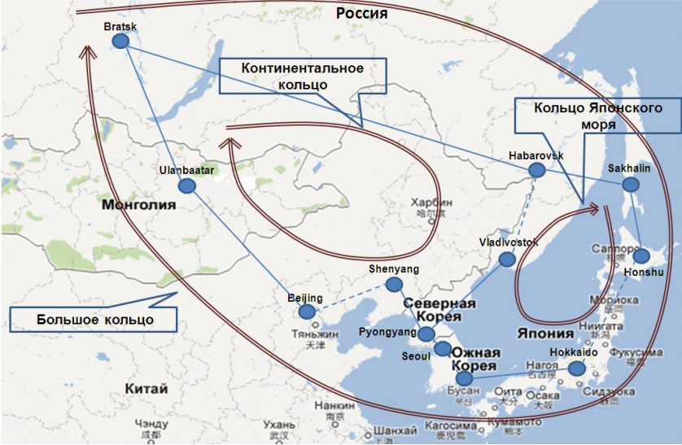
ASIAN RINGED NETWORK (ASIAN SUPER-GRID)
The huge energy potential of Russia, including renewable energy sources, is the real basis for the construction of international energy interconnection in Asia
Objectives of the project:
To create conditions for economic growth in the Asia-Pacific region by improving the access to energy resources.
To improve the reliability of the national power systems of the Asia-Pacific region through the integration and the renewable energy sources involvement.
The main parameters of the project:
Term - 12 years
The length of the high voltage DC line - 2350 km
The wind power plants capacity - 1.5 GW
The gas-fired plants capacity - 2.2 GW
The hydroelectric power capacity - 2 GW
The solar power plants capacity - 0.5 GW
Source: I.Dzhurko (OJSC Far East Energy Management Company), APEF, Vladivostok, May, 2013
Notes:
35

Slide 36
3.3. Joint construction of "green energy" in the eastern regions of Russia in order to ensure reliable power supply isolated and hard to reach consumers
Role of the renewable energy sources
The 15th International Conference on NAGPF-St. Petersburg, Russia, 05.10.2018
Notes:
Legend: Thermal power plant; Installed capacity; ±600 kV DC transmission line; 500 kV AC transmission line; Converter substation

Slide 37
The Energy Strategy of Russia - 2035 and General Scheme of the Electric Power Industry Development until 2030 suggest large-scale adoption of renewable energy sources: the share of RES in the total electricity production is expected to increase from current 0.5% to 2.5-4.5% in 2030-2035.
This is particularly important for the economy and energy of the eastern regions.
The 15th International Conference on NAGPF-St. Petersburg, Russia, 05.10.2018

Slide 38
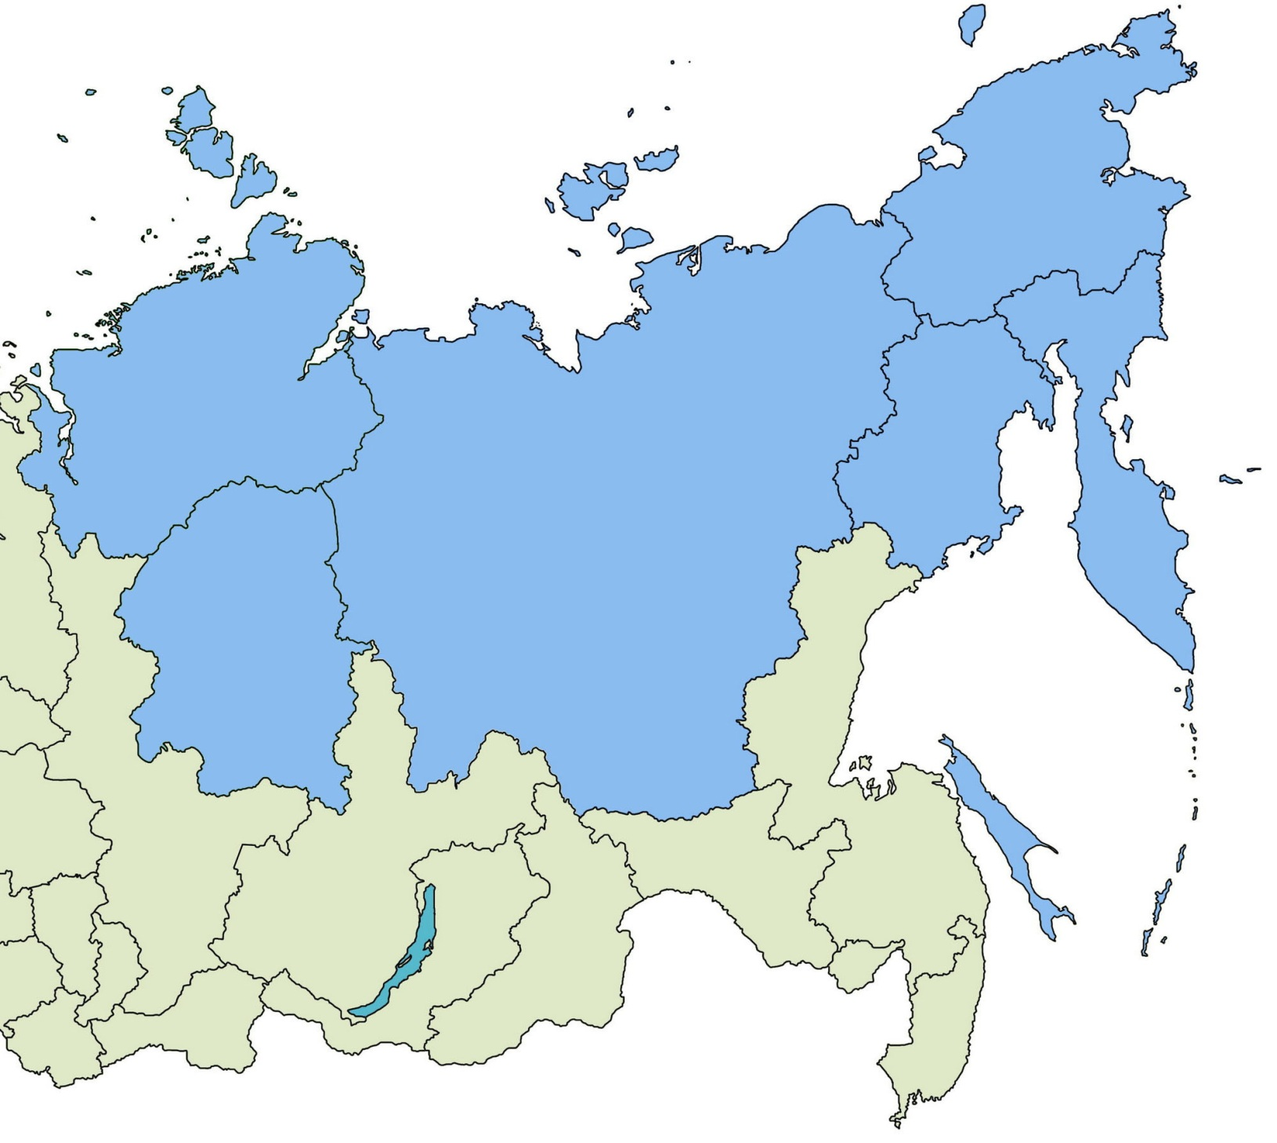




CHARACTERISTIC OF THE ENERGY SOURCES IN THE EASTERN REGIONS OF RUSSIA (as of 2015)
6.7 mln. km² (62%) is situated in the North,
The population is 2 mln. people (14% of the population in East Siberia and the Far East)
Autonomous and backup energy sources
Number of power plants – 5200
Capacity – 2.3 thous. MW
Electricity output– 3.8 bln. kWh
Renewable energy sources
Number of power plants – 36
Capacity – 138 MW
Electricity output– 0.5 bln. kWh
Isolated power systems
Number of power plants – 40
Capacity – 7.4 thous. MW
Electricity output– 24 bln. kWh
Interconnected power systems
Number of power plants – 90
Capacity – 45.8 thous. MW
Electricity output– 180 bln. kWh
The capacity of small-scale energy sources makes up 4.0% of the total capacity of power plants
38

Slide 39
The use of renewable energy sources (mini-HPP, GeoTPP, WPP and others) is a strategic priority of energy development in the northern and hard-to-reach territories in the East of Russia
The 15th International Conference on NAGPF-St. Petersburg, Russia, 05.10.2018

Slide 40
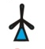







ALLOCATION OF NEW SMALL-CAPACITY ENERGY SOURCES OF DIFFERENT TYPES IN EAST SIBERIA AND THE FAR EAST (AS OF 2030)
Total capacities to be put into operation
 | Connection to centralized electricity supply
 | Mini CP- 70 MW
 | Conversion of DPP to gas – 17 MW
 | Smoll NPP - 108 MW
 | SHPP – 126 MW
 | WPP – 123 MW
 | GEO TPP – 76 MW
 | SOLPP – 140 MW
TOTAL – 692 MW
The 15th International Conference on NAGPF-St. Petersburg, Russia, 05.10.2018

Slide 41
A NEEDFUL LIST OF INNOVATIVE ELECTRICAL EQUIPMENT INTENDED FOR ARCTIC CONDITIONS
─ Cogeneration power plants (mini CHP) operating on coal and gas with a capacity of 3-6 MW
─ Nuclear power plant units with a capacity of 6-12 and 50-100 MW
─ Wind turbines (WT) with a unit capacity of 50-100 kW
─ Photovoltaic modules
The 15th International Conference on NAGPF-St. Petersburg, Russia, 05.10.2018

Slide 42
4. Conclusion - NECESSARY CONDITIONS AND INITIATIVES FOR SUCCESSFUL MUTUALLY BENEFICIAL INNOVATION AND TECHNOLOGY COOPERATION BETWEEN RUSSIA AND NORTHEAST ASIAN COUNTRIES IN THE FIELD OF ENERGY
The 15th International Conference on NAGPF-St. Petersburg, Russia, 05.10.2018

Slide 43
1. It is necessary to elaborate a scientifically grounded strategy (road map) for innovation and technology cooperation between Russia and NEA countries in the field of energy
2. Such a strategy can be worked out only on the basis of international cooperation among research and design institutions, companies, banks, etc. of the countries concerned, and active support of Governments and regional authorities
3. ESI SB RAS is ready to take an active part in solving this very important problem for Russia and all Northeast Asian countries
The 15th International Conference on NAGPF-St. Petersburg, Russia, 05.10.2018

Slide 44
Goseite arigato godzaimasita!
谢谢！
많은 감사! камса-хамнида!
Танд их баярлалаа!
СПАСИБО ЗА ВНИМАНИЕ!
Thank you very much for your kind attention!
The 15th International Conference on NAGPF-St. Petersburg, Russia, 05.10.2018

