Slide 1
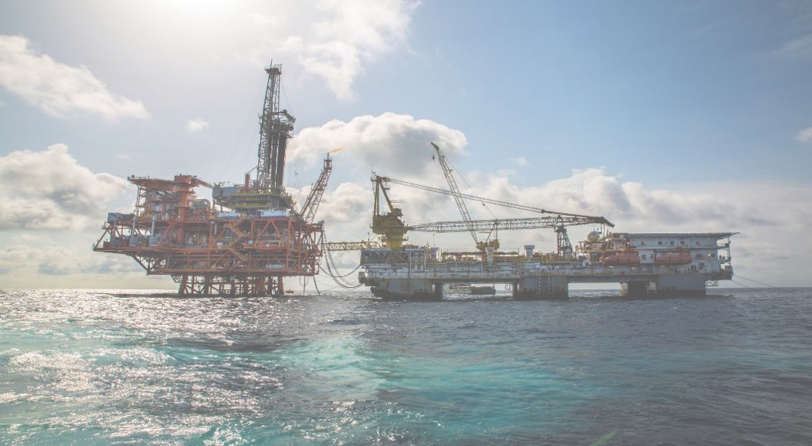
ROSETTI MARINO ONSHORE, OFFSHORE AND SUBSEA EXPERIENCE
Gas Forum - Saint Petersburg
October, 04th 2017

Slide 2
CONTENT
Rosetti Marino Expertise and Experience
R&D Programs
Added value in coop. Gazprom - Rosetti Marino

Slide 4
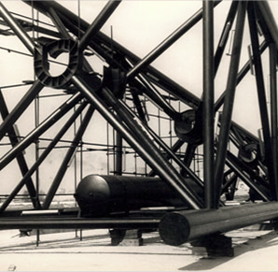
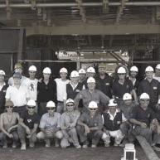
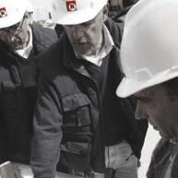
COMPANY MILESTONES
Rosetti Marino is an italian Engineering Procurement & Construction (EPC) Contractor active in the Oil & Gas and Energy sector.
The company is established in Ravenna, North Eastern Italy, as a mechanical fabrication workshop
Rosetti contributes to the development of Chemical and Petrochemical industry in Ravenna and operates also as shipbuilding yard.
The company begins the construction of Offshore Oil & Gas facilities for the Adriatic Sea.
The company recognizes the need for a strong engineering content in its business, thus settling Fores Engineering and purchasing Basis Engineering; hence the core of Rosetti Marino Group is established.
The Group starts international operations and settles foreign subsidiaries in Europe, Africa, Asia and South America.

Slide 6
WHO WE ARE
An Italian EPCI Contractor with:
IN-HOUSE ENGINEERING PROCUREMENT AND CONSTRUCTION CAPABILITIES
STRUCTURAL
MULTIDISCIPLINARY
ELECTRICAL & INSTRUMENTATION
MARINE AND OFFSHORE
WORLDWIDE PRESENCE
IMPRESSIVE TRACK RECORD OF EPCI PROJECTS SUCCESSFULLY DELIVERED FOR O&G MAIN PLAYERS
IMPRESSIVE TRACK RECORD OF EPCI PROJECTS SUCCESSFULLY DELIVERED FOR O&G MAIN PLAYERS

Slide 7
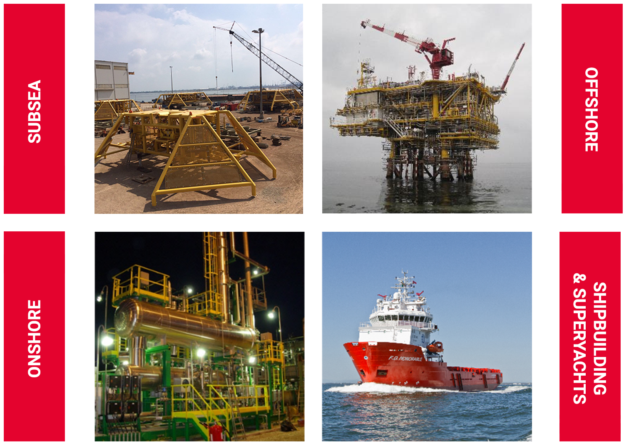
WHAT WE DO

Slide 8
WHAT WE DO
Nowadays, Rosetti’s range of Products and Services can be summarized as follows:
Manifold
Pipeline End Terminal (PLET)
Pipeline End Manifold (PLEM)
Boosting System
Subsea Control Module (SCM)
Subsea Electronic Module (SEM)
Master Control Station (MCS)
Subsea Umbilical Termination Unit (SUTU)
Topside Umbilical Termination Unit (TUTU)
Remote Terminal Unit (RTU)
Jackets
Integrated Topsides
Process modules
Living Quarters
Power Generation, Compression & Utility Modules
Brownfield, Upgrade & Revamping
Gas/Oil separation Plants
Compression Stations
Pumping Stations
Gathering Stations
Oil&Gas Power Plants and Substations
Process Equipment
Harbour tugs
Ocean going tugs
Platform Supply Vessels & AHTS
Ferries
Living Quarters barges
Special purpose barges
Super Yachts

Slide 9
ROSETTI MARINO CAPABILITIES
Rosetti Marino Groups provides a full range of services for the Energy sector including Oil&Gas Upstream, Petrochemical, Power Generation and Subsea Development
Feasibility studies
Reservoir engineering
Process Studies
Structural
Multidisciplinary
E&I
Marine
Telecom
Automation
Skid & Packages
Systems Integration
Existing Facilities Due diligence
Environmental Impact Studies
Permitting engineering
Risk assessment
Site surveys
CAPEX-OPEX estimation +/- 30%
Basic Design
Front End Engineering Design
Tender Documents
Permitting Engineering
Site surveys
Reverse engineering and laser scanning
Risk assessment, HAZID/HAZOP/QRA
CAPEX estimation +/-15 -10%
Owner Engineering Services
Detailed Design
Procurement engineering
Site surveys
Reverse engineering and laser scanning
Risk assessment, HAZID/HAZOP/QRA
Operating Manuals
Commissioning & Startup
Owner Engineering Services
Project Management Services
Installation Supervision Services
Technical Service

Slide 10
ROSETTI MARINO CAPABILITIES
Rosetti Marino Groups provides a full range of services for the Energy sector including Oil&Gas Upstream, Petrochemical, Power Generation and Subsea Development
SUBSEA
OFFSHORE
ONSHORE
SUPERYACHTS / SHIPBUILDING
FLEXIBLE EPC CONTRACTOR

Slide 11
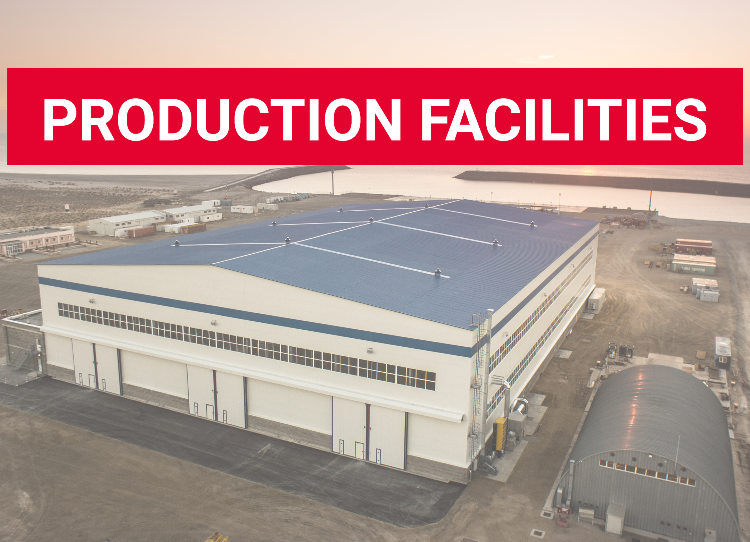

Slide 12
A HUMAN CAPITAL
450.000
ENGINEERING HOURS PER YEARS
A GROUP OF PEOPLE WORKING WORLDWIDE
AROUND 1500 PEOPLE
APPROXIMATELY 4.000 PEOPLE INVOLVED IN WORLDWIDE OPERATIONS
MORE THAN 8 Millions
MANHOURS DELIVERED FOR WORLDWIDE OPERATIONS

Slide 13
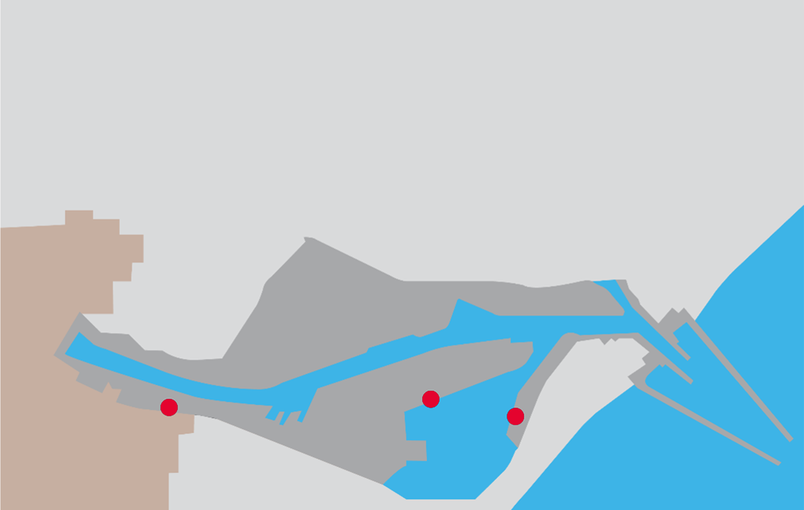
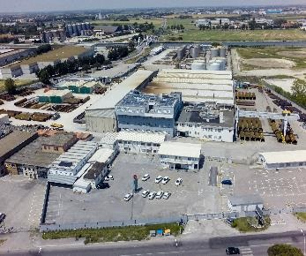
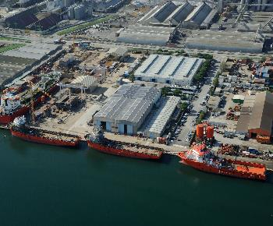
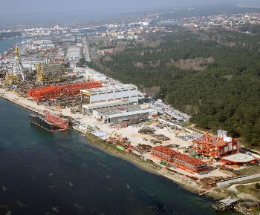
ITALY
Headquarters and Prefabrication Workshops
San Vitale Yard
Piomboni Offshore Yard
CITY OF RAVENNA
HARBOUR CANAL

Slide 14
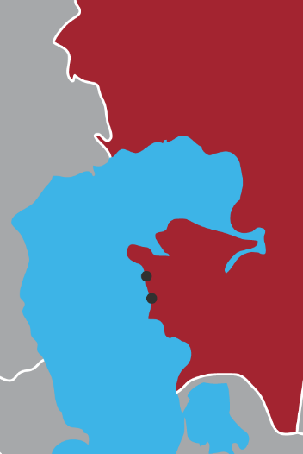
KAZAKHSTAN
KAZAKHSTAN
Located in a land plot of 88 hectares
Land plots property of the company and are located near the village of Akshukur, less than 27 Km far
from Aktau city and at about 8 km from Aktau international airport, along the coast of Mangistau Region
Karabatan
Plant
Island D
Facilities
Akshukur yard
Aktau headquarters
CASPIAN SEA

Slide 15
KAZAKHSTAN
KASHAGAN PROJECTS
Hook Up Mechanical
Hook UP Electrical & Instrumentation
Commissioning Services
Pig Traps
Operation Modification to suit Kashagan Start-up
Onshore Karabatan works
Offshore Island D works
EPC Hook Up
Welding Services
Technical Services for Mechanical Completion & Commissioning
KAZAKHSTAN
Karabatan
Plant
Island D
Facilities
OVERALL DIRECT EMPLOYED MANPOWER
220 Aktau headquarters & Akshukur yard
120 Atyrau office
850 Employees and subcontractor
TOTAL PEAK MANPOWER
1.300 people
2.000.000 man-hours
Akshukur yard
Aktau headquarters
CASPIAN SEA

Slide 16
QHSE MANAGEMENT SYSTEM
Committed to workplace Health and Safety, Security and Environmental protection
Quality and HSE system compliance with international standards
Top Management commitment
Accountability
Communication
Risk assessment and control
Training and competence
Travel Health & Security System
Zero Injury
Accident Free
ISO 9001 since 1993
OHSAS 18001:2007
ISO 14001:2004
ISO 3834
Health&Safety (9.1/10)
Environmental (9.1/10)
Competence&Training (8.1/10)
Quality (9.4/10)

Slide 17
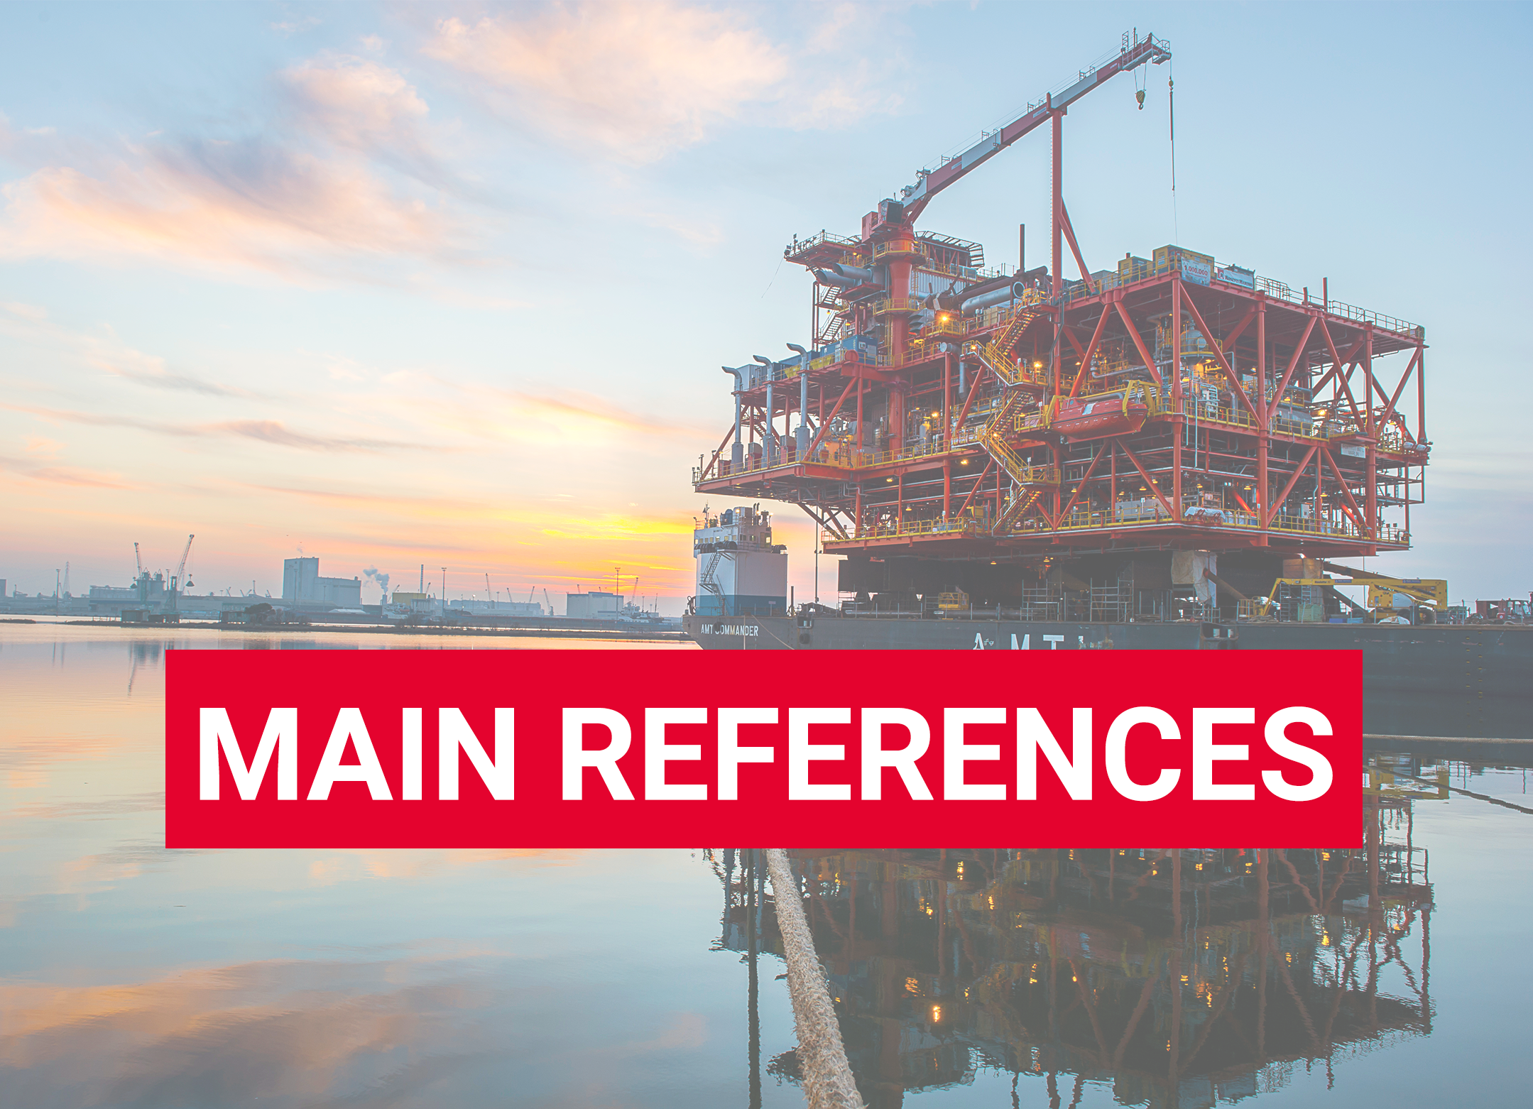

Slide 18
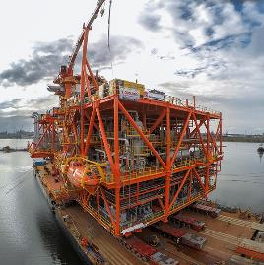
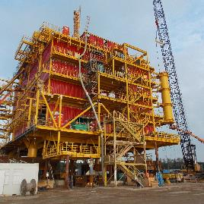
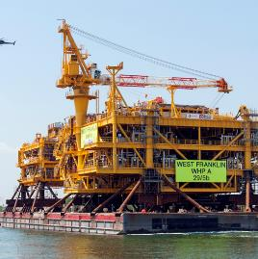
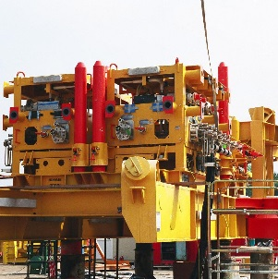
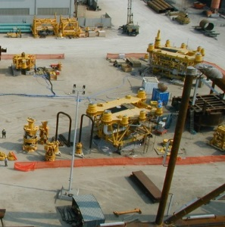
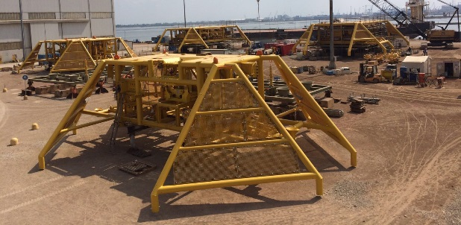
Main references
Marlin Project (Foxtrot)
EPC – Dec. ‘12/Aug. ‘14-Mar. ‘15
Topside: 54x31x20 (LxWxH)
Weight: 4.500 tons
Jacket: H 118 m
Weight: 3.500 tons (+ 1.300 tons for piles)
Living Quarter: 20 POB
Clipper (Shell UK)
EPC – Aug. ‘12/June ‘14
Topsides - Living Quarter (84 POB)
Deck/helideck: 50x25x25 (LxWxH)
Weight: Approx. 3000 tons
Four-legged jacket (800 tons)
West Franklin & Elgin B (Total)
EPC(I) – July ’11/June ‘13
Design pressure: 915 barg
Design temperature: 190°C
Topside : 40x40x20 (LxWxH) 35x35x15 (LxWxH)
Weight: 3.300 + 2.300 tons
Scarab Saffron Project (Kvaerner/Cameron)
ePC and Testing – March ’01/July ’02
2 RMM+2 Manifold Bases, including suction piles foundations+19 UTA+1 SDA
North Africa Gas Fabrication Project-Manifold and PLEM
(Onesubsea UK LTD)
ePC and Testing – July ’15/Feb. ’17
1.100 tons of structural steel and piping, noble materials (625 & cladded piping)

Slide 19
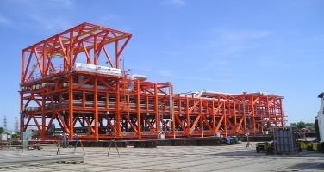
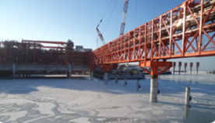
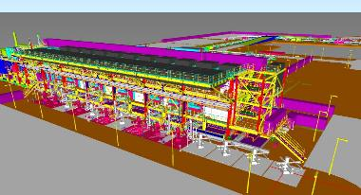
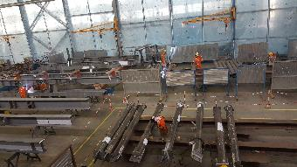
Main references
Kashagan Experimental Program (AGIP KCO NV)
EPC, Preliminaries LS and unit rates
Scope : Procurement and Fabrication of Piperacks and Ancilaries
Location : Astrakan (Russia) and Kuryk (Kazakhstan)
Tons: : > 10.000 overall
Kashagan Experimental Program (AGIP KCO NV)
Preliminaries LS and unit rates
Scope : Hookup Mechanical and Electrical, Precommissioning and Commissioning assistance
Location : North Caspian Sea, Kazakhstan Sector, Island D
Manhours : > 2.000.000 hr
Kashagan Experimental Program (NCOC)
EPC
Scope : EPC 4 Topside facility
Location: Aktau (Kazakhstan)
Tons: : 1650
TCO FGP (ERSAI/Tengiz Chevron Oil)
EC – Unit rates
Scope : Fabrication for pre-assembled pipe racks
Location: Aktau (Kazakhstan)
Tons: : 9500

Slide 20
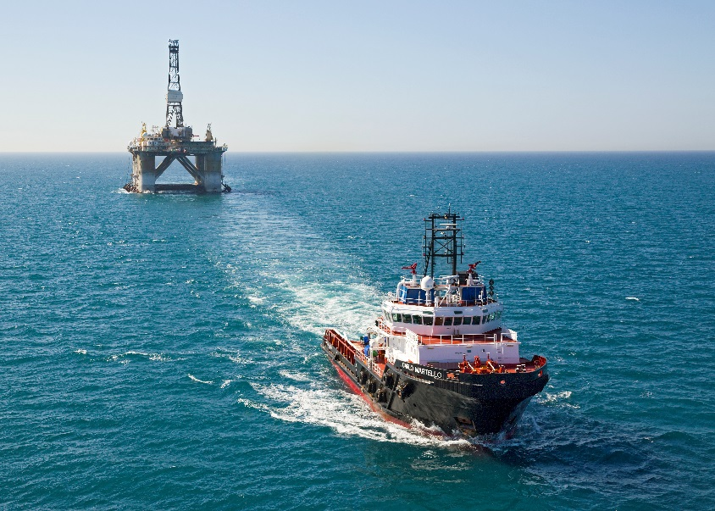
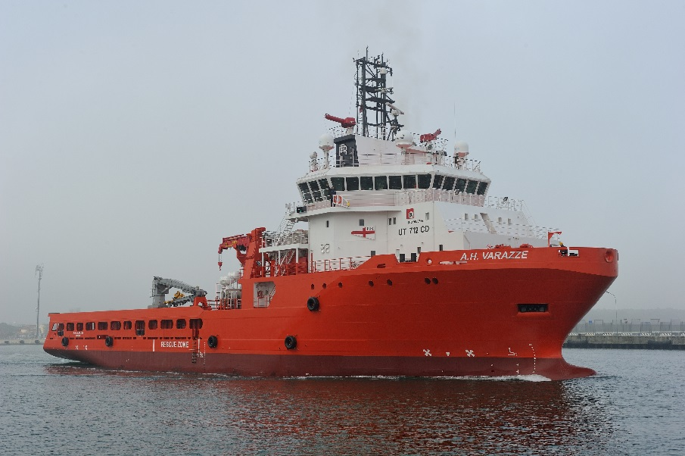
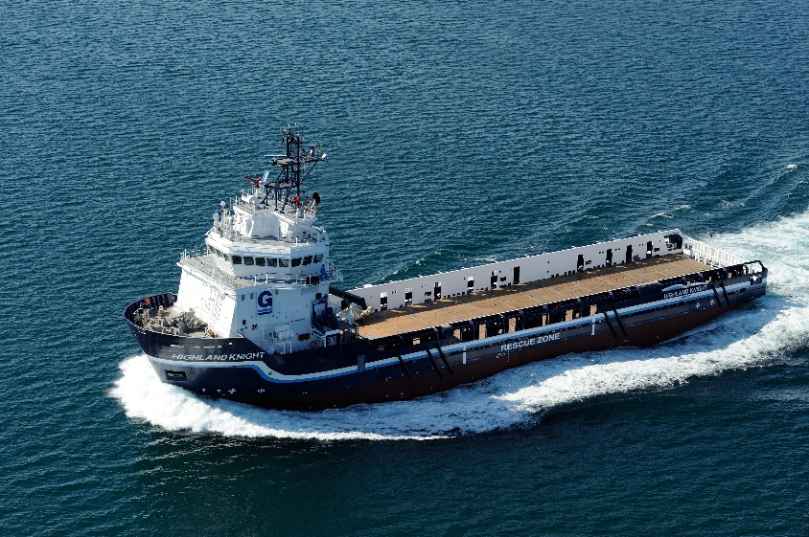
Main references
AHT UT 514 - CARLO MARTELLO:
Owner: Augustea
LOA: 55.40m
B: 15.50m - BP: 155T - Crew: 24
AHTS UT 712 CD - A.H. VARAZZE:
Owner: Finarge
LOA: 79.90m - B: 19.20m - Total Power 14.000kW
BP: 220T - Crew: 35
PSV UT 755 XL - HUGHLAND KNIGHT:
Owner: Gulfmark
LOA: 74.97m - B: 16m - DWT: 3100T - Crew: 24
Designer – Tommaso Spadolini
Customer: Confidential
Lenght: 85m

Slide 22
SUBSEA TREND
Subsea Developments (PRODUCT)
Construction/Cooperation transfer to Local Partner (EXECUTION)
Shallow Water…not only for deep and ultra-deep water
More and more Reliable subsea developments thanks to technology evolutions
Cheapest Solution rather than fixed or floating platform
Boosting System to maximize the well’s life
High Flexibility
Proved International Experience
Strong Attitude to transfer know-how to the End User

Slide 23
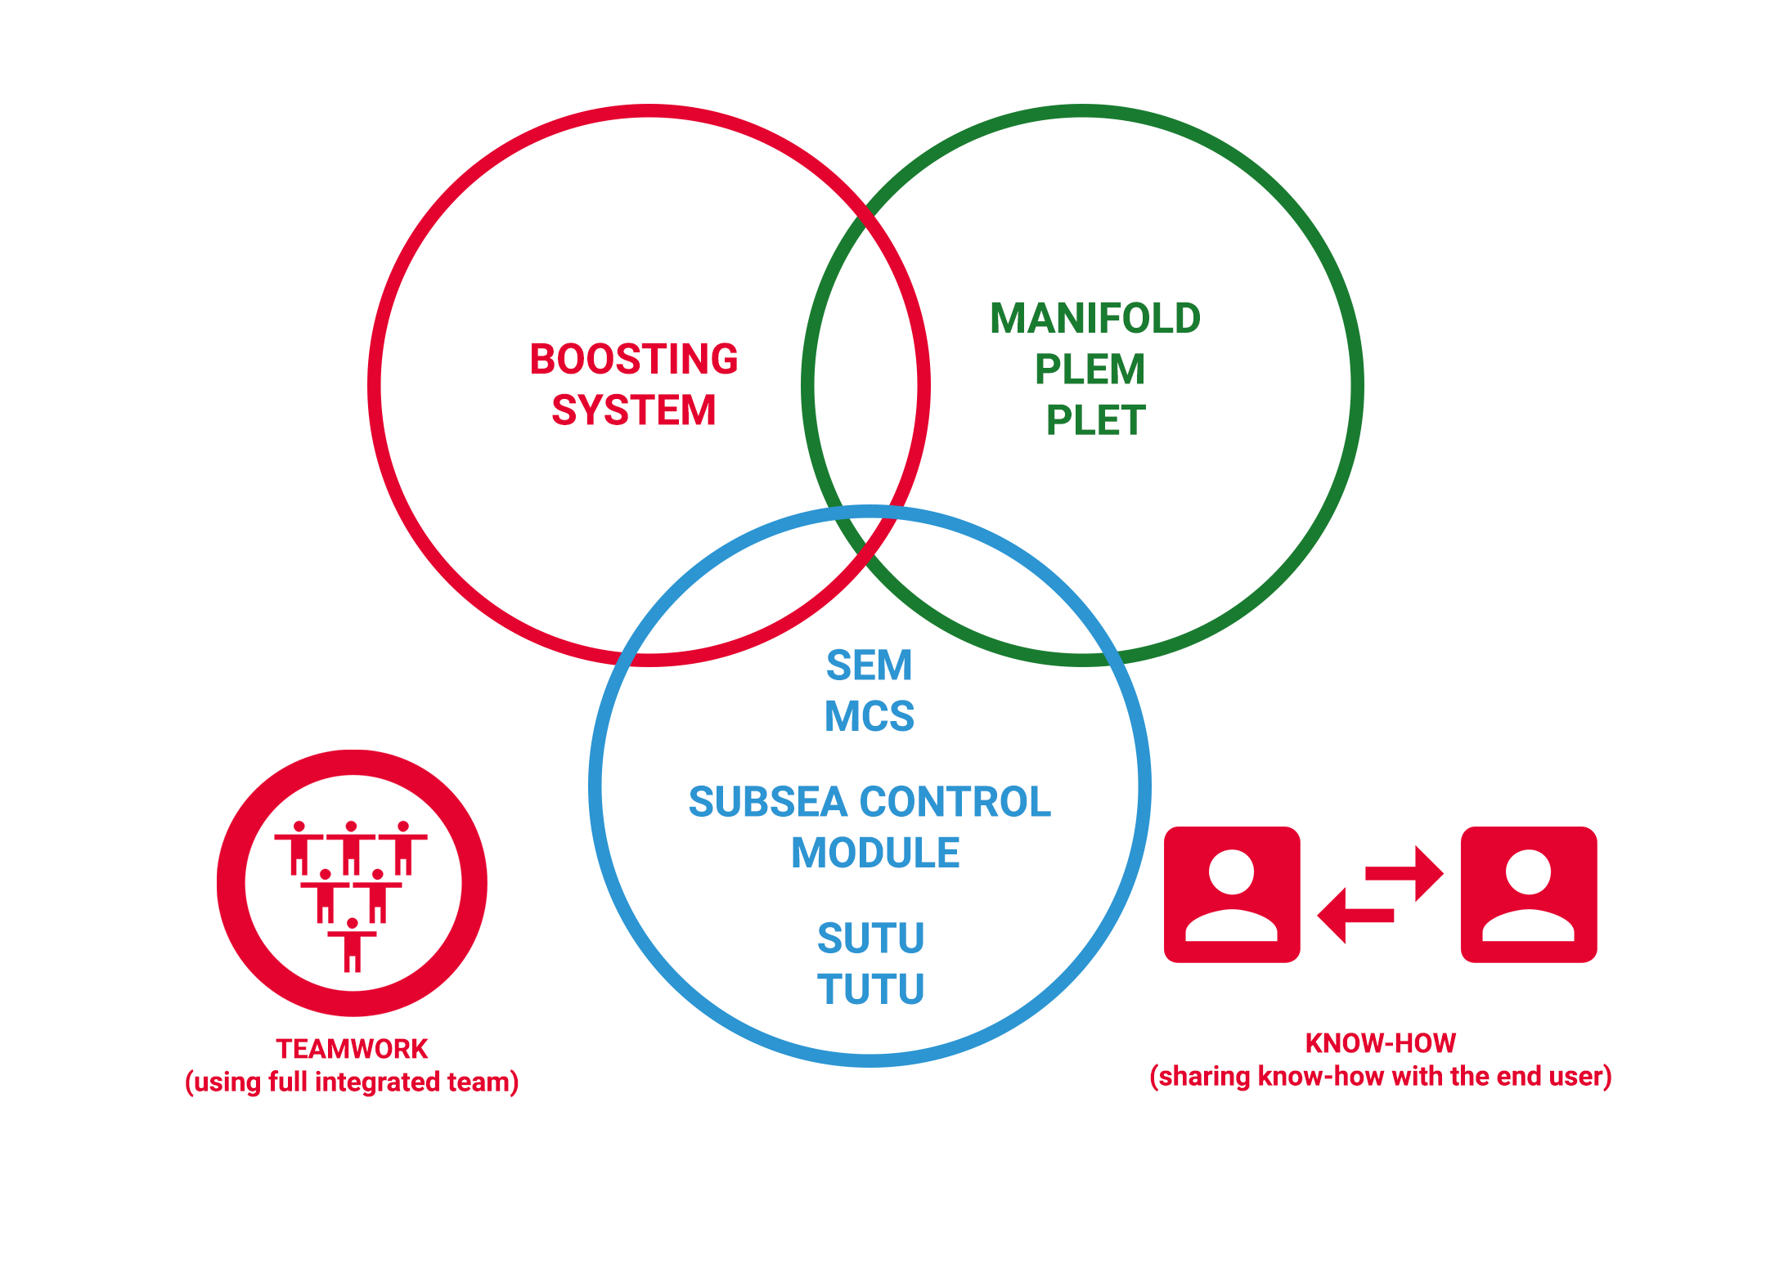
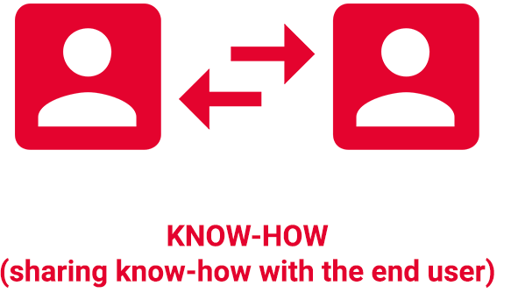
RM Experiences and
IN HOUSE R&D PROGRAMS

Slide 24
IMPORT SUBSTITUTION programs
Rosetti Marino is a Flexible Company on following market evolutions and that has an Long Term International Experiences on:
Offshore and Subsea R&D Programs
Relocating Fabrication
Transfering Know-How to End User
This is what we usually do!

Slide 25
CONCLUSIONS
ROSETTI MARINO WOULD LIKE TO COOPERATE WITH GAZPROM ON SUBSEA/OFFSHORE/ONSHORE DEVELOMENT PROGRAMS
ROSETTI MARINO WOULD LIKE TO COOPERATE ALSO FOR OFFSHORE AND ONSHORE PROJECTS
…ALL ABOVE FOR KIRINSKOYE, SAKALIN AND ARTIC SEA FIELDS

Slide 26
СПАСИБО!
Grazie!

