Slide 1
ROSASIAGAS
Russian Natural Gas for Northeast Asia:
Is Big East Stream Project Possible?
Alexander KALMYCHEK
ROSASIAGAS, executive secretary
Ken ASAKURA
Gas Highway Japan Co., Ltd., CEO
Sankt Petersburg, 2018 October 5
XV Conference of NAGPF

Slide 2
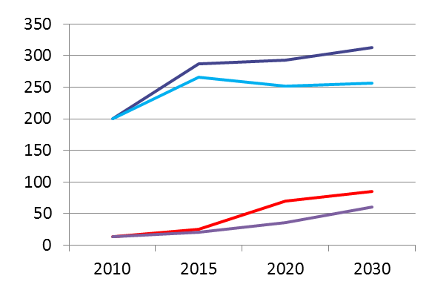
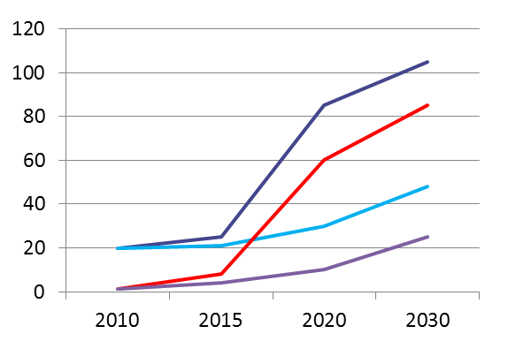
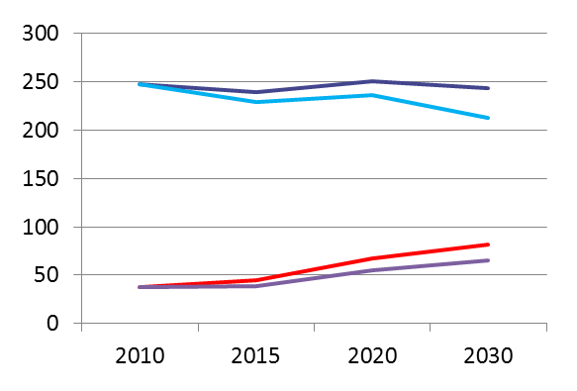
ROSASIAGAS
POTENTIAL OF RUSSIAN EXPORTS OF ENERGY RESOURCES TO NORTHEAST ASIA
total
240
total
315
247
215
260
200
Eastern direction
80
Eastern direction
85
38
65
13
60
Oil, mln t
Gas, bln m³
180
total
170
105
85
116
85
Eastern direction
Eastern direction
75
total
50
20
28
1,1
25
Coal, mln t
Electricity, bln kWh
Notes:
1
1

Slide 3
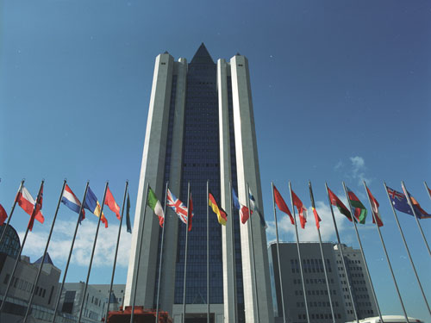
ROSASIAGAS
Russia - a world leader in natural gas production and exports
2015
Natural gas production – 554 bcm
Natural gas exports – 185.5 bcm
2017
Natural gas production – 691 bcm
Natural gas exports – 210,2 bcm

Slide 4
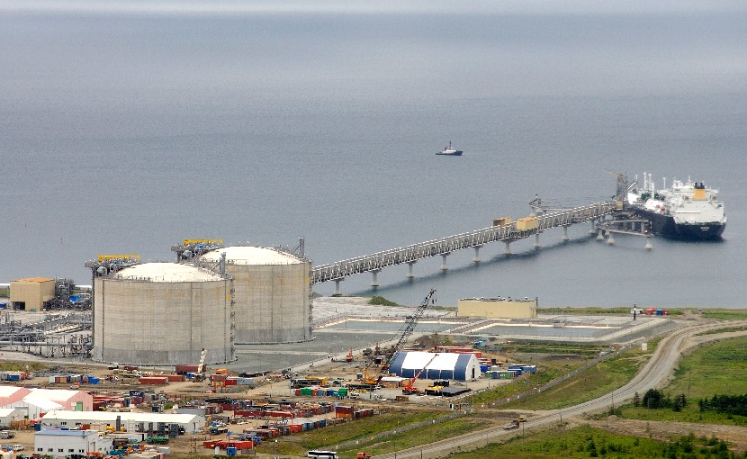
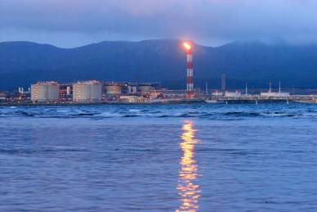
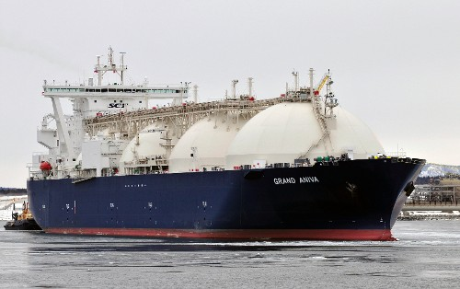
ROSASIAGAS
Sakhalin-2 gas exports to Northeast Asia
2009 - Production of LNG started
Sakhalin-2 LNG Exports to NEA
2010 – 4.381 mil.tons
2011 – 7.125 mil.tons
2012 – 8.306 mil.tons
2015 – 10.82 mil.tons
2017 – 11.49 mil.tons

Slide 5
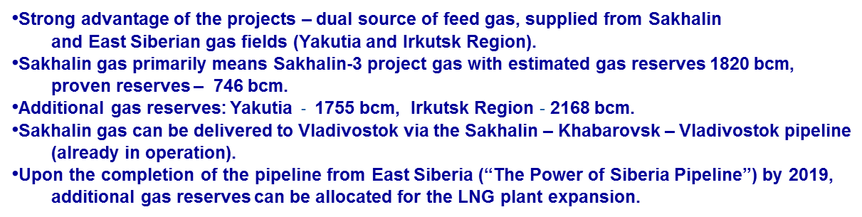
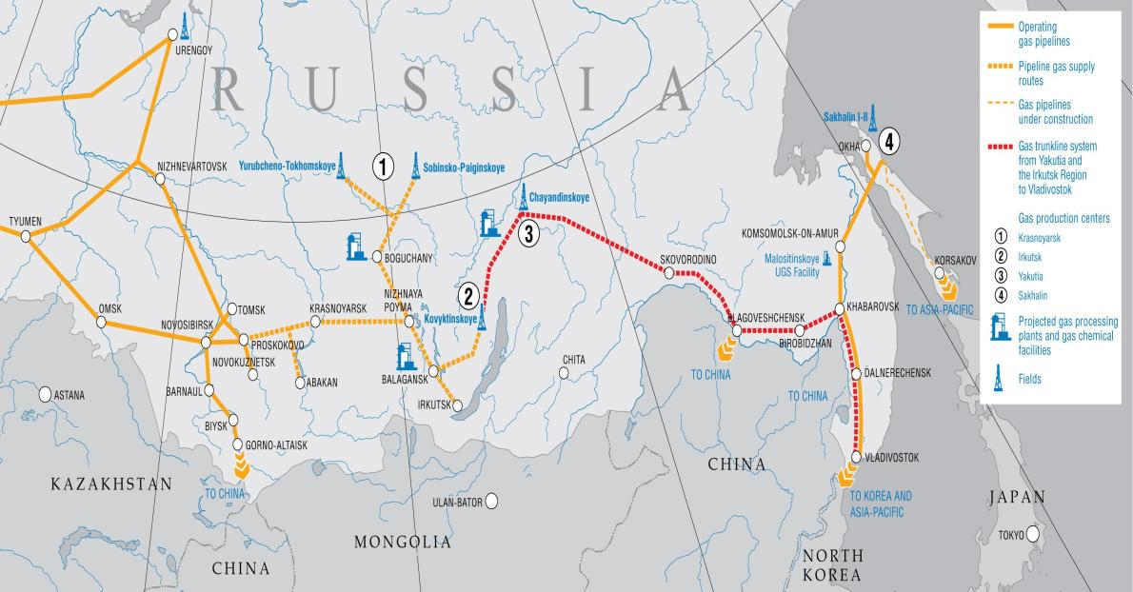
ROSASIAGAS
POWER OF SIBERIA NATURAL GAS PIPELINE PROJECT
2014, May 21 Russia-China 30-years Deal signed
Planned investments - $ 55 bln.
2014, September 1 Construction launched
Sakhalin III

Slide 6

Big East Stream for Japan and Korea
Chayanda
North Sakhalin-
Komsomorsk PL 1)
28.8inch, 5.5Mpa, 570km
West Kamtchatka Shelf
Komsomorsk-
Khabarovsk PL(Existing) :
28 inch, ? Mpa, 375km
Kirinsky
Khabarovsk-Vladivostok-
Hasan PL(Existing) :
56inch, ? Mpa, 900km
Sakhalin2 PL: 48 inch, 6 Mpa,
800 km,(Existing)
L
SAGIP PL:
North Korea PL:
40inch, 7Mpa, 900km
Big East Stream for Korea
Big East Stream for Japan
South Korea East PL:
40inch, 7Mpa, 520km
Japan Gas Highway 2)
Korea-Japan Interconnector:
40 inch, >10Mpa, 230km
: LNG plant (in operation)
: Gas field
L
Note: 1) Parallel PL Construction is planned.
2) Japan Gas Highway will be operated as "Gas Pool".

Slide 7
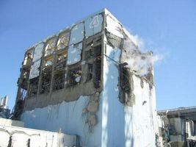
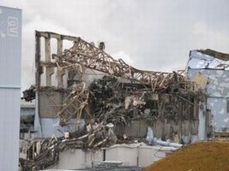
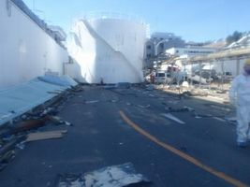
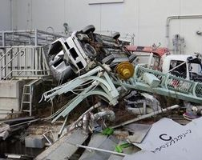
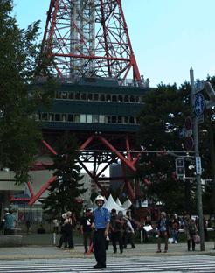

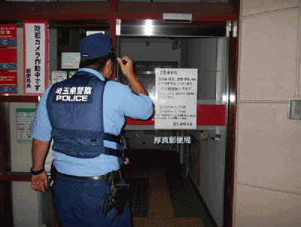
Background in Japan
1) Serious Accidents in recent years
Big Earthquakes attacking Japan
East Japan Big Earthquake in March 11, 2011
  Questioning of safety of nuclear power
  Subsequent System Change of Japan’s Energy Structure Energy Liberalization of Electricity and Town Gas, in 2016 and 2017
Hokkaido Earthquake in September 6, 2018
  Questioning of Concentrated Large-scale Energy Supply System
  Recommendations for the Distributed Energy System, of which Core is Gas-fired Distributed Power and Regional Renewable Energies
Many facilities and tanks were destroyed by the tsunami.
source: meti
The earthquake caused the loss of power on Hokkaido island, cutting power for 5.3 million people.
source: Hokkaido Pref. Police, JGSDF

Slide 8


Background in Japan
2) Overall Energy Liberalization
Starting of Trunkline Construction in conjunction with Sakhalin Pipeline Gas
Offering Big Opportunities for Foreign and Domestic Companies in Gas Wholesale and Power generation, in general
Restructuring of Energy Industries to transform Them into Internationally Competitive Energy Giants
Electricity Market
(regional monopoly, so far)
< Removal of Market Barriers >
City Gas Market
(regional monopoly, so far)
* LPG businesses co-exist.
New Entry
Power Company
- general electric power
(TEPCO, KEPCO etc.）
- wholesale power
(J-POWER, Japan Atomic Power） etc.
About 70% of LNG import is by power companies
Set Sales of Electricity and Gas by power
companies
Gas Sales in conjointed with other services
< Creation of Integrated Energy Market>
collaboration & alliance
collaboration & alliance
Major Gas Companies have already fossil- fuel power capacity of 4,300 MW
Already 20-30% of consolidated operating profit in two major city gas companies is coming from power business
City Gas Company
- general city gas
(Tokyo Gas, Osaka Gas etc.）
- gas pipeline business
(INPEX, JAPEX etc.） etc.
Electricity Sales in conjointed with other services
Set Sales of Electricity and Gas by gas companies
New Entry
Entry from the different fields
IT, Automobiles etc
Oil, LP Gas etc
source: METI

Slide 9
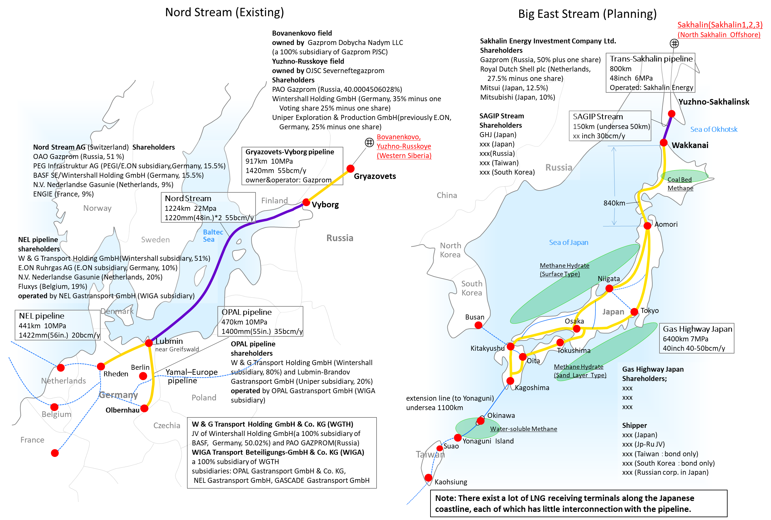
Nord Stream and Big East Streams for Japan
Notes:
8
8

Slide 10
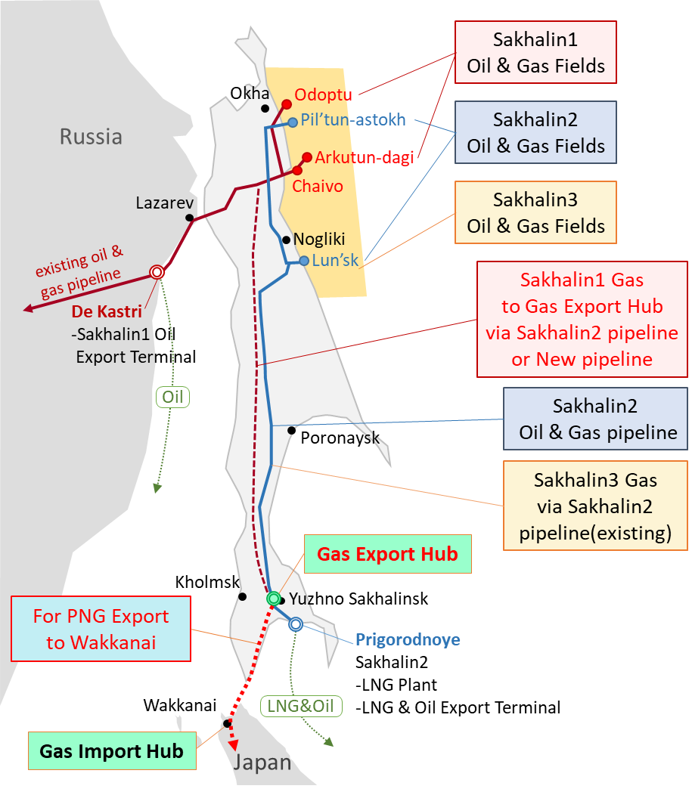
Sakhalin Gas Export Hub
(Gas Source)
Sakhalin 1
Sakhalin 2
Sakhalin 3
Gas Export Hub
Yuzhno Sakhalinsk
Russia-Japan border
Gas Import Hub
Wakkanai
Gas Highway (Japan Gas Trunkline)
Gas Flow

Slide 11
Reform of Japanese Industries
& Possible New Entry of Foreign Companies
Players at the Russia – Japan Border
Japanese Gas Import & Wholesalers
Sakhalin 1
(Exxon, Rosneft etc)
Sakhalin 2
(Sakhalin Energy)
Sakhalin 3
(Gazprom)
Yuzhno-Sakhalinsk
Gas Export Hub
LNG Plant
Russia
Gas Transport Contract
Sales &
Purchase Contract
SAGIP Stream
LNG Export
Japan-Russia Border
(PNG Export)
Wakkanai
Delivery Point
SAGIP Japan
Gas Wholesale Contract
Japan
Company Group A
Company Group B
Company Group C
Others XX
International JV
Others YY
Small Comp.
Others ZZ
GHJ Power
Wakkanai
Imput Point
Power Generation
Gas Highway Japan
Shippers; Group A-C,
Others XX-ZZ
Gas Supply
(Japanese Islands)
Gas Transport Contract
City Gas
Other Gas Consumers
Note: Through these transactions Japanese side will be sure to establish a few of direct gas import & wholesale giants. Others YY includes small town gas and LPG retail companies.
Gas Flow
Contracts
Players
Facilities

Slide 12
Gas Demand Projection in Japan
for Russian Pipeline Gas
-for gas-fired power generation only-
Demand for Russian Pipeline Gas (BCM/Y)
Trunkline Extension (km)
(Existing LNG)
Note: 1) Russian LNG by Sakhalin 2 is not included.
2) Share of Russian Gas includes LNG and PNG.
3) Trunkline Extension includes existing ones of 2,000km.
Notes:
11
11

Slide 13
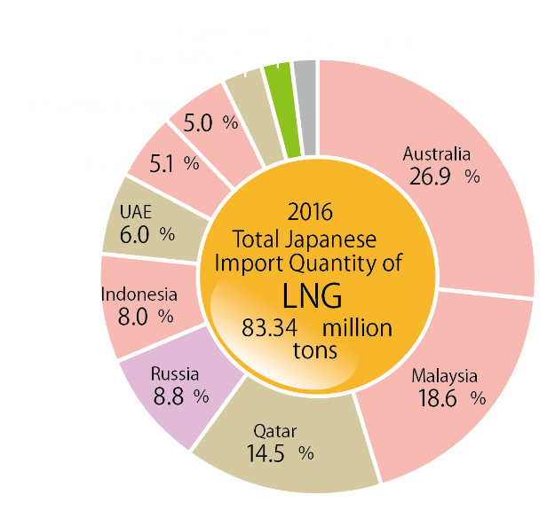
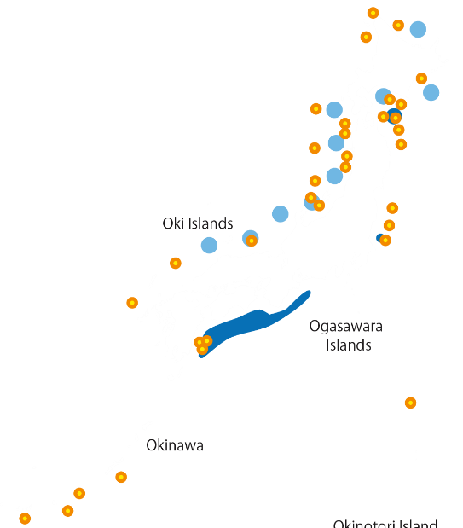
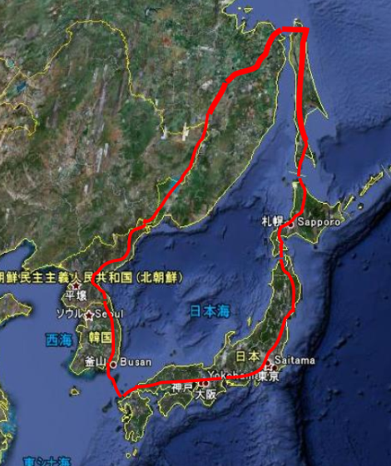
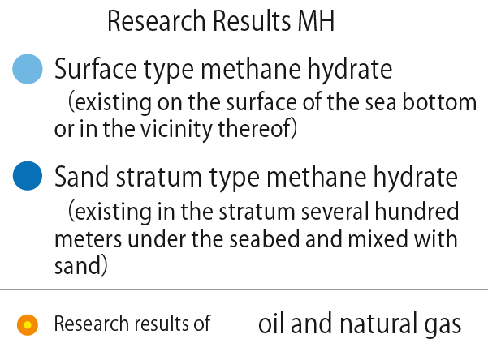
Security of Gas Supply
- for sustainable gas supply
1. National Dependency Ratio of Gas to Russia
---Not More Than 30%
2. Alternative Measures
1) Alternative Sources
2) Alternative Routes
FY2016
Primary Energy
Supply
source: METI
3.Exchange of Investment between Russia and Japan
Russia for Japan’s
mid-downstream businesses
Japan for Russia’s upstream businesses
source: METI

Slide 14
Thank you very much !!

